Slide 1
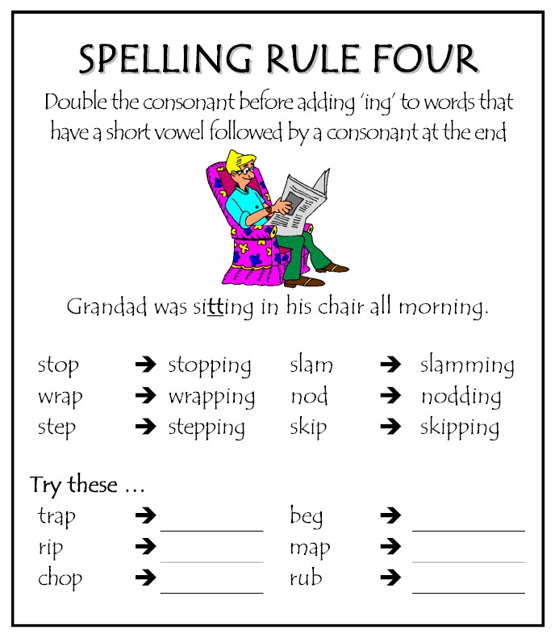
Mon 1/28 and Tue 1/29
1. Copy the spelling rule.
2. Write down two of the examples.
3. Complete the examples
6 = A
5= B
4 =C

Slide 2

Yay! Today is the start of a new semester. It's always nice to start fresh :)

Slide 3
Wed Jan 30 and Thur Jan 31 Agenda: Finish Rough Draft Color Coding Self/Peer Edit Homework Type Round Two Rough Draft
Paragraph: At six in the morning she was led out, barefoot, and clad only in a loose garment, with a halter around her neck. From Notre Dame, she was taken away in a wagon, in which I saw her lying on the straw, with the doctor on one side of her and executioner on the other; the sight of her struck me with horror. I am told that she mounted the scaffold with a firm step and died as she had lived, resolutely, and without fear or emotion. Who: What: Where: When: Why: How:
1. Read the paragraph 2. Answer the 5Ws and 1H 3. Write a 10 words or less sentence summary that answers the 5 Ws and 1H.

Slide 4
This month's topic: "What is your story?"
Think of a significant event in your life that you have been through that you think has given you some wisdom you could impart to someone else. It could be something like parents divorcing, moving, starting at a new school, meeting someone who changed your life, etc.
Use that event to tell your story in a 40 word response.
Fri Feb 1 and Mon Feb 4 Agenda: Answer Quick Questions Round Robin Peer Edits Homework Type Round Three Drafts due

Slide 5
Round 1: Check formatting. MLA Make suggestions.
Round 2: Color Coding and Checklist
Round 3: Check for contractions and anything that is not in the 3rd person. Inform student of any other mistakes.
Round 4: Read through essays and just make general suggestions.
Round 5: Based on the rubric, explain what grade the student would receive.

