Slide 1
Advisory

Slide 2
 | Fri Aug 24 and Mon Aug 27 | Tue Aug 28 and Wed 29 | Thur Aug 30 and Fri 31 (min day)
Class work: | Review vocab syllabus writing prompt Costa questions | GIIG cornell notes short story Costa questions Review new vocab terms | Importance of reading slides Business letter writing, p 1169 and 803-805 (LBB) Read sample letter Business letter to Ms. Swank Peer edit letters
Homework: | bring in file | vocab illustrations Finish story | Complete final draft. To get a 100% A, it must be typed. 5% grade reduction for hand written.

Slide 3

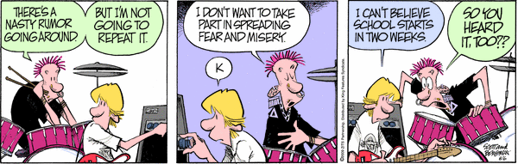
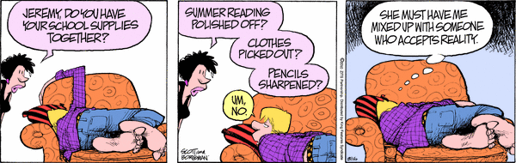



Student Planner…
Date: Fri Aug 24 and Mon Aug 27
What’s a GIIG? & Keeping a Promise
Review Vocab
Collect syllabus, vocab and supplies
Writing Prompt
Costa Questions
Homework: New vocab. Same thing
Shhh...Do ASAP...
+
?
=
+
?
Portfolio
=
Movie Waiver Due too!

Slide 4
What’s a GIIG?
Date & Topic | Quickwrite/DOL/Focus Lesson

Slide 5
What’s a GIIG?
Date & Topic | Quickwrite/DOL/Focus Lesson
GIIG Pledge

Slide 6
GIIG Pledge
On Tuesday, I will remember to quietly walk into language arts, smile and wave at Ms. Swank.
I will also get out my GIIG handout, and sit down with it.
While waiting for instruction on how to do the GIIG, I will update my Homework paper, which will be shown on the PPT slide. I will do this all in silence.
Signed: ___________________
PS: I will miss you this weekend, Ms. Swank.
Please,
copy in your notebook & sign

Slide 7
What’s a GIIG?
Date & Topic | Quickwrite/DOL/Focus Lesson
GIIG Pledge | On Tuesday, I will remember to quietly walk into language arts, smile and wave at Ms. Swank. I will also get out my GIIG handout, and sit down with it. While waiting for instruction on how to do the GIIG, I will update my Homework paper, which will be shown on the PPT slide. I will do this all in silence. Signed: ___________________ PS: I will miss you this weekend, Ms. Swank.

Slide 8
http://www.youtube.com/watch?v=9d_fd65IVzQ&feature=related
http://www.youtube.com/watch?v=enArghMlkWY&feature=fvwrel

Slide 9
So, you know the expectations.
What I know is that life is about choices…
On a piece of paper, write down:
I have to _________________________.
I can’t ___________________________.

Slide 10
Now, cross out the word have from the first sentence and replace it with choose.
Now, cross out can’t and replace it with I don’t want to.
Raise your hand if you agree with your sentences.

Slide 11

Prompt:
Take a few minutes to think about your sentences. What was your first response? Did the discussion change your mind? How do you feel about the sentences? If you would like to talk about this more with me, make a note.
Shoot for the grade you want to earn:
A = your paragraph must be at least 5 sentences and 75+ words in length.
B = Four sentences and/or 50 – 74 words in length.
C = Three sentences and/or 30- 49 words in length.
I will collect your paper today, so don’t put it away.

Slide 12

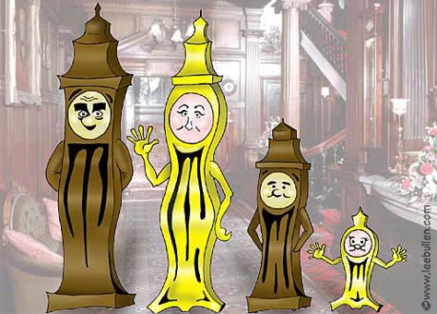
Clock Activity

Slide 13

Costa Questions
Level 1
These questions are simple questions and should allow you to point to the answer.
Not every option is a good option for discovery. Which ones work best for what you are trying to figure out?
Describe it
Define it
List (the steps)
Identify (the parts)
Tell about it (write a paragraph)
Label (the parts)
Summarize (who, what, when, where)

Slide 14
Stump the Class!
Stump the Class!
Stump the Class!

Slide 15

Costa Questions
Level 2
The detective puts the evidence together and analyzes it.
Again, be careful, these questions don’t all work each and every time.
Your answers will not be as simple as pointing out the obvious. You may need to offer a lengthier response.
Analyze (break it down – piece by piece
Infer (If……..then…..)
Sequence things (First this…then this…then this….)
Provide examples…
Explain in your own words…
Group (put things together in a logical way)
Compare (How are things similar/different?)
Solve and explain the process

Slide 16
Stump the Class!
Stump the Class!
Stump the Class!

Slide 17

Costa Questions
Level 3
Wow! This level requires serious thinking and the answers could lead into a debate or deeper discussion. This is meaty and powerful stuff.
Evaluate the information (Which is best? Why?)
Reorganize it (in a new/better way)
Judge (how do you feel about what happened?)
Make a model of a new/different way
Apply a principle (use the math formula to solve the problem/graph the problem)
Interpret the information/the poem/the story
Hypothesize (This will happen because…)

Slide 18
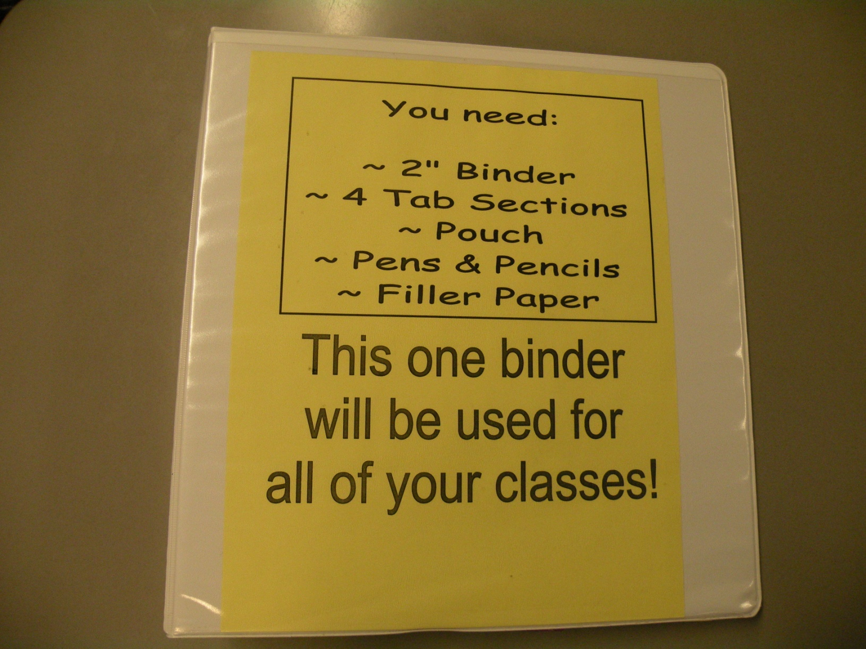
Must have supplies by next class! Don’t forget!

Slide 19
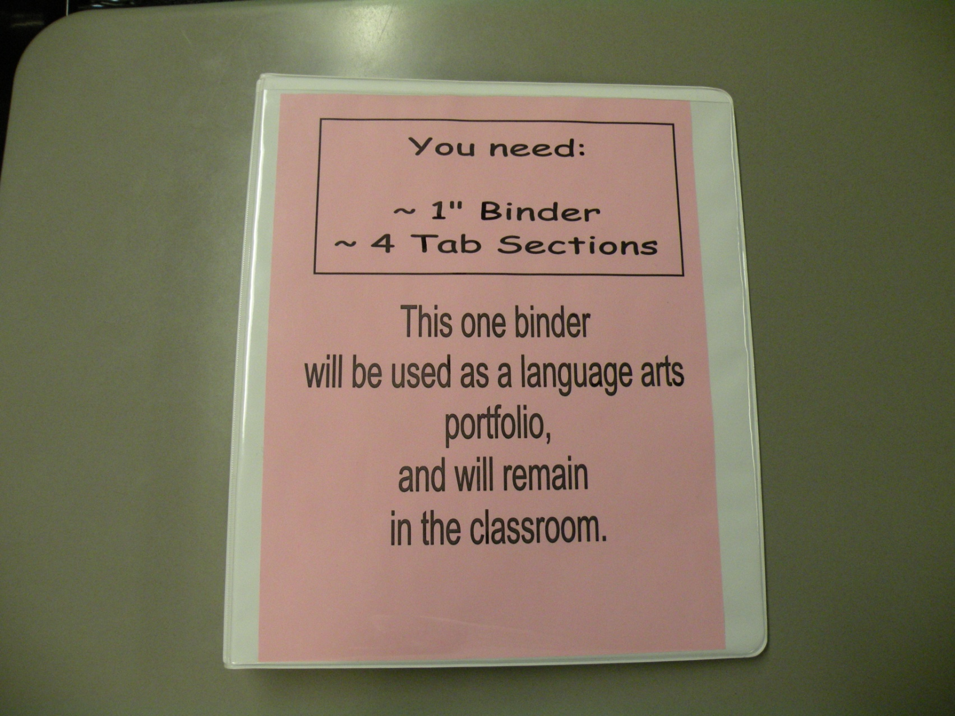

Slide 20

Wacky
Tuesday
Tue 8/28/2012
GIIG
Costa Questions
Hughes’ “Thank You M’am”
Finish as homework
Rewrite the following three sentences by replacing first-person pronouns to third-person.
Example: I go with my father to get metal.
Rewritten Example: He goes with his father to get metal.
I dream about walking in the Dead Places and returning to tell my people about it.
I tell my father that I have decided to leave.
My father gives me a blessing and wishes me well.

Slide 21
Word-Bank Week # 1
Your name: _____________ Period: __
Learn how to spell, define, represent in picture and
embed the following words into a creative paragraph (passage).
WORD | DEFINTION | PICTURE
objective
optimistic
perspective
persuade
subjective
Diction

Slide 22
Portfolio Task
Go to side table and create spine label.
Choose colored strip.
Write First Name ~ Last Name ~ Period __
Insert into spine.
Bring portfolio up to front book shelf.
Deanna Swank Period 1

Slide 23
Remember the
Clock Activity?

Slide 24
Short Story Cornell Notes
Topic | Reading Strategies
Predict Visualize Connect Question Clarify Evaluate
Summary/Reflection :
Include 2 bullet points for each strategy. 12 total.

Slide 25
Short Story Cornell Notes
Topic | Reading Strategies
Predict Visualize Connect Question Clarify Evaluate
Summary/Reflection :
Include 3 bullet points for each strategy. 18 total.

Slide 26
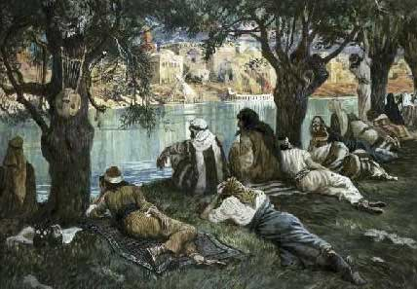
By The Waters of Babylon!
P 42- 57

Slide 27
After reading today’s story, create…
6 or more Costa Questions = A
5 Costa Questions = B
4 Costa Questions = C
3 Costa Questions = D

Slide 28
Create 3 Level One Questions!
Create 2 Level Two Questions!
Create 1 Level Three Question!

Slide 29
The Waters of Babylon
Your name: _______________________ Period: _____
After having read the story, “By the Waters of Babylon” at least twice, generate 3 different questions using the Costa Question list as a guide.
Level One Question: (This question should get an easy or simple response. The answer can easily be found by pointing to the text or having a 1 – 4 word answer.
_______________________________________________________________
Level Two Question: (This question should have a lengthier response. The answer may not necessarily be found directly in the text, and may be implied.)
_______________________________________________________________
Level Three Question: (This question allows for an intense answer, which encourages a varied response and stems a healthy discussion.)
______________________________________________________________

Slide 30
The Waters of Babylon
Your name: _______________________ Period: _____
After having read the story, “By the Waters of Babylon” at least twice, generate 3 different questions using the Costa Question list as a guide.
Level One Question: (This question should get an easy or simple response. The answer can easily be found by pointing to the text or having a 1 – 4 word answer.
_______________________________________________________________
Level Two Question: (This question should have a lengthier response. The answer may not necessarily be found directly in the text, and may be implied.)
_______________________________________________________________
Level Three Question: (This question allows for an intense answer, which encourages a varied response and stems a healthy discussion.)
______________________________________________________________
Do not
write or draw
in these boxes,
please.

Slide 31
The Waters of Babylon
Your name: _______________________ Period: _____
After having read the story, “By the Waters of Babylon” at least twice, generate 3 different questions using the Costa Question list as a guide.
Level One Question: (This question should get an easy or simple response. The answer can easily be found by pointing to the text or having a 1 – 4 word answer.
_______________________________________________________________
Level Two Question: (This question should have a lengthier response. The answer may not necessarily be found directly in the text, and may be implied.)
_______________________________________________________________
Level Three Question: (This question allows for an intense answer, which encourages a varied response and stems a healthy discussion.)
______________________________________________________________
Does the question lead to an answer
that can be found in the text?
Does the question lead to a lengthier answer
which may not be necessarily found in the text?
Does the question lead to an open-ended
answer which allows for a longer explanation or discussion?

Slide 32
Costa Questions
Level 1
These questions are simple questions and should allow you to point to the answer.
Not every option is a good option for discovery. Which ones work best for what you are trying to figure out?
Describe it
Define it
List (the steps)
Identify (the parts)
Tell about it (write a paragraph)
Label (the parts)
Summarize (who, what, when, where)

Slide 33
Costa Questions
Level 2
The detective puts the evidence together and analyzes it.
Again, be careful, these questions don’t all work each and every time.
Your answers will not be as simple as pointing out the obvious. You may need to offer a lengthier response.
Analyze (break it down – piece by piece
Infer (If……..then…..)
Sequence things (First this…then this…then this….)
Provide examples…
Explain in your own words…
Group (put things together in a logical way)
Compare (How are things similar/different?)
Solve and explain the process

Slide 34
Costa Questions
Level 3
Wow! This level requires serious thinking and the answers could lead into a debate or deeper discussion. This is meaty and powerful stuff.
Evaluate the information (Which is best? Why?)
Reorganize it (in a new/better way)
Judge (how do you feel about what happened?)
Make a model of a new/different way
Apply a principle (use the math formula to solve the problem/graph the problem)
Interpret the information/the poem/the story
Hypothesize (This will happen because…)

Slide 35

Wacky
Tuesday
Thur Aug 30 and Fri Aug 31
GIIG
Business Letters, p 1169 & 1170
Write Business Letter about your reading plan
Copy the definition and come up with a sample sentence for the following five reasons a colon is needed.
Colons “announce”. They add dramatic flourishes that introduce lists, quotations, complete sentences, and dialogue.
1. Use a colon to introduce a quotation longer than one sentence.
2. Use a colon to end a paragraph that introduces a quotation in the next paragraph.
3. Use colons to introduce the text of questions and answers (i.e. in interviews).
4. Use colons to show times.
5. Use colons to show citations.

Slide 36
Where Do You Want to Fall?
Exemplary Status: 40 Pts
You are extremely interested in attending a four year university
Mastery Status: 30 Pts
You are considering a junior college
Basic Status: 20 Pts
You are striving to be at grade-level, knowing your future is just around the corner.

Slide 37
There once were 4 students… who came in as a made a commitment to the outcome was
#1: Non-reader: Below Basic | 0 minutes a day of reading time | Remedial Support

Slide 38
There once were 4 students… who came in as a made a commitment to the outcome was
#1: Non-reader: Below Basic | 0 minutes a day of reading time | Remedial Support
#2 Non-reader: Below Basic | Basic Level ~ :20 Five days/wk | Moved up 2 – 4 grade levels

Slide 39
There once were 4 students… who came in as a made a commitment to the outcome was
#1: Non-reader: Below Basic | 0 minutes a day of reading time | Remedial Support
#2 Non-reader: Below Basic | Basic Level ~ :20 Five days/wk | Moved up 2 – 4 grade levels
#3 Non-reader: Below Basic | Mastery Level~ :30 Five days/wk | Moved up 3 – 6 grade levels

Slide 40
There once were 4 students… who came in as a made a commitment to the outcome was
#1: Non-reader: Below Basic | 0 minutes a day of reading time | Remedial Support
#2 Non-reader: Below Basic | Basic Level ~ :20 Five days/wk | Moved up 2 – 4 grade levels
#3 Non-reader: Below Basic | Mastery Level~ :30 Five days/wk | Moved up 3 – 6 grade levels
#4 Non-reader: Below Basic | Exemplary Level ~ :60 Five days/wk | Below Basic Moved up 4 – 8 grade levels

Slide 41
Now for the extreme other side…

Slide 42
Question 3
(Suggested time—40 minutes.
This question counts as one-third of the total essay section score.) In a literary work, a minor character, often known as a foil, possesses traits that emphasize, by contrast or comparison, the distinctive characteristics and qualities of the main character. For example, the ideas or behavior of the minor character might be used to highlight the weaknesses or strengths of the main character.
Choose a novel or play in which a minor character serves as a foil to a main character. Then write an essay in which you analyze how the relation between the minor character and the major character illuminates the meaning of the work. You may choose a work from the list below or another appropriate novel or play of similar literary quality.
Do not merely summarize the plot.

Slide 43
Huckleberry Finn
Invisible Man
King Lear
The Kite Runner
The Misanthrope
The Piano Lesson
Pride and Prejudice
Pygmalion
Reservation Blues
The Sound and the Fury
A Streetcar Named Desire
Sula
A Tale of Two Cities
Their Eyes Were Watching God
Tom Jones
Wuthering Heights
The Age of Innocence
Alias Grace
All the King’s Men
All the Pretty Horses
Anna Karenina
Billy Budd
The Brothers Karamazov
Catch-22
Cold Mountain
The Color Purple
Don Quixote
Emma
Equus
Frankenstein
Glass Menagerie
Henry IV, Part I

Slide 44
Weekly Reading Log
Home Reading Log Name: ____________________
Minimum requirement of reading time over the two week period = 4 hours.
The more time you spend reading, the greater chance you have at improving your reading comprehension.
Choose your reading time wisely around your other commitments, so at least your minimum goal is met.
Exemplary Status: 40 Pts – 60 minutes- You are extremely interested in being in Honor’s English come High School.
Mastery Status: 30 Pts – 30 minutes- You are testing the water’s of being an Honor’s English Student for High School
Basic Status: 20 Pts- 20 minutes- You are striving to be at grade-level, knowing your future is just around the corner.
Obtain your parent signature before you turn this in every Friday.
Weekend | Title: ___________________________ Pages: ______ Summary/Reflection: _________________________________________ __________________________________________________________ __________________________________________________________ _________________________________________ | Reading Minutes:
 |  | Parent Signature:

Slide 45
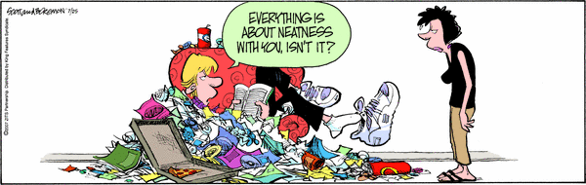
You have to admit, in spite of the mess, at least I’m reading…
What type of commitment will
you make this year?

Slide 46
So…. Which level are you shooting for?
Exemplary Status: 40 Pts
You are extremely interested in attending a four year university
Mastery Status: 30 Pts
You are considering a junior college
Basic Status: 20 Pts
You are striving to be at grade-level, knowing your future is just around the corner.

Slide 47
