Slide 1
August 2011
8 Wkday | 9 Wkday Get kids signed up for STAR! ASAP Internet agreement??? | 10 Welcome! Seat assignments How do you take notes? Smile for the camera! | 11 Fact VS Fiction activity with Cornell Notes Parent Letter Movie Waiver | 12 Parent Love Letter, continue fact vs fiction
15 Continue w/ Fact vs Fiction activity & summary w/ cornell notes due Collect early love letters and portfolios | 16 Collect early love letters and portfolios Technical writing assessment STAR testing Student Survey | 17 Collect early love letters and portfolios Technical writing assessment STAR testing Student Survey | 18 Collect early love letters and portfolios Fact vs Fiction Quiz on kids w/ EC pts due by Oct 7. Who are you? Where are you? Write and share | 19 Collect early love letters and portfolios Learn how to do a GIIG w/ a GIIG
22 Collect early love letters GIIG STAR results & packets | 23 Collect early love letters GIIG | 24 Collect early love letters GIIG | 25 Collect early love letters GIIG | 26 Love letters due! No GIIG, but Collect
29 | 30 | 31 LOVE Letter Day with reflection | 1 | 2

Slide 2
First Day of School Lesson

Slide 3
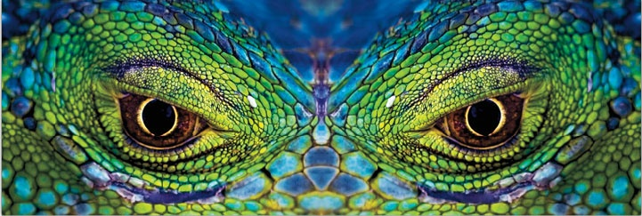
You have 10 minutes to complete :
Complete the “Getting to Know Me” survey on your own piece of paper

Slide 4
Getting to Know Me
Name: ________________________
Period: ______
Instructions: Fill in the blank or circle the best answer for you.
My favorite sport or game or activity is ______________________________________________________________________________.
There are a lot of things I would for $1,000,000 (one million). But one I would never do is _______________________________________.
In my free time, I would rather:
  Watch a movie
  Listen to goo music
  Play a sport or game
  Read a book or magazine
The best thing about me is ______________________________________________________________________________.
I had to choose to be just one, I’d rather be:
  Good-looking
  Popular
  Smart
  Talent
Usually, my homework habit is:
  I do it right away to get it over with
  I usually forget about it
  I ignore it
  If I don’t have time, I’ll copy off of a friend
I’d rather:
  Read silently
  Read out loud
  Listen to someone else read
  Read with a partner
If I could be invisible for the day, I would ______________________________________________________________________________.
How willing are you to get extra help from me when you are struggling (circle all that apply)
  I’ll come in for help at lunch
  I’d stay after school
  I’d message questions on Facebook
  I’ll check your website
The best way you can help me is (circle all that apply):
  Give me space
  Talk to me
  Make sure I get extra help when I am struggling
  Encourage me

Slide 5
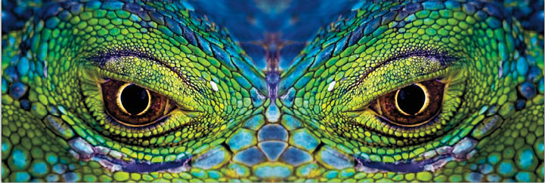
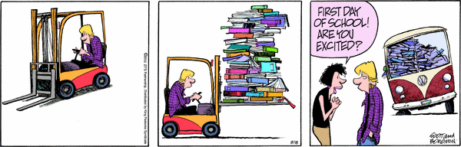

Welcome to
☺ Ms. Swank’s English II ☺
Please, find your seat.
Here’s to the first day of a great year!

Slide 6
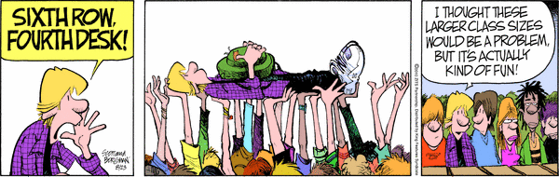
Standard and Objective: Students will be able to use correct and varied sentence types and sentence openings to present a lively and effective personal style by introducing themselves to the class and complete a a sentence record oral story by end of class.

Slide 7

Who’s really here?
Quick Check…
Attendance
Hope these folks keep working on their files!

Slide 8
Guess what???
You know how to behave because you’ve been in school for 10YEARS, so…. even though the rules are usually reserved for today, I’m going to answer any questions you might have AND over the main points of the syllabus in more detail ☺

Slide 9
So… welcome to
my classroom
My name is Ms. Swank, and I’m very happy to have you in my class. I want to help you become more effective students, which will help you find and reach your dreams. I’m not here to pick on you or flunk you or boss you around. I promise to not embarrass you intentionally. But, I expect the same from you.
Now tell me how many of you would rather go to the dentist than read out aloud?
Raise your hands please.

Slide 10
So, you can relax
now because …
You will never have to read out loud in my class if you don’t to.
I don’t want you to hate coming to my class.
I want you to enjoy reading and writing and discussing books and stories and essays that we’re going to be reading.
I want you to learn to analyze other people’s ideas, compare them to your own in an intelligent way.
The more command you have of English, the more successful you will be in school, in your work and in your personal life, especially your love life ;)

Slide 11
But, seriously…
Think you about it. We use words to get many of the things we want in life.
So, when do we use our words?
  To earn a grade
  To score a date
  To convince your parents to get a piercing
  And, someday, to get to know your spouse and in-laws. Yikes!

Slide 12
Oh yeah, and right now,
you have an A
But, it is up to you if you want to keep that A.
But, you will learn I will do my best to help you keep that A.
Are you going to help me?
You’ll just need to attend class regularly, cooperate and work hard ☺

Slide 13

What’s going home today!
Language Arts Parent Letter
  Interested in purchasing portfolios and comp notebooks through me?
    Get it, while supplies last!
Homework Binder
…..SO BRING IT BACK SIGNED, no later than this Friday.

Slide 14
Now… the name game!
Directions:
1. I need a volunteer to start the game.
2. Each of you is going to have to think of an adjective (a describing word) that starts with the same letter as your name. For example, Silly Ms. Swank.
3. You also need to think of an activity for the sentence. For example, Silly Ms. Swank skipped around the classroom. (Oh yeah, bonus points if you can add a verb (an action) with the same letter).
4. It gets harder. You’re going to have to toss a ball to someone who hasn’t given their sentence yet. You need to say everyone else’s before you include a new one.
NOTE: Keep a PG rating for your sentence.

Slide 15

Task #1
Following Directions
As a team, create a seating chart of your assigned section using handout.
I will be watching for the following:
  Supporting one another
  Efficiency
  Respectful behavior
  First/last names listed
  Completed handout returned to me
When you are given the command to start, you will be given 3 minutes to complete the task.

Slide 16
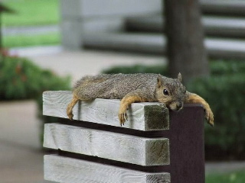
Remember, your two-week seat assignment for when you come back tomorrow!

Slide 17
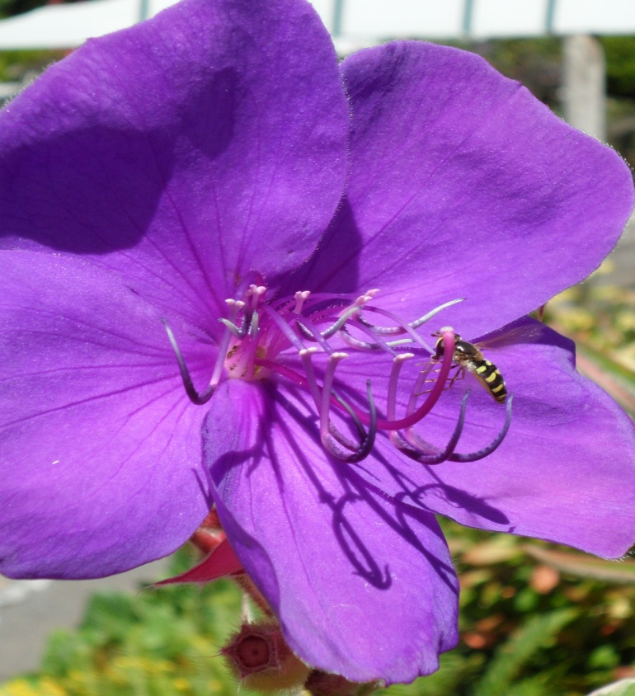
It’s all about me, right now!
What do you know about me?
Using Cornell Notes, show me how your brain organizes what you know about me, based on prior knowledge and/or what you’ve learned today.

Slide 18
Cornell Notes: All About Mrs. Swank
Topic: ____ | Name: _______
Example:

Slide 19
Cornell Notes: All About Mrs. Swank
Topic: ____ | Name: _______
Example: Teacher (Create topic areas of what you know about Mrs. Swank on this side. List answers on the right side.) | 1. 2. 3.

Slide 20
Cornell Notes
All About Ms. Swank
Sample
Topic: ____ | Name: _______
School life Where did you start teaching? What grades have you taught? | Victor Valley High School 2nd, 4th, 5th, 7th, 9th, 10th, 12th.
Summary:

Slide 21
Cornell Notes: All About Mrs. Swank
Topic: ____ | Name: _______
Example:

Slide 22
Cornell Notes: All About Mrs. Swank
Topic: ____ | Name: _______
Example: Teacher (Create topic areas of what you know about Mrs. Swank on this side. List answers on the right side.) | 1. 2. 3.

Slide 23
Cornell Notes: All About Mrs. Swank
Topic: ____ | Name: _______
Teacher ……. ……. Create 2 or more questions that you would want to know the answers to about me. Put them on this side. | If you receive the answer to your questions, put them here on this side.

Slide 24
Cornell Notes: All About Mrs. Swank
Topic: ____ | Name: _______
Summary:

Slide 25
So…. How well do you know me?
Cornell Notes

Slide 26

I will answer 5 different questions.
Only 5 !
No more than 5 !
So make 'em good!

Slide 27
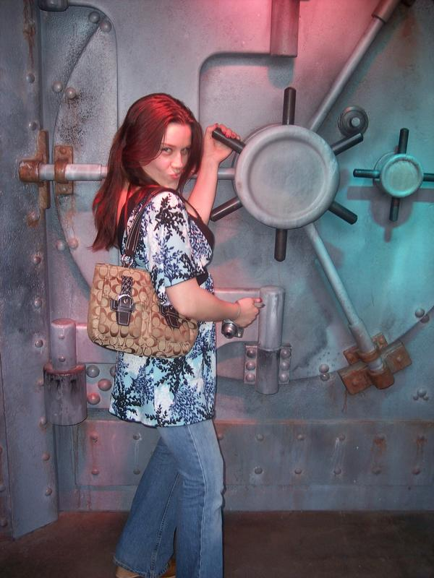
What don’t you know about me?

Slide 28
What college did I attend?
UC San Diego
UC Riverside
Cal State San Bernardino
USC

Slide 29
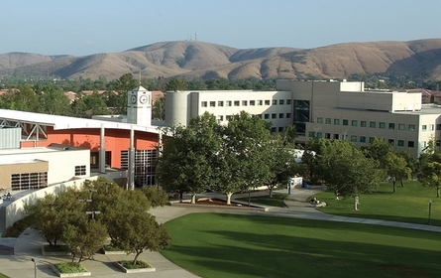
Califoria Statue University
San Bernardino

Slide 30
How many siblings do I have?
1
2
3
4

Slide 31
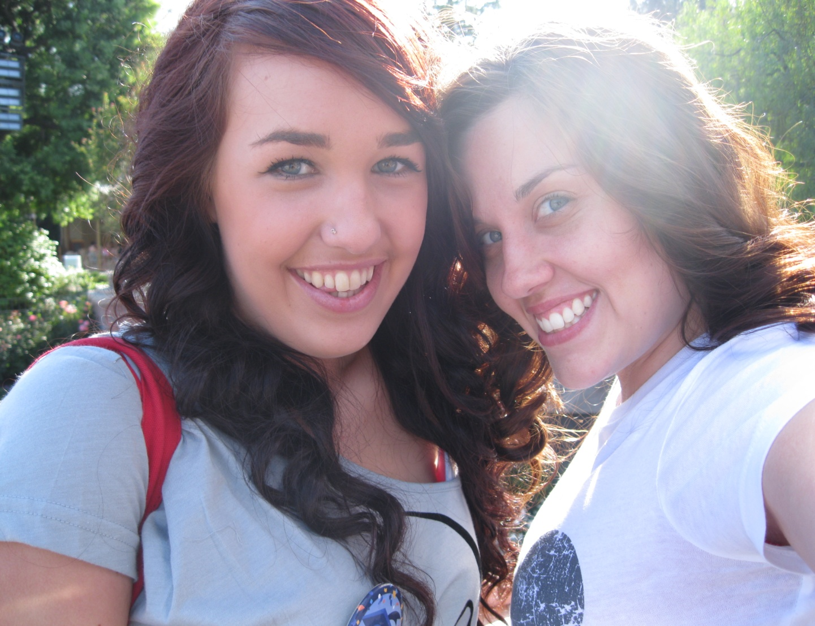
One Younger Sister
Second year army
Alexandra

Slide 32
How many animals do I have?
1 bird
1 dog
1 cat
1 cat and 1 dog

Slide 33
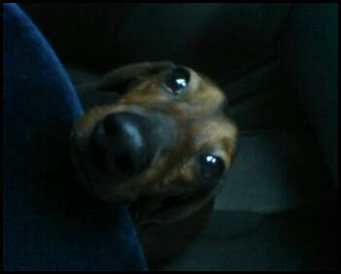
SCOOTER

Slide 34
How many years have I been teaching?
6 years
5 years
4 years
3 years

Slide 35

Starting my
6th year!

Slide 36
Three are true (facts), one is false, which one is the false answer?
Fact or fiction?
I had cancer.
I don’t allow the word ‘shut up’ in my room.
I never give homework.
I have had a professional song recorded about me.
Fiction: I never give homework.

Slide 37
Fact or fiction?
I can eat 4 Taco Bell green burritos in one sitting.
My mom lives on the East Coast.
I’ve only moved three times.
Disneyland is one of my very favorite places.
Fiction: I can eat 4 Taco Bell green burritos in one sitting. Ewwww!

Slide 38
Fact or fiction?
I absolutely love teaching and my students.
I was in drama, choir and band in high school.
I collect magnets from the places I’ve traveled to.
I expect very little from my students.
Fiction: I expect very little from my students.

Slide 39
Fact or fiction?
I love Knott’s Scary Farm.
I have owned a cat.
I rarely get angry.
I absolutely love ice cream.
Fiction: I have owned a cat.

Slide 40
Cornell Notes
All About Mrs. Swank
Topic: ____ | Name: _______
Summary:
Save your notes
until tomorrow.
Do not lose them!

Slide 41
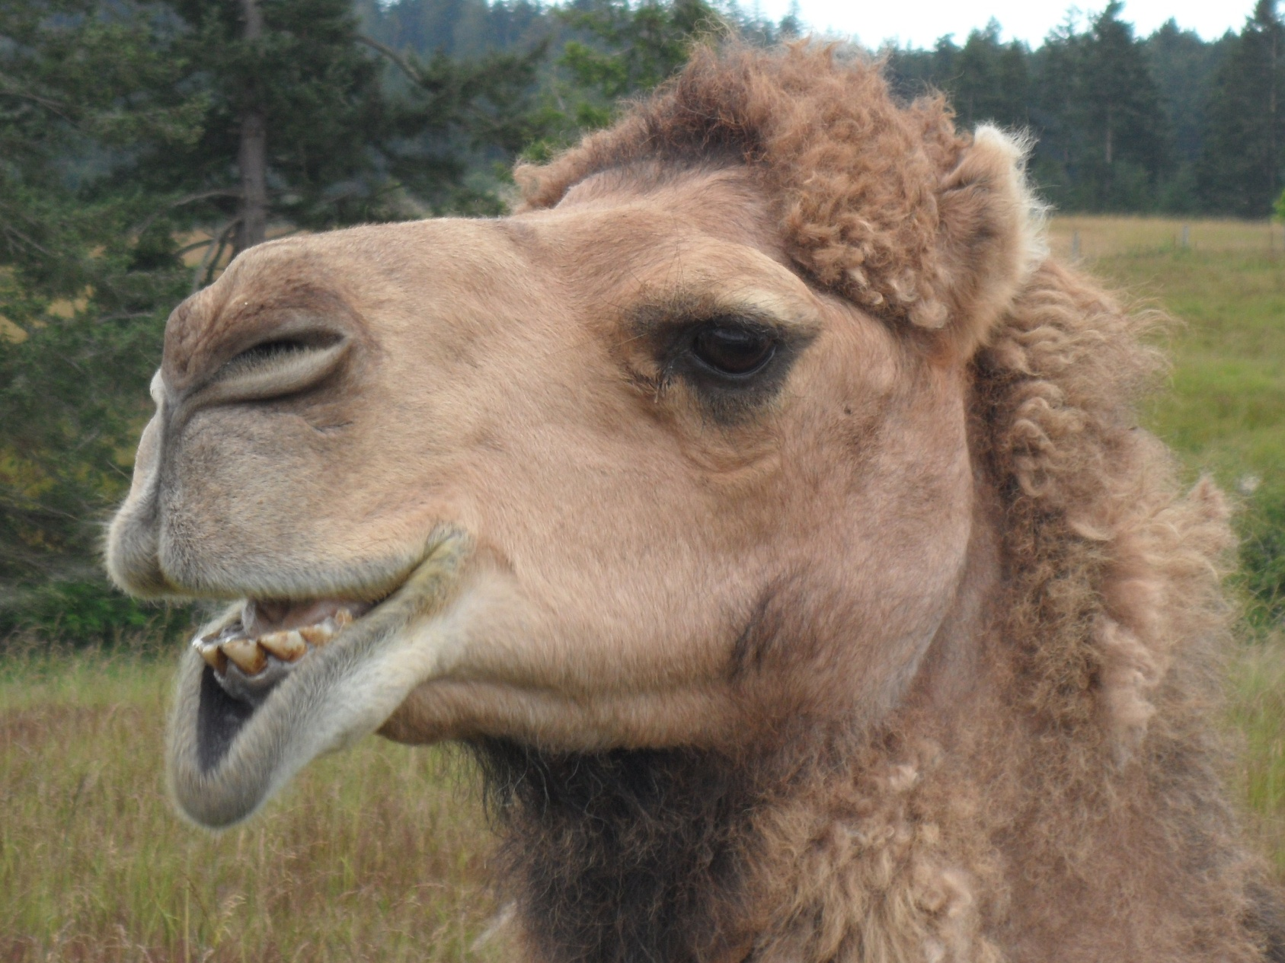
Now it’s all about you!

Slide 42


Your name: ____________ Period: ____
Fact #1:_______________________ ----
Fact #2________________________ ----
Fact #3: _______________________ ----
Fiction: ________________________ ----

Slide 43
Your name: ____________ Period: ____ Fact #1:________________________________________________________ ---- Fact #2_________________________________________________________ ---- Fiction: ________________________________________________________ ----
Your name: ____________ Period: ____ Fact #1:________________________________________________________ ---- Fact #2_________________________________________________________ ---- Fiction: _________________________________________________________ ----

Slide 44
And now for ending our hour…
You are to work on two tasks:
Task 1: Fact VS Fiction
Start thinking about 2 facts about yourself that prove to be interesting, and one piece of fiction.
  Secretly write your information the handout provided.
  Be ready to share this information tomorrow. Can you stump any of us?
Task 2: Seating Chart
Give your first name and initial of your last name to the ‘task master’ who will help create a temporary seating chart for me.

Slide 45
While you are working…
Smile for the camera!
You’ll never have a first day of 8th grade again!

Slide 46
Remember, your two-week seat assignment for when you come back tomorrow!
Remember, your seat assignment for when
you come back tomorrow!

Slide 47
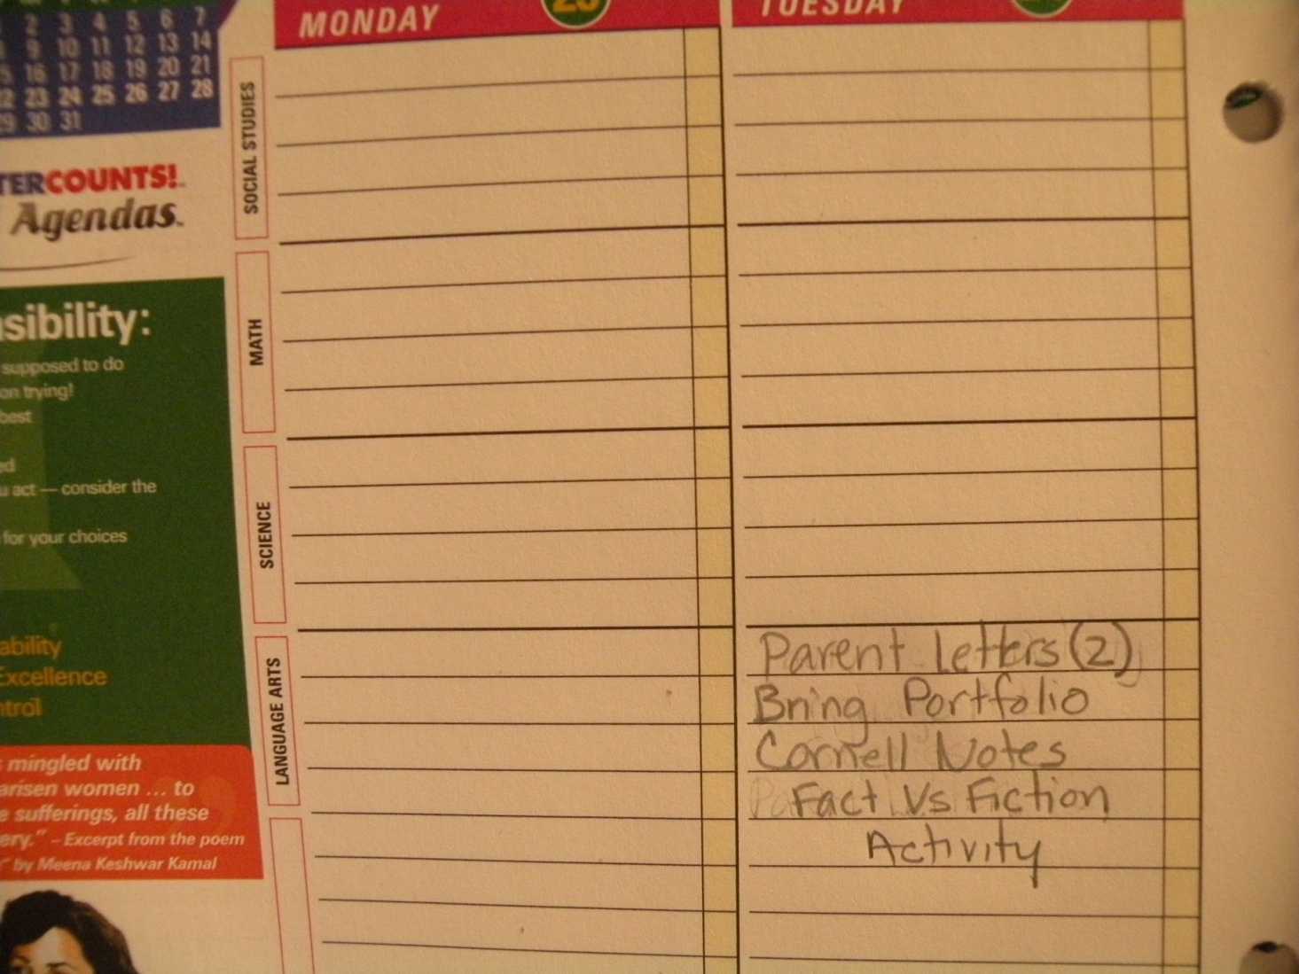
In your agenda, write down:
Parent Letters
Bring Portfolio/supplies
Fact Vs Fiction
Define vocab words within a 5 term phrase
CAHSEE essay due Fri. 9/25

Slide 48
http://www.cde.ca.gov/ta/tg/hs/documents/studyela08sec6.pdf
Writing Task – due Friday, 8/25
By the time students enter high school, they have learned about many moments in history that have influenced our world today.
Think about a moment in history you studied and consider its importance.
Write a composition in which you discuss a moment in history.
Share its importance in today’s world. Be sure to support the moment with details and examples.

Slide 49
Next time we meet, I expect you to bring in your finished
Facts VS Fiction

Slide 50
Homework:
Analysis
Compare; Comparison
Connotation
Denotation
Discomfort
Eagerness
Imply, Implies, Implied
Inform
Interpret
Melancholy
Nostalgia

Slide 51
Second Day of School Lesson
Found in lesson plan folder on computer

Slide 52


Welcome Back!
Please, find the same seat as yesterday, and show me how you can quietly sit before getting started.
I am looking forward to seeing how many of you are starting out the year responsibly.

Slide 53
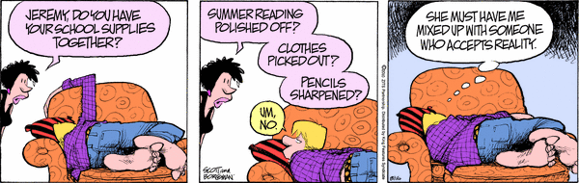
Welcome Back!
Please, quietly find your same seat!
Take out the following items:
~ Homework Log
~ Cornell Notes on Me!
~ Finished ‘Fact/Fiction’
~ Defined vocab terms

Slide 54
Let’s Review
Homework:
Analysis
Compare; Comparison
Connotation
Denotation
Discomfort
Eagerness
Imply, Implies, Implied
Inform
Interpret
Melancholy
Nostalgia

Slide 55
5 Term Vocab Words
Objective
Optimistic; optimism
Perspective
Persuade
Persuasive
Pessimistic, pessimism
Retrospect
Subjective
Sympathy
Transistion
Word Choice

Slide 56
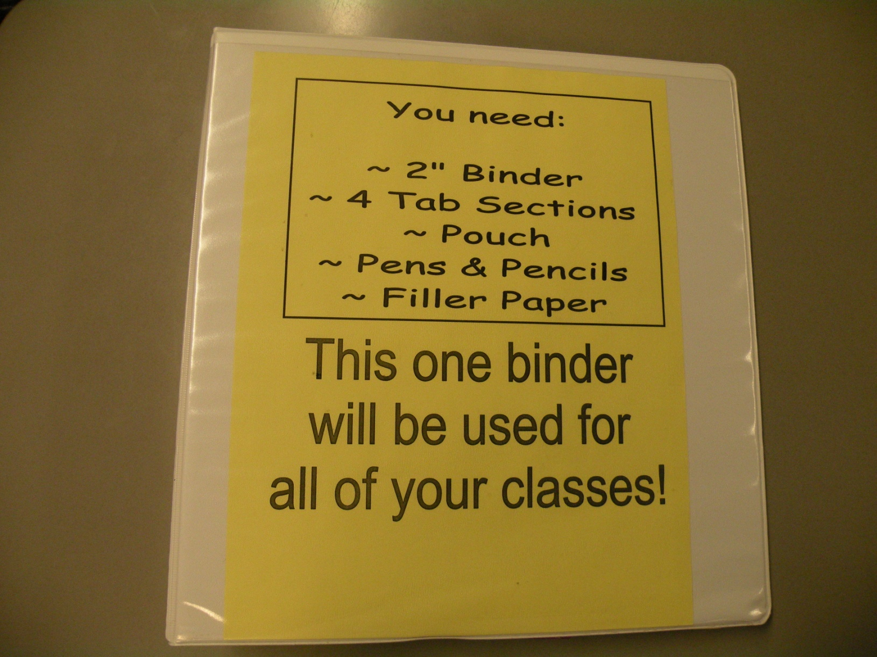

Slide 57
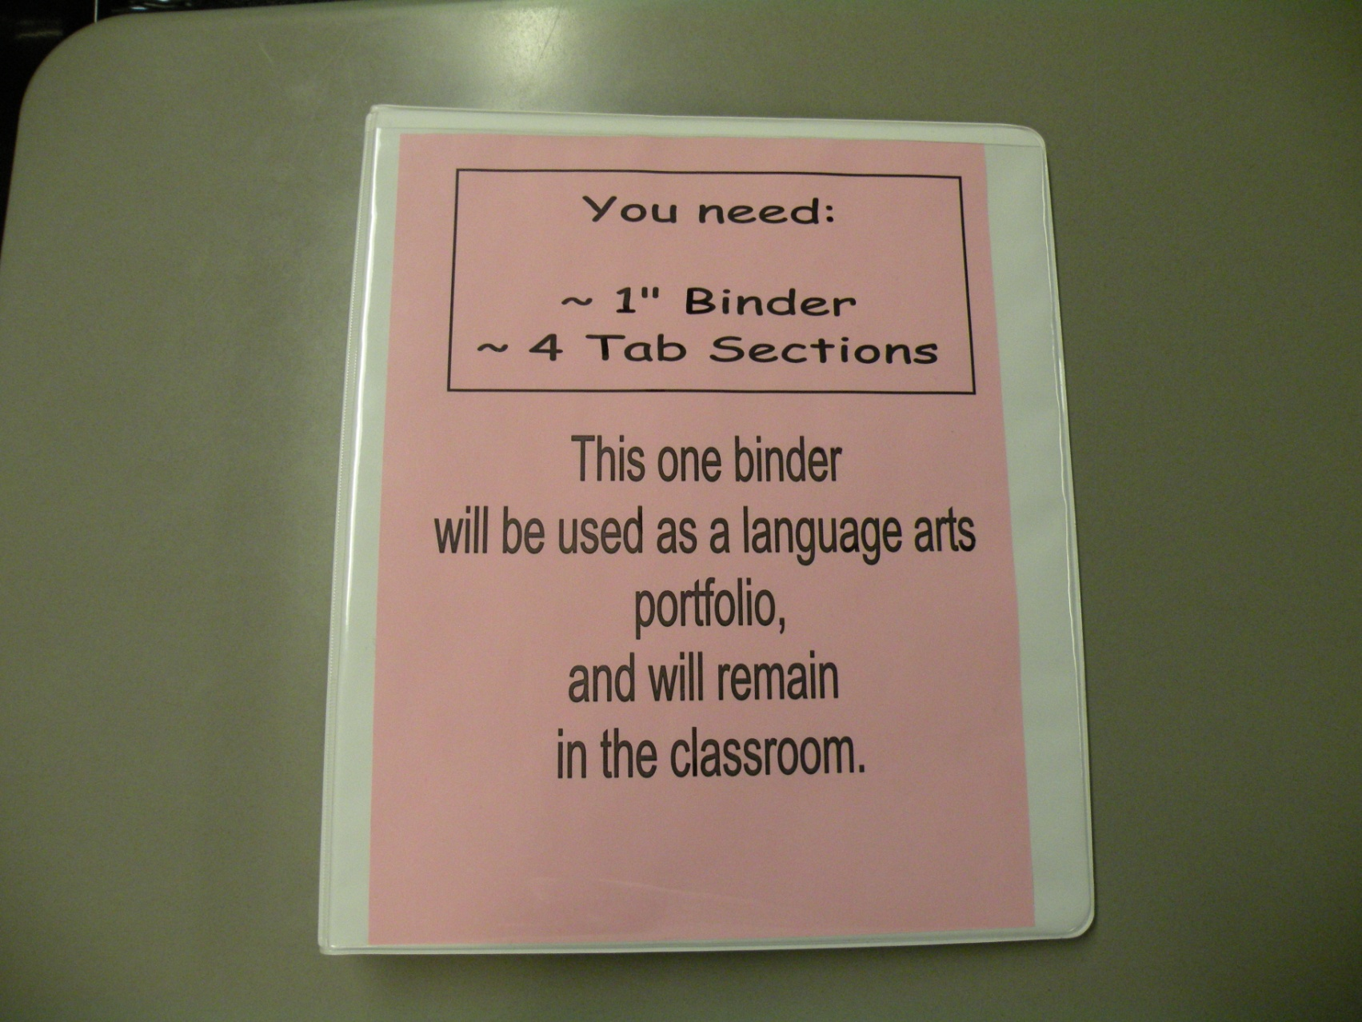

Slide 58
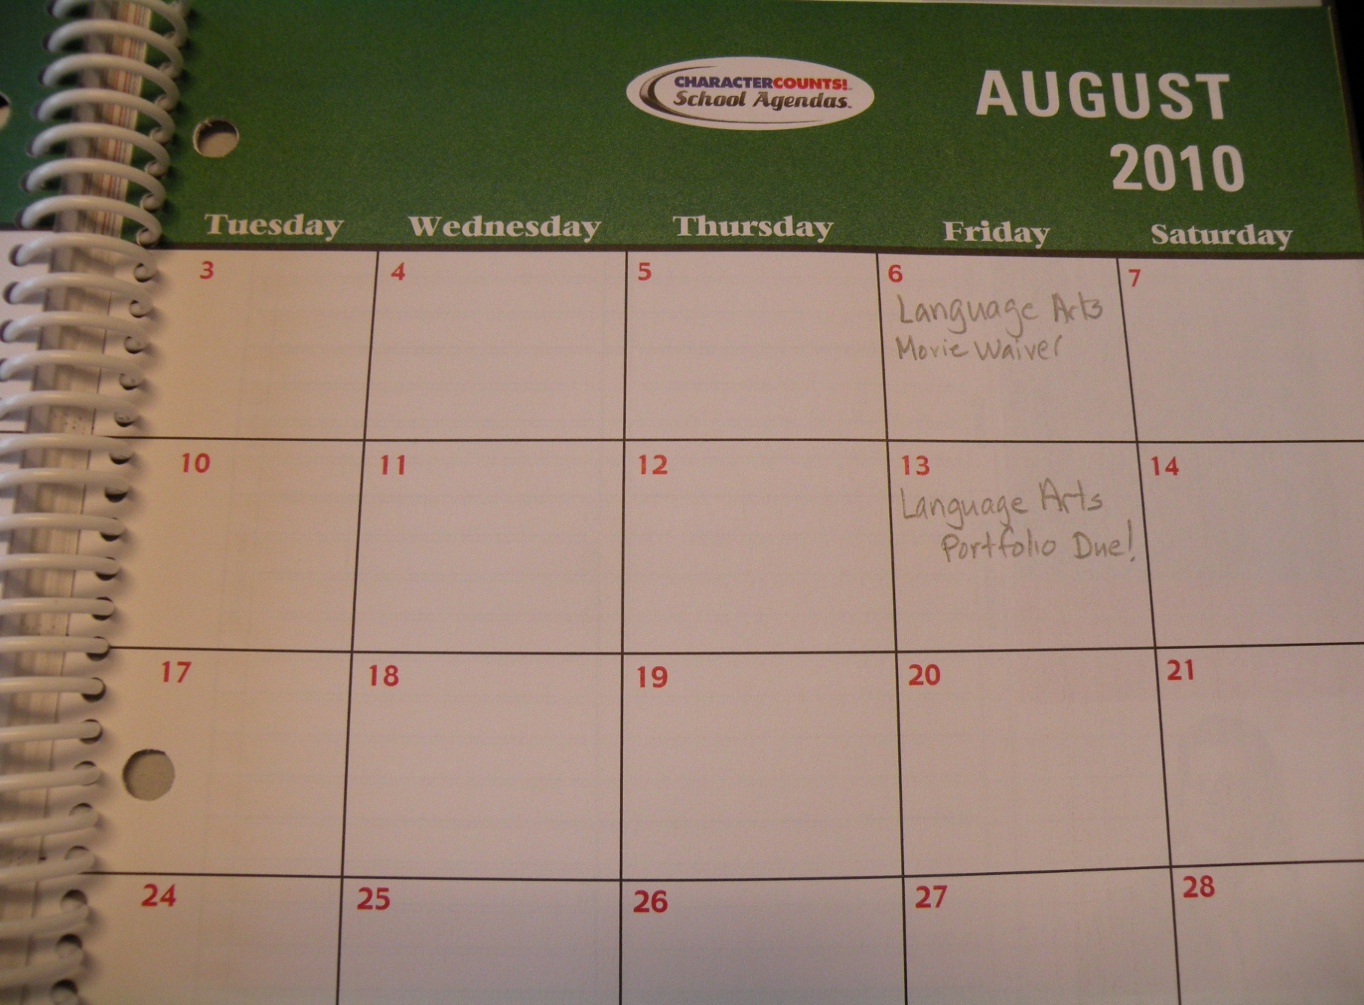
Open to page 5

Slide 59
Open to page 5
Language Arts Movie Waiver

Slide 60
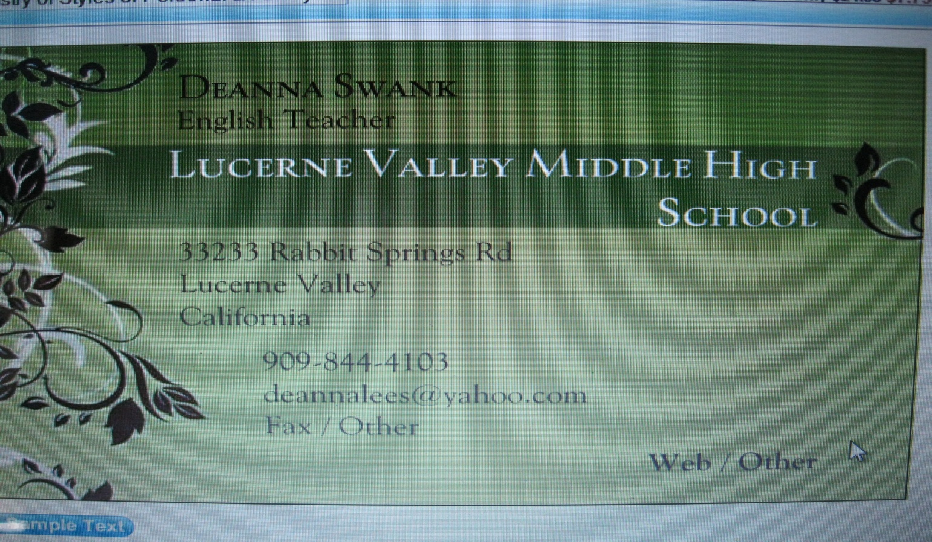
Love Extra Credit ???

Slide 61

Be expecting this from your child!
# 2
Please, return this red Ticket!
Period: _____
Student’s Name:
______________________________________
Parent’s Signature: ______________________
Yes, Ms. Swank’s business card is in a safe place to reference language arts information.

Slide 62
Your name: ____________ Period: ____
Fact #1:_______________________ ----
Fact #2________________________ ----
Fact #3: _______________________ ----
Fiction: ________________________ ----
I am collecting finished
Fact/Fiction papers.

Slide 63
Cornell Notes
All About Mrs. Swank
Topic: ____ | Name: _______
Summary:

Slide 64
Cornell Notes
All About Mrs. Swank
Topic: ____ | Name: _______
Underline the 10 most important things you feel encompass who I am as a person.
Summary:

Slide 65
Cornell Notes
All About Mrs. Swank
Topic: ____ | Name: _______
From the 10 things you underlined, create a minimum of 2 – 3 sentence summary as to what you know about me. Does it read smart? Proofread it!
Summary:

Slide 66
Now it’s all about you!

Slide 67
OK, gang, we are now going to share our ‘Fact vs Fiction’ thoughts.
When your name is called, please stand up. It’s time to play “Fact or Fiction?

Slide 68
Using new Cornell Notes show evidence of interesting things you learn about one another.

Slide 69
Facts VS Fiction

Slide 70
Facts VS Fiction

Slide 71
5 Term Vocab Words
Objective
Optimistic; optimism
Perspective
Persuade
Persuasive
Pessimistic, pessimism
Retrospect
Subjective
Sympathy
Transistion
Word Choice

Slide 72
Day 2 Part 2 of School Lesson
Found in lesson plan folder on computer

Slide 73

Greetings!
Eventually, you’ll be expected to record the agenda in your student planner, but for now…
Also, take out a sheet of lined paper.
Date: _________________________
~ Writing Prompt
~ Love Letter: Parent Homework
Due Tue 9/11/2012
~ Collect early Portfolios

Slide 74
~ Writing Prompt
~ Have parents sign syllabus
~ Love Letter: Parent Homework
Due Tue 9/4/2011
~ Collect early Portfolios

Slide 75
Got Stuff?
Movie Waiver
Portfolio Receipt
Portfolio

Slide 76
Portfolio Task
Go to side table and create spine label.
Choose colored strip.
Write First Name ~ Last Name ~ Period __
Insert into spine.
Bring portfolio up to front book shelf.
Deanna Swank Period 1

Slide 77
Your Parents Have Homework…
Due Tuesday, August 19.
September 11th

Slide 78


Your Parents Have Homework…
Due Tuesday, September 11th.
Must be
returned in
a
Sealed
Envelope
Want to be
an
Early Bird, and
receive
Extra Credit?

Slide 79
Back to...
Facts VS Fiction

Slide 80
Facts VS Fiction

Slide 81
So, you know the expectations.
What I know is that life is about choices…
On a piece of paper, write down:
I have to _________________________.
I can’t ___________________________.

Slide 82
Now, cross out the word have from the first sentence and replace it with choose.
Now, cross out can’t and replace it with I don’t want to.
Raise your hand if you agree with your sentences.

Slide 83
Prompt:
Take a few minutes to think about your sentences. What was your first response? Did the discussion change your mind? How do you feel about the sentences? If you would like to talk about this more with me, make a note.
Shoot for the grade you want to earn:
A = your paragraph must be at least 5 sentences and 75+ words in length.
B = Four sentences and/or 50 – 74 words in length.
C = Three sentences and/or 30- 49 words in length.
I will collect your paper today, so don’t put it away.

Slide 84
3rd Day of School Lesson
Found in lesson plan folder on computer

Slide 85
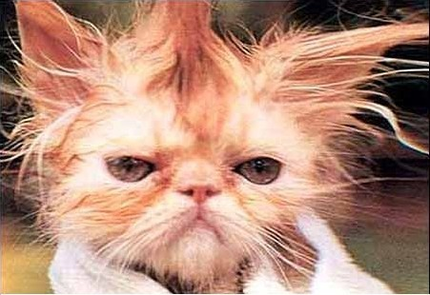
Hi Kids!
We are almost through the first week with success!
Here comes a handout which you’ll need today!
~ GIIG ~

Slide 86

Student Planner…
Date: ____________________
What’s a GIIG? & Keeping a Promise
Collect items…
Shhh...Do ASAP...
+
?
=
+
?
Portfolio
=
Movie Waiver Due too!

Slide 87
What’s a GIIG?
Date & Topic | Quickwrite/DOL/Focus Lesson

Slide 88
What’s a GIIG?
Date & Topic | Quickwrite/DOL/Focus Lesson
GIIG Pledge

Slide 89
GIIG Pledge
On Tuesday, I will remember to quietly walk into language arts, smile and wave at Ms. Swank.
I will also get out my GIIG handout, and sit down with it.
While waiting for instruction on how to do the GIIG, I will update my Homework paper, which will be shown on the PPT slide. I will do this all in silence.
Signed: ___________________
PS: I will miss you this weekend, Ms. Swank.
Please,
copy on your GIIG & sign

Slide 90
What’s a GIIG?
Date & Topic | Quickwrite/DOL/Focus Lesson
GIIG Pledge | On Tuesday, I will remember to quietly walk into language arts, smile and wave at Ms. Swank. I will also get out my GIIG handout, and sit down with it. While waiting for instruction on how to do the GIIG, I will update my Homework paper, which will be shown on the PPT slide. I will do this all in silence. Signed: ___________________ PS: I will miss you this weekend, Ms. Swank.

Slide 91
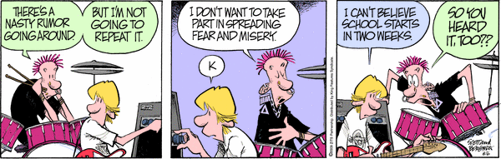
I CAN’T BELIEVE WE STARTED SCHOOL THiS WEEK.

Slide 92
Must have supplies by Tuesday! Don’t forget!

Slide 93
I hope to pass out my supplies to give by Thursday!

Slide 94
Love Extra Credit ???
See if you can find me this weekend!
http://msdeannaswanksclassroomsite.yolasite.com

Slide 95
Be expecting this from your child!
# 2
Please, return this red Ticket!
Period: _____
Student’s Name:
______________________________________
Parent’s Signature: ______________________
Yes, Ms. Swank’s business card is in a safe place to reference language arts information.

Slide 96
Your Parents Have Homework…
Due Wednesday, August 19.
Friday September 16th

Slide 97
Your Parents Have Homework…
Due Tuesday Sept 11th.
Must be
returned in
a
Sealed
Envelope
Want to be
an
Early Bird, and
receive
Extra Credit?

Slide 98
Make sure your name is on your Cornell Notes.
Time to turn it in!
Time to turn it in!
Anyone willing to help collect?

Slide 99
Anyone willing to help collect?

