Slide 1
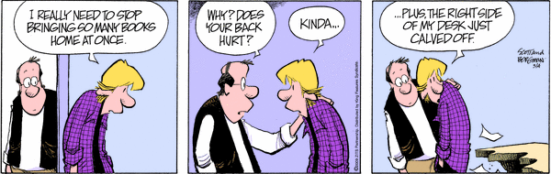
Let’s Show What You Know…
TEST TIME !

Slide 2
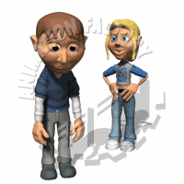
GIIG ~
QW
Monday: 5/14/2012
GIIG – Prep Review
CW: SS 5 – Postcard
HW: Writing Project
LOF: Read to p 142
Can peer pressure ever be a good thing? Why or why not?
30+ words = A
25-29 words = B
20-24 words = C
Underline at least 5
of your prepositions
to get the ‘+’.
Is this a good thing?
Pressure, pressure, pressure…

Slide 3
GIIG ~
QW
SWBAT compare and contrast motivations and reactions of literary characters from different historical eras confronting similar situations or conflicts by completing the Socratic Seminar Five handout, to show what motivates the historical issues of characters LRA 3.3
Can peer pressure ever be a good thing? Why or why not?
50+ words = A
40 – 49 words = B
30 – 39 words = C
Underline at least 5
of your prepositions
to get the ‘+’.
Is this a good thing?
Pressure, pressure, pressure…

Slide 4
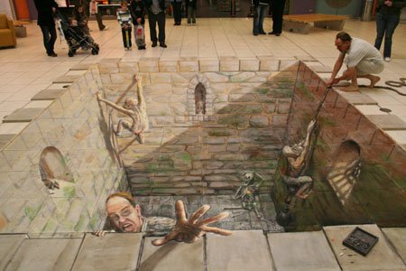

Slide 5
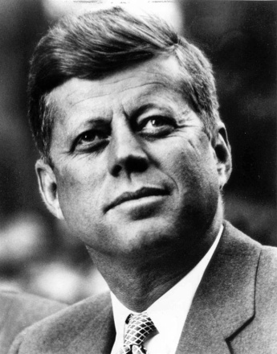

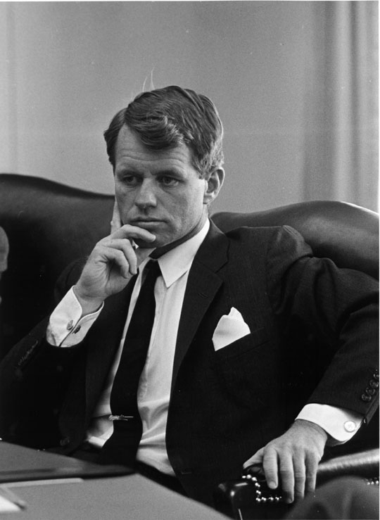

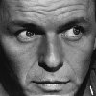

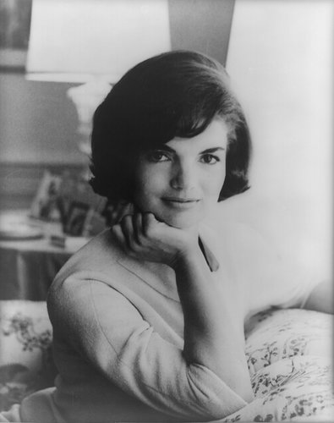

facebook
Wall
Photos
Flair
Boxes
John F. Kennedy
Logout
Anyone still need to turn in your Facebook handout from last week?
Double check!
John F. Kennedy is preparing to sign the Nuclear Test Ban Treaty
Wall
Info
Photos
Boxes
Write something…
Share
View photos of JFK (5)
Send JFK a message
John F. Kennedy is preparing to sign the Nuclear Test Ban Treaty
October 7, 1963
Poke message
Bobby Kennedy to John F. Kennedy Have you finalized your plans for the Texas trip?
October 1, 1963
Information
Networks:
Washington D.C.
Birthday:
May 29, 1917
Political:
Democrat
Religion:
Catholic
Hometown:
Brookline, Mass.
John F. Kennedy I can’t believe I had to actually send the National Guard to Alabama just so some kids could go to college!
June 11, 1963
John F. Kennedy is so glad we avoided war with the Russians! That Crisis in Cuba had my blood boiling!
October 28, 1962
Friends
John F. Kennedy hopes everyone realizes how serious I am about putting a man on the moon!!!
September 9, 1962
LBJ
Frank
Marilyn
John F. Kennedy wishes the Bay of Pigs invasion had gone better! I think Castro is going to be a major thorn in the side of the U.S.
April 17, 1961
Bobby
Jackie
Robert

Slide 6
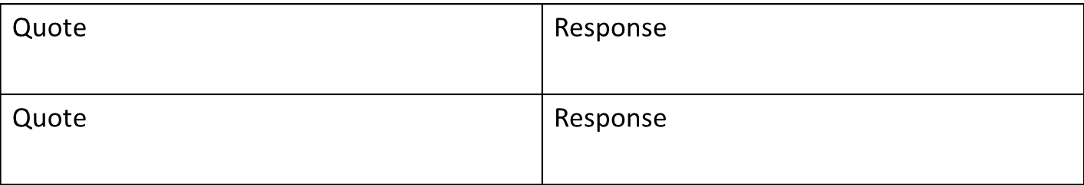
Name: ____________________ Period: ___
Socratic Seminar #5 Title of Book: ________________________ Group # ___
Before this seminar, you need to have read your assigned reading, and complete the task listed below.
  Create a bookmark by describing characters in this week’s reading
  Create 3 Costa Questions concerning the story to have ready for discussion. OPTION 1 KIDS ONLY
  Complete 2 quotes/responses. Make sure they are important to the book.
  Do Indepth question listed below.
Question 1: (Level 1) __________________________________________________________________________________________________________
Question 2: (Level 2) __________________________________________________________________________________________________________
Question 3: (Level 3) __________________________________________________________________________________________________________
In-depth Question: Which character would you be if you were in the novel, or who is the most like you. (Yes, you must pick someone) Why? Be sure to use a quote from the book with MLA citation to prove your point.
_________________________________________________________________________________________________________________________________________________________________________________________________________________________________________________________________________________________________________________________________________________________________________________________________

Slide 7
Before tomorrow…
You need to have read your assigned reading, and complete the task listed below.
  Create a bookmark by describing characters in this week’s reading
  Create 3 Costa Questions concerning the story to have ready for discussion. OPTION 1 KIDS ONLY
  Complete 2 quotes/responses. Make sure they are important to the book.
  Do Indepth question listed below.

Slide 8
Before Friday, you need to have read your assigned reading, and complete the task listed below.
  Create a Facebook page for the one of the characters in your current reading section.
  Create 3 Costa Questions concerning the story to have ready for discussion. OPTION 1 KIDS ONLY
  Do in-depth question listed below.

Slide 9
Name: ____________________ Period: ___
Socratic Seminar #5 Title of Book: ________________________ Group # ___
Before this seminar, you need to have read your assigned reading, and complete the task listed below.
  Create a bookmark by describing characters in this week’s reading
  Create 3 Costa Questions concerning the story to have ready for discussion. OPTION 1 KIDS ONLY
  Complete 2 quotes/responses. Make sure they are important to the book.
  Do Indepth question listed below.
Question 1: (Level 1) __________________________________________________________________________________________________________
Question 2: (Level 2) __________________________________________________________________________________________________________
Question 3: (Level 3) __________________________________________________________________________________________________________
In-depth Question: Which character would you be if you were in the novel, or who is the most like you. (Yes, you must pick someone) Why? Be sure to use a quote from the book with MLA citation to prove your point.
_________________________________________________________________________________________________________________________________________________________________________________________________________________________________________________________________________________________________________________________________________________________________________________________________
Option 1 Kids for a 10/10

Slide 10
Name: ____________________ Period: ___
Socratic Seminar #5 Title of Book: ________________________ Group # ___
Before this seminar, you need to have read your assigned reading, and complete the task listed below.
  Create a bookmark by describing characters in this week’s reading
  Create 3 Costa Questions concerning the story to have ready for discussion. OPTION 1 KIDS ONLY
  Complete 2 quotes/responses. Make sure they are important to the book.
  Do Indepth question listed below.
Question 1: (Level 1) __________________________________________________________________________________________________________
Question 2: (Level 2) __________________________________________________________________________________________________________
Question 3: (Level 3) __________________________________________________________________________________________________________
In-depth Question: Which character would you be if you were in the novel, or who is the most like you. (Yes, you must pick someone) Why? Be sure to use a quote from the book with MLA citation to prove your point.
_________________________________________________________________________________________________________________________________________________________________________________________________________________________________________________________________________________________________________________________________________________________________________________________________
Option 2 Kids: Cross out!!!!!!

Slide 11
Before this seminar, you need to have read your assigned reading, and complete the task listed below.
  Create a Visual Book Mark. Draw a picture and answer all questions on the back.
  Create 5 Costa Questions concerning the story to have ready for discussion.
  Complete 2 quotes/responses. Make sure they are important to the book.
  Do indepth question listed below.

Slide 12
Name: ____________________ Period: ___
Socratic Seminar #5 Title of Book: ________________________ Group # ___
Before this seminar, you need to have read your assigned reading, and complete the task listed below.
  Create a bookmark by describing characters in this week’s reading
  Create 3 Costa Questions concerning the story to have ready for discussion. OPTION 1 KIDS ONLY
  Complete 2 quotes/responses. Make sure they are important to the book.
  Do Indepth question listed below.
Question 1: (Level 1) __________________________________________________________________________________________________________
Question 2: (Level 2) __________________________________________________________________________________________________________
Question 3: (Level 3) __________________________________________________________________________________________________________
In-depth Question: Which character would you be if you were in the novel, or who is the most like you. (Yes, you must pick someone) Why? Be sure to use a quote from the book with MLA citation to prove your point.
_________________________________________________________________________________________________________________________________________________________________________________________________________________________________________________________________________________________________________________________________________________________________________________________________

Slide 13
Before this seminar, you need to have read your assigned reading, and complete the task listed below.
  Create a Visual Book Mark. Draw a picture and answer all questions on the back.
  Create 5 Costa Questions concerning the story to have ready for discussion.
  Complete 2 quotes/responses. Make sure they are important to the book.
  Do in-depth question listed below.

Slide 14

Indepth Question:
Which character would you be if you were in the novel, or who is the most like you. (Yes, you must pick someone) Why? Be sure to use a quote from the book with MLA citation to prove your point.
Yes, include a page number.

Slide 15
Now it’s time to take the luxury of
READING

Slide 16
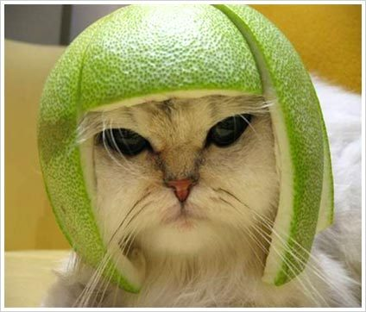
GIIG
~QW
Tuesday: 5/15/2012
New GIIG – Conjunctions
CW: SS 6 – Post Card
HW: Writing Project
LOF: Read to 121
Are you a risk taker?
Use 3 conjunctions (FANBOYS)
Explain your answer.
A = 30+ words
B = 20 – 29 words
C = 10 – 19 words

Slide 17
GIIG
~QW
SWBAT “determine the relevance of the setting to the mood and tone” by completing the Socratic Seminar Six (postcard) handout, to show the settings within the book and the moods of the characters through the tone they use to write the postcard. LRA 3.4
Are you a risk taker?
Use 3 conjunctions (FANBOYS)
Explain your answer.
A = 30+ words
B = 20 – 29 words
C = 10 – 19 words

Slide 18
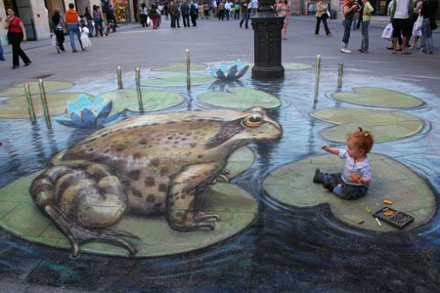

Slide 19
Option 1 Kids – Homework
Option 2 Kids- Start Today …
Socratic
Seminar
#6
Paperwork

Slide 20
Name: ____________________ Period: ___
Socratic Seminar #6 Title of Book: ________________________ Group # ___
Before this seminar, you need to have read your assigned reading, and complete the task listed below.
  Create 2 character postcards. Write the postcard from your characters point-of-view. Draw a picture of the setting, then write a letter, using the character’s appropriate tone to show the mood of the character.
  Create 3 Costa Questions concerning the story to have ready for discussion. OPTION 1 KIDS ONLY
  Complete 2 quotes/responses. Make sure they are important to the book.
  Do in-depth question listed below.
Question 1: (Level 1) __________________________________________________________________________________________________________
Question 2: (Level 2) __________________________________________________________________________________________________________
Question 3: (Level 3) __________________________________________________________________________________________________________
In-depth Question: Pretend you get to create the music soundtrack for 5 different entries. What three songs would you include? Write an explanation for each song: why would you include it, how does the song connect to events. ________________________________________________________________________________________________________________________________________________________________________________________________________________________________________________________________________________________________________________________________________________________________________________________________________________________________________________________________________________________________

Slide 21
Name: ____________________ Period: ___
Socratic Seminar #6 Title of Book: ________________________ Group # ___
Before this seminar, you need to have read your assigned reading, and complete the task listed below.
  Create 2 character postcards. Write the postcard from your characters point-of-view. Draw a picture of the setting, then write a letter, using the character’s appropriate tone to show the mood of the character.
  Create 3 Costa Questions concerning the story to have ready for discussion. OPTION 1 KIDS ONLY
  Complete 2 quotes/responses. Make sure they are important to the book.
  Do in-depth question listed below.
Question 1: (Level 1) __________________________________________________________________________________________________________
Question 2: (Level 2) __________________________________________________________________________________________________________
Question 3: (Level 3) __________________________________________________________________________________________________________
In-depth Question: Pretend you get to create the music soundtrack for 3 different entries. What three songs would you include? Write an explanation for each song: why would you include it, how does the song connect to events. ________________________________________________________________________________________________________________________________________________________________________________________________________________________________________________________________________________________________________________________________________________________________________________________________________________________________________________________________________________________________

Slide 22
Before next Tuesday…
  Create 2 character postcards. Write the postcard from your characters point-of-view. Draw a picture of the setting, then write a letter, using the character’s appropriate tone to show the mood of the character.
  Create 3 Costa Questions concerning the story to have ready for discussion. OPTION 1 KIDS ONLY
  Complete 2 quotes/responses. Make sure they are important to the book.
  Do in-depth question listed below.

Slide 23


Post Card Front: Draw the key scene/setting from three different entries. | Post Card Back: Write from the character’s perspective. Who are they writing to? What would they tell that person? Remember the setting, mood and tone should all make sense together.

Slide 24
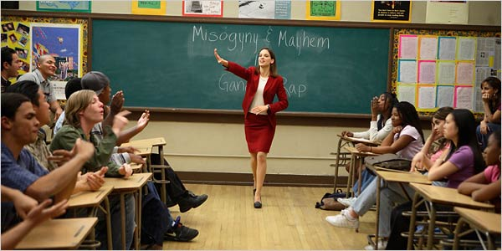

Post Card Sample:
Post Card Front: Draw the key scene/setting from two important scenes. | Post Card Back: Write from the character’s perspective. Who are they writing to? What would they tell that person? using the character’s appropriate tone to show the mood of the character. Attach message to another piece of paper, if necessary. You should have 5 sentences.

Slide 25
Before Friday’s Discussion…
  Create 2 character postcards. Write the postcard from your characters point-of-view. Draw a picture of the setting, then write a letter, using the character’s appropriate tone to show the mood of the character.
  Create 3 Costa Questions concerning the story to have ready for discussion.
  Complete 2 quotes/responses. Make sure they are important to the book.
  Do in-depth question listed below.

Slide 26
Name: ____________________ Period: ___
Socratic Seminar #6 Title of Book: ________________________ Group # ___
Before this seminar, you need to have read your assigned reading, and complete the task listed below.
  Create 2 character postcards. Write the postcard from your characters point-of-view. Draw a picture of the setting, then write a letter, using the character’s appropriate tone to show the mood of the character.
  Create 3 Costa Questions concerning the story to have ready for discussion. OPTION 1 KIDS ONLY
  Complete 2 quotes/responses. Make sure they are important to the book.
  Do in-depth question listed below.
Question 1: (Level 1) __________________________________________________________________________________________________________
Question 2: (Level 2) __________________________________________________________________________________________________________
Question 3: (Level 3) __________________________________________________________________________________________________________
In-depth Question: Pretend you get to create the music soundtrack for 5 different entries. What three songs would you include? Write an explanation for each song: why would you include it, how does the song connect to events. ________________________________________________________________________________________________________________________________________________________________________________________________________________________________________________________________________________________________________________________________________________________________________________________________________________________________________________________________________________________________
Option 1 Kids for a 10/10

Slide 27
Name: ____________________ Period: ___
Socratic Seminar #6 Title of Book: ________________________ Group # ___
Before this seminar, you need to have read your assigned reading, and complete the task listed below.
  Create 2 character postcards. Write the postcard from your characters point-of-view. Draw a picture of the setting, then write a letter, using the character’s appropriate tone to show the mood of the character.
  Create 3 Costa Questions concerning the story to have ready for discussion. OPTION 1 KIDS ONLY
  Complete 2 quotes/responses. Make sure they are important to the book.
  Do in-depth question listed below.
Question 1: (Level 1) __________________________________________________________________________________________________________
Question 2: (Level 2) __________________________________________________________________________________________________________
Question 3: (Level 3) __________________________________________________________________________________________________________
In-depth Question: Pretend you get to create the music soundtrack for 5 different entries. What three songs would you include? Write an explanation for each song: why would you include it, how does the song connect to events. ________________________________________________________________________________________________________________________________________________________________________________________________________________________________________________________________________________________________________________________________________________________________________________________________________________________________________________________________________________________________
Option 2 Kids: Cross out!!!!!!

Slide 28
Before Friday’s Discussion…
  Create 2 character postcards. Write the postcard from your characters point-of-view. Draw a picture of the setting, then write a letter, using the character’s appropriate tone to show the mood of the character.
  Create 3 Costa Questions concerning the story to have ready for discussion.
  Complete 2 quotes/responses. Make sure they are important to the book.
  Do in-depth question listed below.

Slide 29
Name: ____________________ Period: ___
Socratic Seminar #6 Title of Book: ________________________ Group # ___
Before this seminar, you need to have read your assigned reading, and complete the task listed below.
  Create 2 character postcards. Write the postcard from your characters point-of-view. Draw a picture of the setting, then write a letter, using the character’s appropriate tone to show the mood of the character.
  Create 3 Costa Questions concerning the story to have ready for discussion. OPTION 1 KIDS ONLY
  Complete 2 quotes/responses. Make sure they are important to the book.
  Do in-depth question listed below.
Question 1: (Level 1) __________________________________________________________________________________________________________
Question 2: (Level 2) __________________________________________________________________________________________________________
Question 3: (Level 3) __________________________________________________________________________________________________________
In-depth Question: Pretend you get to create the music soundtrack for 3 different entries. What three songs would you include? Write an explanation for each song: why would you include it, how does the song connect to events. ________________________________________________________________________________________________________________________________________________________________________________________________________________________________________________________________________________________________________________________________________________________________________________________________________________________________________________________________________________________________

Slide 30

In-depth Question: Pretend you get to create the music soundtrack for 5 different entries. What five songs would you include? Write an explanation for each song: why would you include it, how does the song connect to events.
Please, remember to include the page number with MLA citation.

Slide 31
Name: ____________________ Period: ___
Socratic Seminar #6 Title of Book: ________________________ Group # ___
Before this seminar, you need to have read your assigned reading, and complete the task listed below.
  Create 2 character postcards. Write the postcard from your characters point-of-view. Draw a picture of the setting, then write a letter, using the character’s appropriate tone to show the mood of the character.
  Create 3 Costa Questions concerning the story to have ready for discussion. OPTION 1 KIDS ONLY
  Complete 2 quotes/responses. Make sure they are important to the book.
  Do in-depth question listed below.
Question 1: (Level 1) __________________________________________________________________________________________________________
Question 2: (Level 2) __________________________________________________________________________________________________________
Question 3: (Level 3) __________________________________________________________________________________________________________
In-depth Question: Pretend you get to create the music soundtrack for 3 different entries. What three songs would you include? Write an explanation for each song: why would you include it, how does the song connect to events. ________________________________________________________________________________________________________________________________________________________________________________________________________________________________________________________________________________________________________________________________________________________________________________________________________________________________________________________________________________________________

Slide 32
Time to Begin
Socratic Seminar
# 5
Remember to make your
points count.
Today is heavily weighted.

Slide 33
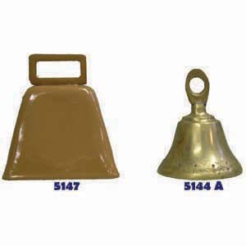
Wait for the Bell.
Final 12 minutes will be for you to do your Group’s Debrief.

Slide 34
Please, do your debrief.
Submit in this order:
1. Debrief paper: Side One
2. Socratic Seminar 2 Handout

Slide 35
Names | Student arrived with a ‘stamped’ paperwork. | Student helped with discussion & it was apparent they were up to date on their reading. | Student was commendable on their behavior, and was truly on task the entire time. | Today’s score:
 | YES / Somewhat / No 20 / 15 / 0 | YES / Somewhat / No 15 / 10 / 0 | YES / Somewhat / No 15 / 10 / 0
 | YES / Somewhat / No 20 / 15 / 0 | YES / Somewhat / No 15 / 10 / 0 | YES / Somewhat / No 15 / 10 / 0
 | YES / Somewhat / No 20 / 15 / 0 | YES / Somewhat / No 15 / 10 / 0 | YES / Somewhat / No 15 / 10 / 0
 | YES / Somewhat / No 20 / 15 / 0 | YES / Somewhat / No 15 / 10 / 0 | YES / Somewhat / No 15 / 10 / 0
 | YES / Somewhat / No 20 / 15 / 0 | YES / Somewhat / No 15 / 10 / 0 | YES / Somewhat / No 15 / 10 / 0
The Debrief

Slide 36
Names | Student arrived with a ‘stamped’ paperwork. | Student helped with discussion & it was apparent they were up to date on their reading. | Student was commendable on their behavior, and was truly on task the entire time. | Today’s score:
 | YES / Somewhat / No 20 / 15 / 0 | YES / Somewhat / No 15 / 10 / 0 | YES / Somewhat / No 15 / 10 / 0
 | YES / Somewhat / No 20 / 15 / 0 | YES / Somewhat / No 15 / 10 / 0 | YES / Somewhat / No 15 / 10 / 0
 | YES / Somewhat / No 20 / 15 / 0 | YES / Somewhat / No 15 / 10 / 0 | YES / Somewhat / No 15 / 10 / 0
 | YES / Somewhat / No 20 / 15 / 0 | YES / Somewhat / No 15 / 10 / 0 | YES / Somewhat / No 15 / 10 / 0
 | YES / Somewhat / No 20 / 15 / 0 | YES / Somewhat / No 15 / 10 / 0 | YES / Somewhat / No 15 / 10 / 0

Slide 37
BACKSIDE
What are the essential guiding questions that drove today’s discussion? ______________________________________
What were the most important ideas expressed during the conversation? ____________________________________
At what point did the conversation dive into a deeper level? What particular response or question created that change? _________________________________________
What were your overall impressions of the seminar discussion? ______________________________________
What went well during this seminar discussion?
What needs to be improved? ________________________
On a 1 – 10 scale, how would you rank today’s Socratic Seminar?
1 - 2 - 3 - 4 - 5 - 6 - 7 - 8 - 9 - 10
8. Before your next seminar, how many pages/chapters does your group need to have read?
__________ Pages or ________ chapters

Slide 38
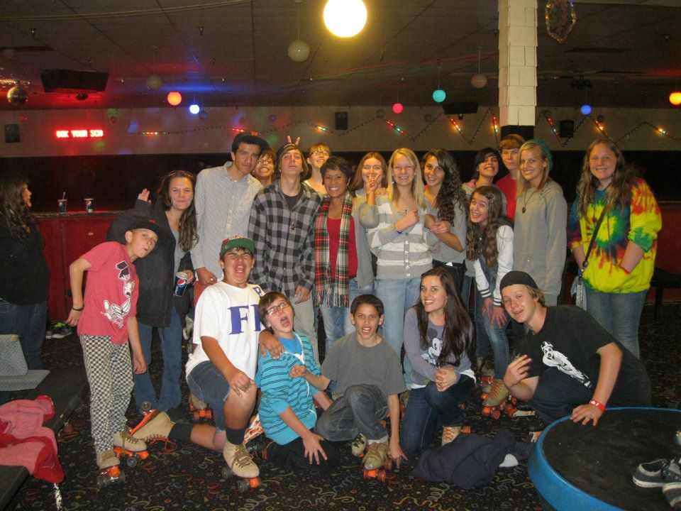
Show your
smarts!
Begin!

Slide 39
DENOTATIVE DEFINTION : | SYNONYM: ANTONYM:
MINDSKETCH | CONTEXTUAL SENTENCE John, you seem like an astute man. Maybe you can help explain something to me.
astute
adjective
Absent:
Fill in the rest. Use a dictionary to look up the meaning.

Slide 40
DENOTATIVE DEFINTION : | SYNONYM: ANTONYM:
MINDSKETCH | CONTEXTUAL SENTENCE John, you seem like an astute man. Maybe you can help explain something to me.
astute
adjective
Copy me, please !!!!

Slide 41
DENOTATIVE DEFINTION : Of strong judgment | SYNONYM: smart ANTONYM: stupid
MINDSKETCH | CONTEXTUAL SENTENCE John, you seem like an astute man. Maybe you can help explain something to me.
Copy the definition
astute
adjective

Slide 42
DENOTATIVE DEFINTION : Of strong judgment | SYNONYM: smart ANTONYM: stupid
MINDSKETCH | CONTEXTUAL SENTENCE John, you seem like an astute man. Maybe you can help explain something to me.
Come up with 1 more!
astute
adjective

Slide 43
DENOTATIVE DEFINTION : Of strong judgment | SYNONYM: smart ANTONYM: stupid
MINDSKETCH | CONTEXTUAL SENTENCE John, you seem like an astute man. Maybe you can help explain something to me.
astute
adjective
Draw picture

Slide 44
Jack: I have every faith in your reconciliatory navigational skills, Master Gibbs… We have a need to travel upriver.
Gibbs: By need, do you mean a trifling need, fleeting, as in, say, a passing fancy?
Jack: No, a resolute and unyielding need.
Will: … We need to…. Make sail for Port Royale with all haste.
Jack: William, I shall trade you the compass if you will help me to find this. (Shows a drawing of a key)
Will: You want me to find this?
Jack: No, you want to find this. Because the finding of this finds you incapacitorially finding and or locating, in your discovering, the detecting a way to save your dolly bell…

Slide 45
Reconciliatory
Trifling
Fleeting
Resolute
Unyielding
Haste
incapacitorially
Making consistent
Unimportant
Disappearing quickly
Determined
Stubborn
Speed
Made up word, meaning, doing so

Slide 46
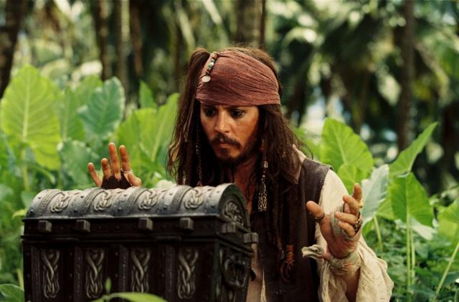
Were you right?

Slide 47
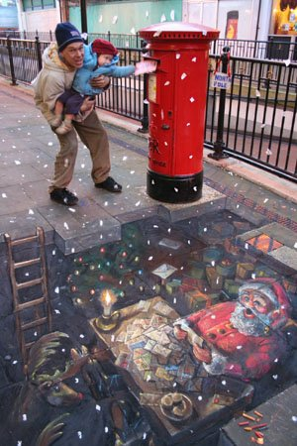

Slide 48
GIIG
~QW
Thursday: 5/17/2012
GIIG – figurative lang
CW: Outline
HW: Writing Project
LOF: Read to p 163
Using the quote to the right, answer the following questions.
What type of figurative language it is.
How do mistakes give you a window to discovering things? Explain. Or, have you ever had a time where your mistakes led you to a discovery? What happened?
“A man's errors are his portals (windows) of discovery.”
~James Joyce~
(One of my very favorite quotes)

Slide 49
GIIG
~QW
SWBAT Establish coherence within and among paragraphs through effective transitions, parallel structures, and similar writing techniques by filling in the transitions and commentaries of the essay outline. WS 1.2
Using the quote to the right, answer the following questions.
What type of figurative language it is.
How do mistakes give you a window to discovering things? Explain. Or, have you ever had a time where your mistakes led you to a discovery? What happened?
“A man's errors are his portals (windows) of discovery.”
~James Joyce~
(One of my very favorite quotes)

Slide 50
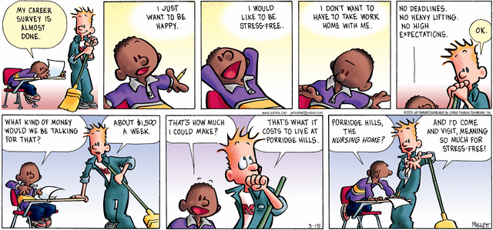

Slide 51
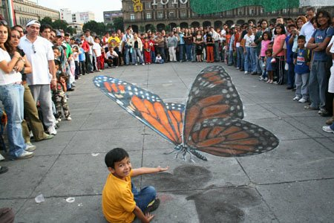

Slide 52
What’s Due When?
 |  |  | 5/17: Today start draft! | 5/18: Think about who will be your assessor and continue writing!
 |  | 5/23 Want Teacher to assess? Today is the final day you can submit ‘ticket’ w/ draft sandwich.
 |  |  | 5/30 Final Draft Due

Slide 53
What’s Due When?
 |  |  | 5/17: Start outline!
 |  | Start Rough draft Show me your rough draft and ‘sandwich.’ | Show me your rough draft and ‘sandwich.’ | Show me your rough draft and ‘sandwich.’

Slide 54
What’s Due When?
 |  |  | 5/17: Start outline! | Finish outline!
 |  | Start Rough draft Show me your rough draft and ‘sandwich.’ | Show me your rough draft and ‘sandwich.’ | Show me your rough draft and ‘sandwich.’

Slide 55
What’s Due When?
 |  |  | 5/17: Start outline | 5/18: Think about who will be your assessor and continue writing!
 |  | 5/23 Want Teacher to assess? Today is the final day you can submit ‘ticket’ w/ draft sandwich.
 |  |  | 5/30 Final Draft Due
Show me your rough draft done,
no matter who assesses it.

Slide 56

What’s Due When?
 |  |  | 5/17: Today start draft! | 5/18: Think about who will be your assessor and continue writing!
 |  | 5/23 Want Teacher to assess? Today is the final day you can submit ‘ticket’ w/ draft sandwich.
 |  |  | 5/20 Final Draft Due
Show me your rough draft done,
no matter who assesses it.
If you don't show
me your R.D. by this date,
you will call home &
have lunch detention
every day until you
can give it to me.

Slide 57
What’s Due When?
 |  |  | 5/17: Today start draft! | 5/18: Think about who will be your assessor and continue writing!
 |  | 5/23 Want Teacher to assess? Today is the final day you can submit ‘ticket’ w/ draft sandwich. |  | Early Bird Final +4
Early Bird Final +3 | Early Bird Final +2 | Early Bird Final +1 | 5/30 Final Draft Due
Show me your rough draft done,
no matter who assesses it.

Slide 58
What’s Due When?
 |  |  | 5/17: Today start draft! | 5/18: Think about who will be your assessor and continue writing!
Work on essay at home! | Work on essay at home! | 5/23 Want Teacher to assess? Today is the final day you can submit ‘ticket’ w/ draft sandwich. |  | Early Bird Final +4
Early Bird Final +3 | Early Bird Final +2 | Early Bird Final +1 | 5/30 Final Draft Due
Show me your rough draft done,
no matter who assesses it.

Slide 59
What’s Due When?
 |  |  | 5/17: Today start draft! | Work on essay at home!
Work on essay at home! | Work on essay at home! | 5/23 Want Teacher to assess? Today is the final day you can submit ‘ticket’ w/ draft sandwich. |  | Early Bird Final +4
Early Bird Final +3 | Early Bird Final +2 | Early Bird Final +1 | 5/30 Final Draft Due
Show me your rough draft done,
no matter who assesses it.

Slide 60
What’s Due When?
 |  |  | 5/17: Today start draft! | 5/18: Think about who will be your assessor and continue writing!
Work on essay at home! | Work on essay at home! | 5/23 Want Teacher to assess? Today is the final day you can submit ‘ticket’ w/ draft sandwich. |  | Early Bird Final +4
Early Bird Final +3 | Early Bird Final +2 | Early Bird Final +1 | 5/30 Final Draft Due | Every day you are late, you lose 10 points off rubric score.
Show me your rough draft done,
no matter who assesses it.

Slide 61
What’s Due When?
 |  |  | 5/17: Today start draft! | 5/18: Think about who will be your assessor and continue writing!
Work on essay at home! | Work on essay at home! | 5/23 Want Teacher to assess? Today is the final day you can submit ‘ticket’ w/ draft sandwich. |  | Early Bird Final +4
Early Bird Final +3 | Early Bird Final +2 | Early Bird Final +1 | 5/30 Final Draft Due | Every day you are late, you lose 10 points off rubric score.
Show me your rough draft done,
no matter who assesses it.

Slide 62
GIIG
~QW
Friday: 5/18/2012
GIIG – contextual
sentences
CW: Outline
HW: Writing Project
LOF: catch up
Which phrase is the best definition of protruded?
Re-write the sentence with the best definition instead.
Lay hidden
Stuck out
Reached forth
Revealed itself
Cameron’s eyes dropped to the crack under the closet door, but no paper wing or fin protruded as a clue.

Slide 63
GIIG
~QW
SWBAT Create compositions that establish a controlling impression, have a coherent thesis, and end with a clear and well-supported conclusion on essay outline. WS 1.1
Which phrase is the best definition of protruded?
Re-write the sentence with the best definition instead.
Lay hidden
Stuck out
Reached forth
Revealed itself
Cameron’s eyes dropped to the crack under the closet door, but no paper wing or fin protruded as a clue.

Slide 64
Use may week 2 stuff for next week

Slide 65
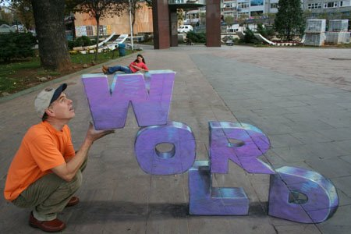

Slide 66

What’s Due When?
 |  | 5/13 |  | Early Bird Final +4
Early Bird Final +3 | Early Bird Final +2 | Early Bird Final +1 | 5/21 Final Draft Due | Every day you are late, you lose 10 points off rubric score.
Show me your rough draft done,
no matter who assesses it.
Who still owes me a rough drafts?
Avoid lunch detention
on Monday!
+4 ?

Slide 67
Congrats Shout Out!
Period 4
Anyone shooting for the final +1 Early Bird? Look at this amazing list of Early Birds!
Danna P
Artie K
Eddie M
Kealani O
Ryan R
Alana B
Melanie H

Slide 68
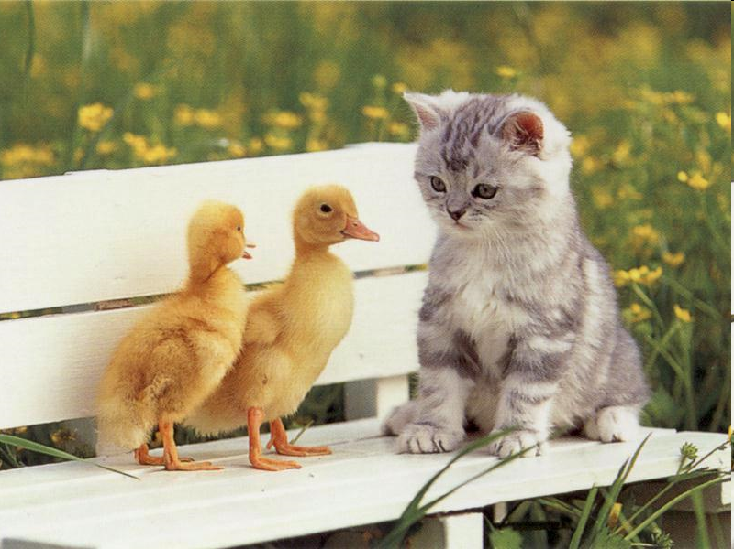
Got Early Rough Draft? You only have two days left to avoid lunch detention.
I know, I know… I want to show I have my act together. I’ll be ready by tomorrow for sure!
Happy Wednesday!
Cheep! Cheep!

Slide 69
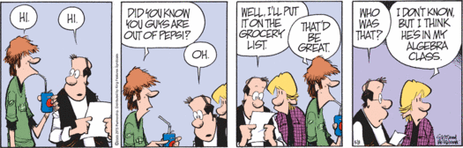
Happy Friday!
Got Rough Draft?

