Slide 1
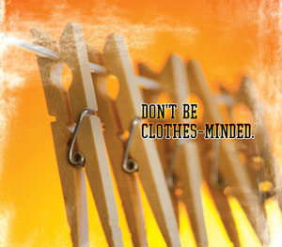
Making Mondays Matter
Monthly
Monday, 4/30/2012
GIIG –MMMM
Read and work day!
Homework: Writing Project
Option 1- read to p
In a paragraph, come up with the following to share with your family:
Do you plan to go home and through your clothes to find something to donate?
What about old dresses/clothes from dances?

Slide 2
Making Mondays Matter
Monthly
SWBAT compare and contrast motivations and reactions of literary characters from different historical eras confronting similar situations or conflicts by completing the Socratic Seminar Three handout on their novel, including the Venn Diagram, which will compare the character’s motivations. LRA 3.3
In a paragraph, come up with the following to share with your family:
Do you plan to go home and through your clothes to find something to donate?
What about old dresses/clothes from dances?
FACTS
20 billion pounds of clothing and textiles are thrown away every year—an average of 68 pounds per person.
1.5 billion pairs of unworn or barely worn shoes are lying in closets.
Over 36.2 million of the U.S. population lives in poverty.
On average, 3 million men, women, and children are homeless at some point each year.
50% of all homeless women and children are fleeing domestic violence, usually with only the clothes on their backs.
Clothing donations to qualified charitable organizations are tax deductible.

Slide 3

What figurative language/literary device am I?
Don’t forget to raise your hand!

Slide 4
Name: ____________________ Period: ___
Socratic Seminar #3 Title of Book: ________________________ Group # ___
Before this seminar, you need to have read your assigned reading, and complete the task listed below.
  Create a Venn Diagram between your two stories. Come up with at least 10 items per section of your diagram. These items need to reflect the exposition or plot of the story.
  Create 5 Costa Questions concerning the story to have ready for discussion. At least two of the questions must reflect both the first and second stories you are reading.
  Do Indepth question listed below.
Question 1: (Level 1) __________________________________________________________________________________________________________
Question 2: (Level 2) __________________________________________________________________________________________________________
Question 3: (Level 2) __________________________________________________________________________________________________________
Question 4: (Level 2 or 3) __________________________________________________________________________________________________________
Question 5: (Level 3) __________________________________________________________________________________________________________
Indepth Question: Choose one character from this story. If you could interview them, what kinds of questions would you want to ask them and why? Come up with 5 pivotal questions. After you write them, explain why these questions are important to you, linking them to existing evidence from the story thus far.
_____________________________________________________________________________________________________________________________________________________________________________________________________________________________________________________________________________________________________________________________________
_________________________________________________________________
_________________________________________________________________

Slide 5
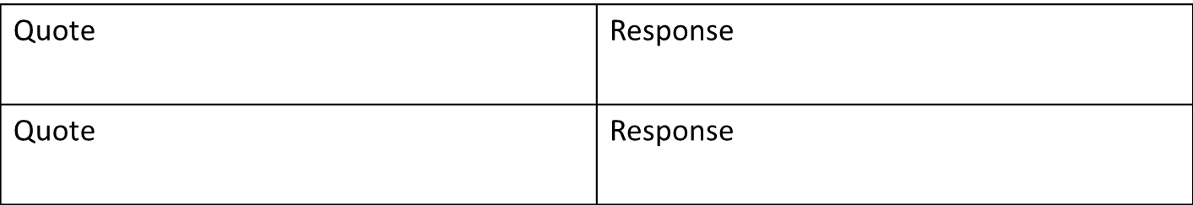
Name: ____________________ Period: ___
Socratic Seminar #3 Title of Book: ________________________ Group # ___
Before this seminar, you need to have read your assigned reading, and complete the task listed below.
  Create a Venn Diagram Come up with at least 10 items per section of your diagram. These items need to reflect character motivations.
    LOF Kids: Compare Jack and Ralph.
    FW Kids: Compare “TWTTIN” and FW.
    TWTTIN Kids: Compare Bryon and Mark
  Create 3 Costa Questions concerning the story to have ready for discussion. OPTION 1 KIDS ONLY
  Complete 2 quotes/responses. Make sure they are important to the book.
  Do Indepth question listed below.
Question 1: (Level 1) __________________________________________________________________________________________________________
Question 2: (Level 2) __________________________________________________________________________________________________________
Question 3: (Level 3) __________________________________________________________________________________________________________
In-depth Question: Choose one character from this story. If you could interview them, what kinds of questions would you want to ask them and why? Come up with 5 pivotal questions. After you write them, explain why these questions are important to you, linking them to existing evidence from the story thus far.
_________________________________________________________________________________________________________________________________________________________________________________________________________________________________________________________________________________________________________________________________________________________________________________________________

Slide 6
  Create a Venn Diagram Come up with at least 10 items per section of your diagram. These items need to reflect character motivations.
    LOF Kids: Compare Jack and Ralph.
    FW Kids: Compare “TWTTIN” and FW.
    TWTTIN Kids: Compare Bryon and Mark
  Create 3 Costa Questions concerning the story to have ready for discussion. OPTION 1 KIDS ONLY
  Complete 2 quotes/responses. Make sure they are important to the book.
  Do In-depth question listed below.

Slide 7
Socratic Seminar #3 Venn Diagram
My name: ______________ Period: ___
Differences
Similarities
1.
2.
3.
4.
5.
6.
7.
8.
9.
10.
Differences
Does drugs, so
Character 1: Bryon Character 2 Mark _

Slide 8
Socratic Seminar #3 Venn Diagram
My name: ______________ Period: ___
Similaities
Similarities
Since they’re
Gangsters, they
Get in fights.
2. Since they do
Drugs, they
Differences
Character 1: ___________ Character 2: ____________

Slide 9
Socratic Seminar #3 Venn Diagram
My name: ______________ Period: ___
Differences
Smoke cigrarettes
–
Similarities
They kill people-
They are criminals
Differences
-
Character 1: Outsiders Character 2: FW

Slide 10
Socratic Seminar #3 Venn Diagram
My name: ______________ Period: ___
Differences
1.
2.
3.
4.
5.
6.
7.
8.
9.
10.
Similarities
1.
2.
3.
4.
5.
6.
7.
8.
9.
10.
Differences
1.
2.
3.
4.
5.
6.
7.
8.
9.
10.
Johnny
Ponyboy
Character 1: __________ Character 2: ____________

Slide 11

Socratic Seminar #3 Venn Diagram
My name: ______________ Period: ___
Differences
Alcoholic parents, so doesn’t stay
At home much
2. No brothers, so he is really close
to Ponyboy
Differences
1.Dead parents, so
He relies on his bros
2. Has brothers, but they are more
like parents, so he doesn’t feel
Understood. .
Johnny
Character 1: ___________ Character #2: ____________
Ponyboy

Slide 12
Socratic Seminar #3 Venn Diagram
My name: ______________ Period: ___
Similarities
Both greasers,
so mocked for being poor
Johnny
Ponyboy
Character 1: ___________ Character #2: ____________

Slide 13
  Create a Venn Diagram Come up with at least 10 items per section of your diagram. These items need to reflect character motivations.
    LOF Kids: Compare Jack and Ralph.
    FW Kids: Compare “TWTTIN” and FW.
    TWTTIN Kids: Compare Bryon and Mark
  Create 3 Costa Questions concerning the story to have ready for discussion. OPTION 1 KIDS ONLY
  Complete 2 quotes/responses. Make sure they are important to the book.
  Do In-depth question listed below.

Slide 14
Name: ____________________ Period: ___
Socratic Seminar #3 Title of Book: ________________________ Group # ___
Before this seminar, you need to have read your assigned reading, and complete the task listed below.
  Create a Venn Diagram Come up with at least 10 items per section of your diagram. These items need to reflect character motivations.
    LOF Kids: Compare Jack and Ralph.
    FW Kids: Compare “TWTTIN” and FW.
    TWTTIN Kids: Compare Bryon and Mark
  Create 3 Costa Questions concerning the story to have ready for discussion. OPTION 1 KIDS ONLY
  Complete 2 quotes/responses. Make sure they are important to the book.
  Do Indepth question listed below.
Question 1: (Level 1) __________________________________________________________________________________________________________
Question 2: (Level 2) __________________________________________________________________________________________________________
Question 3: (Level 3) __________________________________________________________________________________________________________
In-depth Question: Choose one character from this story. If you could interview them, what kinds of questions would you want to ask them and why? Come up with 5 pivotal questions. After you write them, explain why these questions are important to you, linking them to existing evidence from the story thus far.
_________________________________________________________________________________________________________________________________________________________________________________________________________________________________________________________________________________________________________________________________________________________________________________________________
Option 1 Kids

Slide 15
Avoid unnecessary questions that don’t stem comprehension or discussion.
Question 1: (Level 1) __________________________________
Question 2: (Level 2) __________________________________
Question 3: (Level 3)__________________________________

Slide 16

I’m going to nail you this week!
Question 1: (Level 1) __________________________________
Question 2: (Level 2) __________________________________
Question 3: (Level 3) __________________________________

Slide 17
Name: ____________________ Period: ___
Socratic Seminar #3 Title of Book: ________________________ Group # ___
Before this seminar, you need to have read your assigned reading, and complete the task listed below.
  Create a Venn Diagram Come up with at least 10 items per section of your diagram. These items need to reflect character motivations.
    LOF Kids: Compare Jack and Ralph.
    FW Kids: Compare “TWTTIN” and FW.
    TWTTIN Kids: Compare Bryon and Mark
  Create 3 Costa Questions concerning the story to have ready for discussion. OPTION 1 KIDS ONLY
  Complete 2 quotes/responses. Make sure they are important to the book.
  Do Indepth question listed below.
Question 1: (Level 1) __________________________________________________________________________________________________________
Question 2: (Level 2) __________________________________________________________________________________________________________
Question 3: (Level 3) __________________________________________________________________________________________________________
In-depth Question: Choose one character from this story. If you could interview them, what kinds of questions would you want to ask them and why? Come up with 5 pivotal questions. After you write them, explain why these questions are important to you, linking them to existing evidence from the story thus far.
_________________________________________________________________________________________________________________________________________________________________________________________________________________________________________________________________________________________________________________________________________________________________________________________________
Option 1 Kids
Option 2 Kids: Cross out!!!!!!

Slide 18
  Create a Venn Diagram Come up with at least 10 items per section of your diagram. These items need to reflect character motivations.
    LOF Kids: Compare Jack and Ralph.
    FW Kids: Compare “TWTTIN” and FW.
    TWTTIN Kids: Compare Bryon and Mark
  Create 3 Costa Questions concerning the story to have ready for discussion. OPTION 1 KIDS ONLY
  Complete 2 quotes/responses. Make sure they are important to the book.
  Do In-depth question listed below.

Slide 19
Name: ____________________ Period: ___
Socratic Seminar #3 Title of Book: ________________________ Group # ___
Before this seminar, you need to have read your assigned reading, and complete the task listed below.
  Create a Venn Diagram Come up with at least 10 items per section of your diagram. These items need to reflect character motivations.
    LOF Kids: Compare Jack and Ralph.
    FW Kids: Compare “TWTTIN” and FW.
    TWTTIN Kids: Compare Bryon and Mark
  Create 3 Costa Questions concerning the story to have ready for discussion. OPTION 1 KIDS ONLY
  Complete 2 quotes/responses. Make sure they are important to the book.
  Do Indepth question listed below.
Question 1: (Level 1) __________________________________________________________________________________________________________
Question 2: (Level 2) __________________________________________________________________________________________________________
Question 3: (Level 3) __________________________________________________________________________________________________________
In-depth Question: Choose one character from this story. If you could interview them, what kinds of questions would you want to ask them and why? Come up with 5 pivotal questions. After you write them, explain why these questions are important to you, linking them to existing evidence from the story thus far.
_________________________________________________________________________________________________________________________________________________________________________________________________________________________________________________________________________________________________________________________________________________________________________________________________

Slide 20
  Create a Venn Diagram Come up with at least 10 items per section of your diagram. These items need to reflect character motivations.
    LOF Kids: Compare Jack and Ralph.
    FW Kids: Compare “TWTTIN” and FW.
    TWTTIN Kids: Compare Bryon and Mark
  Create 3 Costa Questions concerning the story to have ready for discussion. OPTION 1 KIDS ONLY
  Complete 2 quotes/responses. Make sure they are important to the book.
  Do In-depth question listed below.

Slide 21

Costa Questions
Level 1
These questions are simple questions and should allow you to point to the answer.
Not every option is a good option for discovery. Which ones work best for what you are trying to figure out?
Describe it
Define it
List (the steps)
Identify (the parts)
Tell about it (write a paragraph)
Label (the parts)
Summarize (who, what, when, where)

Slide 22

Costa Questions
Level 2
The detective puts the evidence together and analyzes it.
Again, be careful, these questions don’t all work each and every time.
Your answers will not be as simple as pointing out the obvious. You may need to offer a lengthier response.
Analyze (break it down – piece by piece
Infer (If……..then…..)
Sequence things (First this…then this…then this….)
Provide examples…
Explain in your own words…
Group (put things together in a logical way)
Compare (How are things similar/different?)
Solve and explain the process

Slide 23
Now it’s time to take the luxury of
READING

Slide 24
GIIG ~
Grammar
Tuesday 5/1/2012
GIIG- poetry
Option 1 Kids: Discuss
Option 2 kids: read and work
Homework: Writing Project
Option 1: Read to p 93
TWTTIN: Read to p 71
Poetry Type and why (#27)?
When John Henry was a lil' baby,
Sittin' on his mamma's knee
He gave out a long and a lonesome cry
"Gonna be a steel–drivin' man,
Lawd, Lawd, Gonna be a steel–drivin' man."
Cap'n says to John Henry,
"Gonna bring me a steam drill 'round.
Gonna take that steam drill out on the job,
Gonna whop that steel on down,
Lawd, Lawd, gonna whop that steel on down.“
Get out your S.S. 3 paper
________________________________

Slide 25
GIIG ~
Grammar
Tuesday 5/1/2012
GIIG- poetry
Option 1 Kids: Discuss
Option 2 kids: read and work
Homework: Writing Project
Option 1: Read to p 93
TWTTIN: Read to p 71
Poetry Type and why (#27)?
When John Henry was a lil' baby,
Sittin' on his mamma's knee
He gave out a long and a lonesome cry
"Gonna be a steel–drivin' man,
Lawd, Lawd, Gonna be a steel–drivin' man."
Cap'n says to John Henry,
"Gonna bring me a steam drill 'round.
Gonna take that steam drill out on the job,
Gonna whop that steel on down,
Lawd, Lawd, gonna whop that steel on down.“
________________________________

Slide 26
GIIG ~
Grammar
SWBAT compare and contrast motivations and reactions of literary characters from different historical eras confronting similar situations or conflicts by completing the Socratic Seminar Four handout, to show what motivates the characters by filling out a Facebook page for their novel.
Poetry Type and why (#27)?
When John Henry was a lil' baby,
Sittin' on his mamma's knee
He gave out a long and a lonesome cry
"Gonna be a steel–drivin' man,
Lawd, Lawd, Gonna be a steel–drivin' man."
Cap'n says to John Henry,
"Gonna bring me a steam drill 'round.
Gonna take that steam drill out on the job,
Gonna whop that steel on down,
Lawd, Lawd, gonna whop that steel on down.“
Ballad It has a repeated line and informal/slang language.

Slide 27

What type of
literary device?

Slide 28
Name: ____________________ Period: ___
Socratic Seminar #4 Title of Book: ________________________ Group # ___
Before this seminar, you need to have read your assigned reading, and complete the task listed below.
  Create a Facebook page for the one of the characters in your current reading section.
  Create 3 Costa Questions concerning the story to have ready for discussion. OPTION 1 KIDS ONLY
  Complete 2 quotes/responses. Make sure they are important to the book.
  Do Indepth question listed below.
Question 1: (Level 1) __________________________________________________________________________________________________________
Question 2: (Level 2) __________________________________________________________________________________________________________
Question 3: (Level 3) __________________________________________________________________________________________________________
In-depth Question: If you were stuck on an isolated island, who would be the best character to have with you? Why? Which character would be the worst character to be stuck with? Why? Remember to include a quote and page number from your current assigned reading to support this.
_________________________________________________________________________________________________________________________________________________________________________________________________________________________________________________________________________________________________________________________________________________________________________________________________

Slide 29
Name: ____________________ Period: ___
Socratic Seminar #5 Title of Book: ________________________ Group # ___
Before this seminar, you need to have read your assigned reading, and complete the task listed below.
  Create a bookmark by describing characters in this week’s reading
  Create 3 Costa Questions concerning the story to have ready for discussion. OPTION 1 KIDS ONLY
  Complete 2 quotes/responses. Make sure they are important to the book.
  Do Indepth question listed below.
Question 1: (Level 1) __________________________________________________________________________________________________________
Question 2: (Level 2) __________________________________________________________________________________________________________
Question 3: (Level 3) __________________________________________________________________________________________________________
In-depth Question: Which character would you be if you were in the novel, or who is the most like you. (Yes, you must pick someone) Why? Be sure to use a quote from the book with MLA citation to prove your point.
_________________________________________________________________________________________________________________________________________________________________________________________________________________________________________________________________________________________________________________________________________________________________________________________________

Slide 30
Before next Tuesday…
you need to have read your assigned reading, and complete the task listed below.
  Create a Facebook page for the one of the characters in your current reading section.
  Create 3 Costa Questions concerning the story to have ready for discussion. OPTION 1 KIDS ONLY
  Complete 2 quotes/responses. Make sure they are important to the book.
  Do In-depth question listed below.

Slide 31
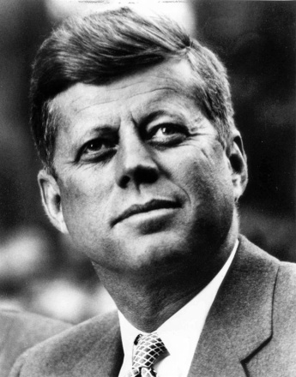

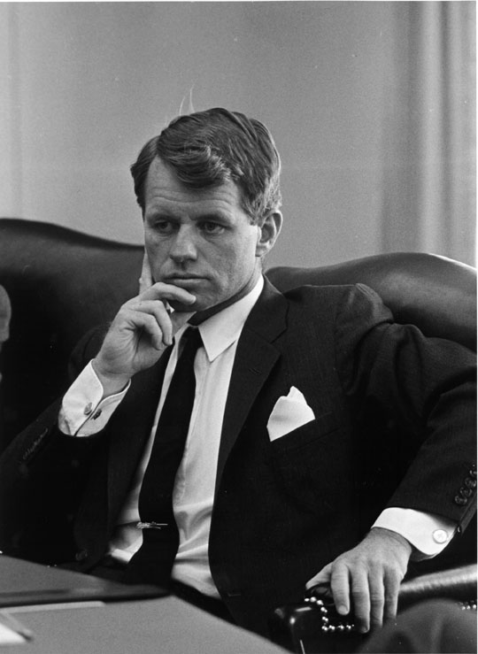

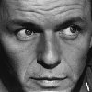

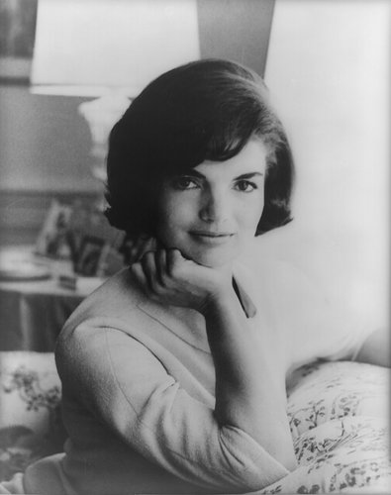

facebook
Wall
Photos
Flair
Boxes
John F. Kennedy
Logout
John F. Kennedy is preparing to sign the Nuclear Test Ban Treaty
Wall
Info
Photos
Boxes
Write something…
Share
View photos of JFK (5)
Send JFK a message
John F. Kennedy is preparing to sign the Nuclear Test Ban Treaty
October 7, 1963
Poke message
Bobby Kennedy to John F. Kennedy Have you finalized your plans for the Texas trip?
October 1, 1963
Information
Networks:
Washington D.C.
Birthday:
May 29, 1917
Political:
Democrat
Religion:
Catholic
Hometown:
Brookline, Mass.
John F. Kennedy I can’t believe I had to actually send the National Guard to Alabama just so some kids could go to college!
June 11, 1963
John F. Kennedy is so glad we avoided war with the Russians! That Crisis in Cuba had my blood boiling!
October 28, 1962
Friends
John F. Kennedy hopes everyone realizes how serious I am about putting a man on the moon!!!
September 9, 1962
LBJ
Frank
Marilyn
John F. Kennedy wishes the Bay of Pigs invasion had gone better! I think Castro is going to be a major thorn in the side of the U.S.
April 17, 1961
Bobby
Jackie
Robert

Slide 32
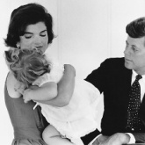
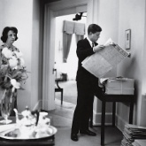
facebook
Wall
Photos
Flair
Boxes
John F. Kennedy
Logout
John F. Kennedy is preparing to sign the Nuclear Test Ban Treaty
Wall
Info
Photos
Boxes
Basic Information
Networks: Washington D.C.
Sex: Male
Birthday: May 29, 1917
Hometown: Brookline, Massachusetts
Relationship Status: Married to Jacqueline Kennedy
Political Views: Democrat
Religious Views: Catholic
View photos of JFK (5)
Send JFK a message
Poke message
Personal Information
Information
Activities: Commanding the Army, making peace with the Soviet Union, promoting civil rights,
Interests: Sailing, Football, Summers in Hyannis, Space Exploration
Favorite Music: Frank Sinatra, Dean Martin, Sammy Davis, Jr.
Favorite Movies: Some Like it Hot, Gentleman Prefer Blondes, Ocean’s Eleven, Guys and Dolls
Favorite TV Shows: The Ed Sullivan Show, The Frank Sinatra Show, To Tell the Truth
Favorite Books: The Road Not Taken, From Russia With Love, Marlborough, Decline and Fall of the Roman Empire
Networks:
Washington D.C.
Birthday:
May 29, 1917
Political:
Democrat
Religion:
Catholic
Hometown:
Brookline, Mass.
Photos
Contact Information
2 Albums
Address: 1600 Pennsylvania Avenue NW, Washington, DC 20500
Phone Number: (202) 456-1111
The Family
Updated last Tuesday
White House
Updated two months ago

Slide 33
Before Friday, you need to have read your assigned reading, and complete the task listed below.
  Create a Facebook page for the one of the characters in your current reading section.
  Create 3 Costa Questions concerning the story to have ready for discussion. OPTION 1 KIDS ONLY
  Do in-depth question listed below.

Slide 34
Name: ____________________ Period: ___
Socratic Seminar #3 Title of Book: ________________________ Group # ___
Before this seminar, you need to have read your assigned reading, and complete the task listed below.
  Create a Facebook page for the one of the characters in your current reading section.
  Create 3 Costa Questions concerning the story to have ready for discussion. OPTION 1 KIDS ONLY
  Complete 2 quotes/responses. Make sure they are important to the book.
  Do Indepth question listed below.
Question 1: (Level 1) __________________________________________________________________________________________________________
Question 2: (Level 2) __________________________________________________________________________________________________________
Question 3: (Level 3) __________________________________________________________________________________________________________
In-depth Question: If you were stuck on an isolated island, who would be the best character to have with you? Why? Which character would be the worst character to be stuck with? Why? Remember to include a quote and page number from your current assigned reading to support this.
_________________________________________________________________________________________________________________________________________________________________________________________________________________________________________________________________________________________________________________________________________________________________________________________________
Option 1 Kids for a 10/10

Slide 35
Name: ____________________ Period: ___
Socratic Seminar #3 Title of Book: ________________________ Group # ___
Before this seminar, you need to have read your assigned reading, and complete the task listed below.
  Create a Facebook page for the one of the characters in your current reading section.
  Create 3 Costa Questions concerning the story to have ready for discussion. OPTION 1 KIDS ONLY
  Complete 2 quotes/responses. Make sure they are important to the book.
  Do Indepth question listed below.
Question 1: (Level 1) __________________________________________________________________________________________________________
Question 2: (Level 2) __________________________________________________________________________________________________________
Question 3: (Level 3) __________________________________________________________________________________________________________
In-depth Question: If you were stuck on an isolated island, who would be the best character to have with you? Why? Which character would be the worst character to be stuck with? Why? Remember to include a quote and page number from your current assigned reading to support this.
_________________________________________________________________________________________________________________________________________________________________________________________________________________________________________________________________________________________________________________________________________________________________________________________________
Option 2 Kids: Cross out!!!!!!

Slide 36
Before this seminar, you need to have read your assigned reading, and complete the task listed below.
  Create a Visual Book Mark. Draw a picture and answer all questions on the back.
  Create 5 Costa Questions concerning the story to have ready for discussion.
  Complete 2 quotes/responses. Make sure they are important to the book.
  Do indepth question listed below.

Slide 37
Name: ____________________ Period: ___
Socratic Seminar #3 Title of Book: ________________________ Group # ___
Before this seminar, you need to have read your assigned reading, and complete the task listed below.
  Create a Facebook page for the one of the characters in your current reading section.
  Create 3 Costa Questions concerning the story to have ready for discussion. OPTION 1 KIDS ONLY
  Complete 2 quotes/responses. Make sure they are important to the book.
  Do Indepth question listed below.
Question 1: (Level 1) __________________________________________________________________________________________________________
Question 2: (Level 2) __________________________________________________________________________________________________________
Question 3: (Level 3) __________________________________________________________________________________________________________
In-depth Question: If you were stuck on an isolated island, who would be the best character to have with you? Why? Which character would be the worst character to be stuck with? Why? Remember to include a quote and page number from your current assigned reading to support this.
_________________________________________________________________________________________________________________________________________________________________________________________________________________________________________________________________________________________________________________________________________________________________________________________________

Slide 38
Before this seminar, you need to have read your assigned reading, and complete the task listed below.
  Create a Visual Book Mark. Draw a picture and answer all questions on the back.
  Create 5 Costa Questions concerning the story to have ready for discussion.
  Complete 2 quotes/responses. Make sure they are important to the book.
  Do in-depth question listed below.

Slide 39

Indepth Question:
Indepth Question: If you were stuck on an isolated island, who would be the best character to have with you? Why? Which character would be the worst character to be stuck with? Why? Remember to include a quote and page number from your current assigned reading to support this.
Yes, include a page number.

Slide 40
Option 1 Kids – Homework
Option 2 Kids- Start Today …
Socratic
Seminar
# 3
Paperwork

Slide 41
Time to Begin
Socratic Seminar
# 3
Remember to make your
points count.
Today is heavily weighted.

Slide 42
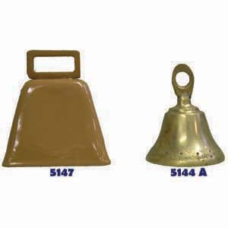
Wait for the Bell.
Final 12 minutes will be for you to do your Group’s Debrief.

Slide 43
Please, do your debrief.
Submit in this order:
1. Debrief paper: Side One
2. Socratic Seminar 2 Handout

Slide 44
Names | Student arrived with a ‘stamped’ paperwork. | Student helped with discussion & it was apparent they were up to date on their reading. | Student was commendable on their behavior, and was truly on task the entire time. | Today’s score:
 | YES / Somewhat / No 20 / 15 / 0 | YES / Somewhat / No 15 / 10 / 0 | YES / Somewhat / No 15 / 10 / 0
 | YES / Somewhat / No 20 / 15 / 0 | YES / Somewhat / No 15 / 10 / 0 | YES / Somewhat / No 15 / 10 / 0
 | YES / Somewhat / No 20 / 15 / 0 | YES / Somewhat / No 15 / 10 / 0 | YES / Somewhat / No 15 / 10 / 0
 | YES / Somewhat / No 20 / 15 / 0 | YES / Somewhat / No 15 / 10 / 0 | YES / Somewhat / No 15 / 10 / 0
 | YES / Somewhat / No 20 / 15 / 0 | YES / Somewhat / No 15 / 10 / 0 | YES / Somewhat / No 15 / 10 / 0
The Debrief

Slide 45
Names | Student arrived with a ‘stamped’ paperwork. | Student helped with discussion & it was apparent they were up to date on their reading. | Student was commendable on their behavior, and was truly on task the entire time. | Today’s score:
 | YES / Somewhat / No 20 / 15 / 0 | YES / Somewhat / No 15 / 10 / 0 | YES / Somewhat / No 15 / 10 / 0
 | YES / Somewhat / No 20 / 15 / 0 | YES / Somewhat / No 15 / 10 / 0 | YES / Somewhat / No 15 / 10 / 0
 | YES / Somewhat / No 20 / 15 / 0 | YES / Somewhat / No 15 / 10 / 0 | YES / Somewhat / No 15 / 10 / 0
 | YES / Somewhat / No 20 / 15 / 0 | YES / Somewhat / No 15 / 10 / 0 | YES / Somewhat / No 15 / 10 / 0
 | YES / Somewhat / No 20 / 15 / 0 | YES / Somewhat / No 15 / 10 / 0 | YES / Somewhat / No 15 / 10 / 0

Slide 46
BACKSIDE
What are the essential guiding questions that drove today’s discussion? ______________________________________
What were the most important ideas expressed during the conversation? ____________________________________
At what point did the conversation dive into a deeper level? What particular response or question created that change? _________________________________________
What were your overall impressions of the seminar discussion? ______________________________________
What went well during this seminar discussion?
What needs to be improved? ________________________
On a 1 – 10 scale, how would you rank today’s Socratic Seminar?
1 - 2 - 3 - 4 - 5 - 6 - 7 - 8 - 9 - 10
8. Before your next seminar, how many pages/chapters does your group need to have read?
__________ Pages or ________ chapters

Slide 47
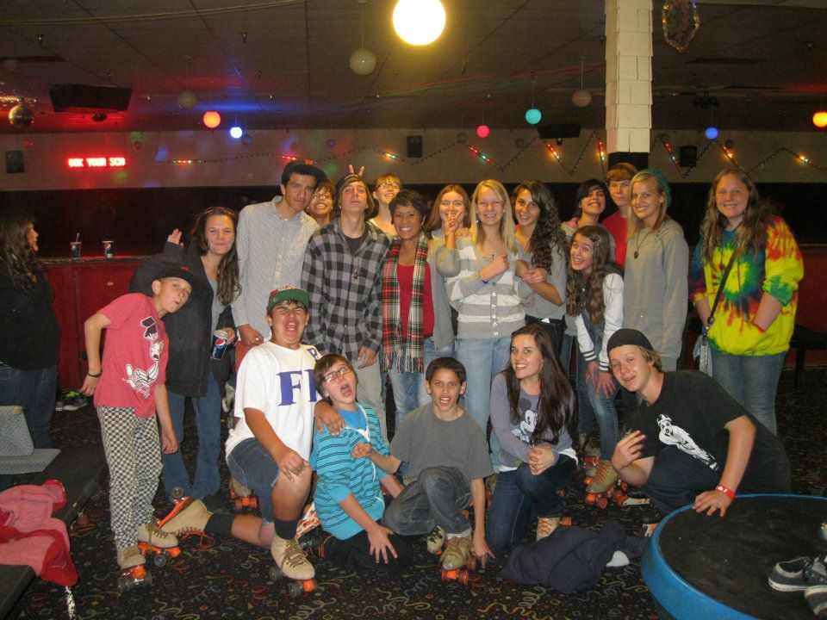
Show your
smarts!
Begin!

Slide 48

News Flash!
Lucerne Valley MHS has been struck!
News at the bell! Please, take out your GIIG and sit for further information.

Slide 49

Time to find out more….

Slide 50

Welcome detectives…
Before we seek evidence from the crime scene…

Slide 51

Now back to the crime…
We now must look at how evidence can be gathered…

Slide 52
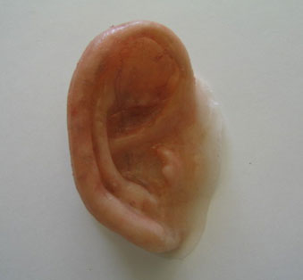

GIIG
Wed. May 2, 2012
The Crime Scene
Homework: Writing Project
Option 1: Read to
Gathering evidence the right way. It’s all in the way how it looks and sounds….

Slide 53
1. We often hang laundry out on the lines that border her rows of blooming things that are beautiful.
A. beautiful garden | B. rows of garden.
C. rows of flowers, so beautiful. | D. Leave as is.

Slide 54
2. The sound of the dull pencil scraping over the paper, annoyed everyone in the library.
A. the pencil that needed sharpening scraping over the paper | B. the dull pencil moving over the paper
C. the pencil that was dull scraping over the paper | D. Leave as is.

Slide 55
3. He treats all with respect, whether he/she is a garbage collector or a bank president.
A. whether you are garbage collectors or a bank president. | B. whether I am a garbage collector or a bank president.
C. whether they’re garbage collectors or a bank president. | D. Leave as is.

Slide 56
4. Zack is gathering ideas for a document about using scissors. Which idea does not belong?
A. Types of items that can be cut by scissors | B. Family members who share scissors
C. Steps in using a pair of scissors | D. A simple description of scissors

Slide 57
GIIG
SWBAT establish coherence within and among paragraphs through effective transitions, parallel structures, and similar writing techniques by solving the crime scene, to discuss a weakness of Benchmark 3. WS 1.2
Gathering evidence the right way. It’s all in the way how it looks and sounds….

Slide 58
The Crime Scene

Slide 59
The Crime Scene
(1) A murder has been committed in the classroom that belongs to Ms. Swank. (2) Apparently, a student snuck in the classroom late at night and was attacked by another person. (3) Very little evidence was left on the decomposing body and by the time the students arrived, the body was taken and the only thing left was a taped lay-out of where the body fell. (4) Red hair samples were found that were not from the victim and the DNA tests will most likely link the killer to being someone who attends or works at the school. (5) They also identified a pair of small foot prints, leading to truck tracks, near the room. (6) The police began questioning all staff and all students, knowing that within a matter of time, they would find the culprit who did the dirty deed if it is truly a person who came from this site.

Slide 60
The Crime Scene
(1) A murder has been committed in the classroom that belongs to Ms. Swank. (2)Apparently, a student snuck in the classroom late at night and was attacked by another person. (3) Very little evidence was left on the decomposing body and by the time the students arrived, the body was taken and the only thing left was a taped lay-out of where the body fell. (4) Red hair samples were found that were not from the victim and the DNA tests will most likely link the killer to being someone who attends or works at the school. (5) They also identified a pair of small foot prints, leading to truck tracks, near the room. (6) The police began questioning all staff and all students, knowing that within a matter of time, they will find the culprit who did the dirty deed if it is truly a person who came from this site.
  1. How can word choice be improved in the underlined part of sentence 1?
  A murder has been committed in a room on campus that belongs to Ms. Swank
  A murder has been committed in Ms. Swank’s classroom.
  A murder has been committed in the classroom.
  Leave as is.

Slide 61
(1) A murder has been committed in the classroom that belongs to Ms. Swank. (2)Apparently, a student snuck in the classroom late at night and was attacked by another person. (3) Very little evidence was left on the decomposing body and by the time the students arrived, the body was taken and the only thing left was a taped lay-out of where the body fell. (4) Red hair samples were found that were not from the victim and the DNA tests will most likely link the killer to being someone who attends or works at the school. (5) They also identified a pair of small foot prints, leading to truck tracks, near the room. (6) The police began questioning all staff and all students, knowing that within a matter of time, they will find the culprit who did the dirty deed if it is truly a person who came from this site.
  2. If the information could transition to a new paragraph, which sentence would be a good starter sentence for the second paragraph.
  A year is a long time, but there is a reason for it.
  Five months plus five months is why it took so long.
  There is a reason why it took so long to figure out who did it.
  Leave as is.

Slide 62
(1) A murder has been committed in the classroom that belongs to Ms. Swank. (2)Apparently, a student snuck in the classroom late at night and was attacked by another person. (3) Very little evidence was left on the decomposing body and by the time the students arrived, the body was taken and the only thing left was a taped lay-out of where the body fell. (4) Red hair samples were found that were not from the victim and the DNA tests will most likely link the killer to being someone who attends or works at the school. (5) They also identified a pair of small foot prints, leading to truck tracks, near the room. (6) The police began questioning all staff and all students, knowing that within a matter of time, they will find the culprit who did the dirty deed if it is truly a person who came from this site.
  3. Which sentence should be placed between 4 and 5 as a transition between the two ideas?
  More people should have red hair.
  DNA tests can be done by a painless cheek- scraping with a swab and sending it in the mail.
  The hair samples were barely noticed because they were only 3 mm in length.
  The students and employees at Lucerne Valley work hard.

Slide 63
(1) A murder has been committed in the classroom that belongs to Ms. Swank. (2)Apparently, a student snuck in the classroom late at night and was attacked by another person. (3) Very little evidence was left on the decomposing body and by the time the students arrived, the body was taken and the only thing left was a taped lay-out of where the body fell. (4) Red hair samples were found that were not from the victim and the DNA tests will most likely link the killer to being someone who attends or works at the school. (5) They also identified a pair of small foot prints, leading to truck tracks, near the room. (6) The police began questioning all staff and all students, knowing that within a matter of time, they will find the culprit who did the dirty deed if it is truly a person who came from this site.
4. Which sentence should be placed between sentence 5 and 6 as a transition between the two ideas?
The police got tired.
A murder can be a messy circumstance.
One time the staff members volunteered to conduct the investigation.
Unfortunately, finding the murderer was more difficult than expected because the math just didn’t add up.

Slide 64
The Crime Scene
Your name: _______________________ Period: __
1.
2.
3.
4.
5. Who is the murderer? _________________

Slide 65

Now to show me you ‘get it.’

Slide 66
Please, turn your paper over!

Slide 67
GIIG ~
Grammar
Thursday 5/3/2012
GIIG –Grammar
CW: SS2 handout
HW: Finish handout and writing project
Option 1 kids: Read to page 58
What is the tone and Setting, and why? (#13)
My desk–
My haven after school,
My captive friend who has no choice but to listen
To my off–tune singing, quiet mutterings to myself,
While I crunch numbers, potato chips, pen lids, and rough drafts
That finally come to rest in an overflowing round file.
________________________________ ________________________________

Slide 68
GIIG ~
Grammar
SWBAT Understand and explain the use of a complex mechanical device by following technical directions AND Use information from a variety of consumer documents to explain a situation or decision and to solve a problem to find research regarding how to get into their post-high school plans. RC 2.5 and 2.6
What is the tone and Setting, and why? (#13)
My desk–
My haven after school,
My captive friend who has no choice but to listen
To my off–tune singing, quiet mutterings to myself,
While I crunch numbers, potato chips, pen lids, and rough drafts
That finally come to rest in an overflowing round file.
________________________________ ________________________________

Slide 69
The Confession

Slide 70
Yep, it was me. I’m the culprit who did the crime. Want to know why? I had a fleeting moment to prove that I’m not a laggard teacher, who gets involved in trifling issues. I didn’t mean any harm; I was actually trying to show a reconciliatory gesture towards the student, but in my haste, they slipped and fell.

Slide 71
Guest speaker today!
With Mrs. Bohner, our college and career lady!
Be seated quietly, right away, so we can get some good information!
Also, please know I will be pulling a couple of you aside to help out with research.
GIIGS will be collected. Have them out!

Slide 72
GIIG ~
Grammar
Monday, 5/7/2012
GIIG – setting/mood
CW: Facebook page and reading
HW: Writing Project
Option 1 kids: Read to page
How does the setting effect the mood? (#12)
My desk–
My haven after school,
My captive friend who has no choice but to listen
To my off–tune singing, quiet mutterings to myself,
While I crunch numbers, potato chips, pen lids, and rough drafts
That finally come to rest in an overflowing round file.
________________________________ ________________________________

Slide 73
GIIG ~
Grammar
SWBAT Present detailed evidence, examples, and reasoning to support arguments, differentiating between facts and opinion & support theses or conclusions, quotations, opinions from authorities, comparisons, and similar devices by completing the essay outline. WA 2.4
How does the setting effect the mood? (#12)
My desk–
My haven after school,
My captive friend who has no choice but to listen
To my off–tune singing, quiet mutterings to myself,
While I crunch numbers, potato chips, pen lids, and rough drafts
That finally come to rest in an overflowing round file.
The setting is a quiet room. The mood is thoughtful.

Slide 74
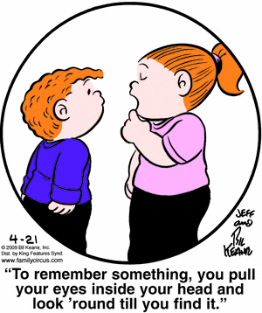
Happy Testing!
Show your smarts
you deserve it!

Slide 75
Jack: I have every faith in your reconciliatory navigational skills, Master Gibbs… We have a need to travel upriver.
Gibbs: By need, do you mean a trifling need, fleeting, as in, say, a passing fancy?
Jack: No, a resolute and unyielding need.
Will: … We need to…. Make sail for Port Royale with all haste.
Jack: William, I shall trade you the compass if you will help me to find this. (Shows a drawing of a key)
Will: You want me to find this?
Jack: No, you want to find this. Because the finding of this finds you incapacitorially finding and or locating, in your discovering, the detecting a way to save your dolly bell…

Slide 76
Reconciliatory
Trifling
Fleeting
Resolute
Unyielding
Haste
incapacitorially
Making consistent
Unimportant
Disappearing quickly
Determined
Stubborn
Speed
Made up word, meaning, doing so

Slide 77
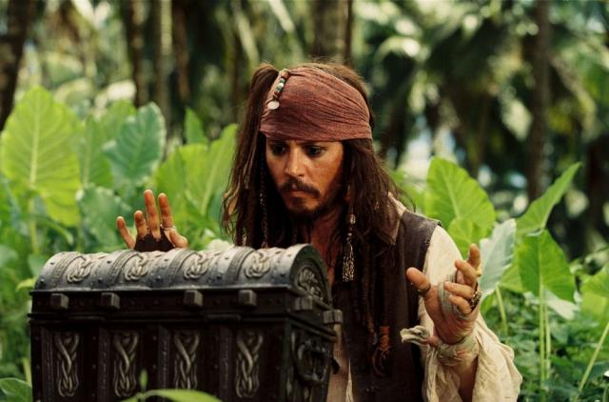
Were you right?

