Slide 1
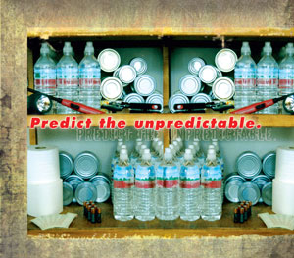
Making Mondays Matter
Monthly
Monday, 12/3 and Tuesday, 12/4
Review chapters 1-6
Read Chapters 7-9
Complete Quote tracker
Complete Mini Script
Mock Trial Case
In a paragraph, come up with the following to share with your family:
Develop a family communication plan by selecting a person outside the high desert for everyone to call
Designate two meeting locations

Slide 2
Making Mondays Matter
Monthly
SWBAT Determine the relationship between the purposes and different forms of poetry (e.g., ballad, lyric, couplet, epic, elegy, ode, sonnet) and analyze metaphors, and similes by reading their peer’s differentiated Titanic poem. LRA 3.1
FACTS
On average, 1,300 tornadoes are reported annually in the U.S.
The average twister path is 660 feet wide and can be as long as 50 miles.
40 states are considered at risk of an earthquake.
More deaths occur due to extreme heat and cold than from hurricanes, lightning, tornadoes, floods, and earthquakes combined.
Because of contamination, clean water is harder to find than food after a flood.
91% of people surveyed agree that it is important to be prepared for emergencies, but only 55% said that they had taken any steps to prepare.
Disasters are never planned, but they will happen. They are inevitable. Being prepared is the only thing you can do. Having proper supplies and a well thought-out plan can make all the difference in your survival. Readiness will also reduce fear, anxiety, and potential losses. Prepare today … for any kind of tomorrow.
In a paragraph, come up with the following to share with your family:
Develop a family communication plan by selecting a person outside L.V. for everyone to call
Designate a two meeting locations.

Slide 3
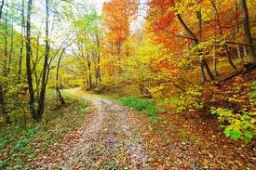
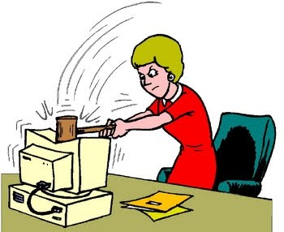

Wed Dec 5 and Thur Dec 6
GIIG – Vocab
Finish Mock Trial
Review Chap 7-9; perform skits
Read chapter 8-10; quote tracker
Monster Post Card
Homework: Find a beauty article
GIIG-
Contextual Vocab
A. lacking self confidence
B. shedding foliage
C. injurious
1. deciduous
2. deleterious
3. diffident
Match the words
To the definitions

Slide 4
Wed Dec 5 and Thur Dec 6
GIIG – Vocab
Finish Mock Trial
Review Chap 7-9; perform skits
Read chapter 8-10; quote tracker
Monster Post Card
GIIG-
Contextual Vocab
1. deciduous
2. deleterious
3. diffident
B. shedding foliage
C. injurious
A. lacking self confidence

Slide 5
Thur. 11/29 and Fri. 11/30
GIIG
Vocab Quiz
Theme
Read chap 5-7
Theme Illustrations
Homework: Finish 5-7, quote tracking
GIIG-
Contextual Vocab
churlish
circumlocution
circumnavigate
He is a valiant as the lion, VULGAR as the bear
He had an earnest desire to tantalize a listener by INDIRECT LANGUAGE/UNNECESSARILY WORDY
No doubt the whale had thrice PROCEED AROUND the globe

Slide 6
Post Card Requirements
http://www.teachersproperty.com/images%5Csamples%5CSamples_Enlarged_Postcard_Activity.pdf
You must complete 1 post card for each chapter
The monster is the writer of the post card. the letter writer. Most likely you will want him to write to Victor Frankenstein. The letter must be written in first person.
It must include:
  a relevant date based on the setting of the book (the 1790s) ,
  a greeting/salutation (Dear, ),
  the body (one paragraph of at least five sentences, and one original quote)
  a closing
  A cute (and relevant) stamp
The letter must have correct spelling and follow proper
grammar rules.
Additionally, it must be legible and neatly written or typed

Slide 7
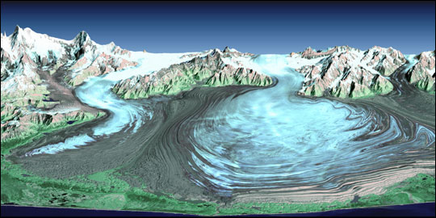

Slide 8

Post Card Sample
Dec 2, 1792
Dear Creator,
1 “Yet I ask you not to spare me; listen to me” (69). 2. ….............. 3.................4...................
5....................
Respectfully,
  Your Creation
Victor Frankenstein 123 Monster Land Ingoldstein, England 12345

Slide 9
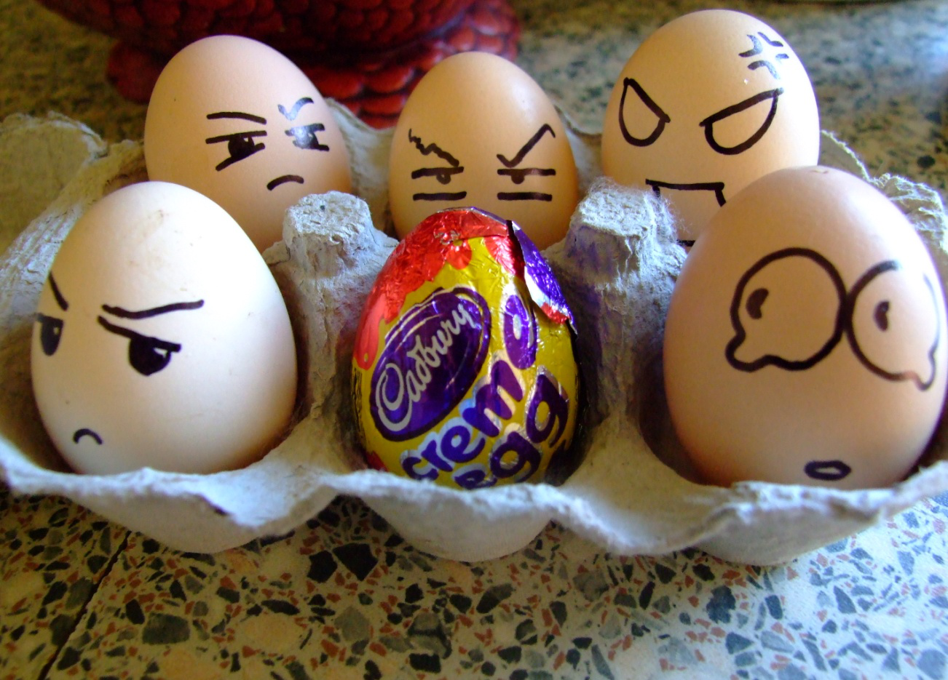
Quick
Write
Friday, 12/7 and Monday, 12/4
Review chapters 10-12
Price of Beauty Video clip
Beauty Artifacts Discussion
Graphic Novel Assignment
Read chapters 13-15
Four Corners Debate
Describe “Exquiste Monster”
What are reasons people get rejected by others? Society? Their peers? When is a time you felt rejected?
30 words

Slide 10
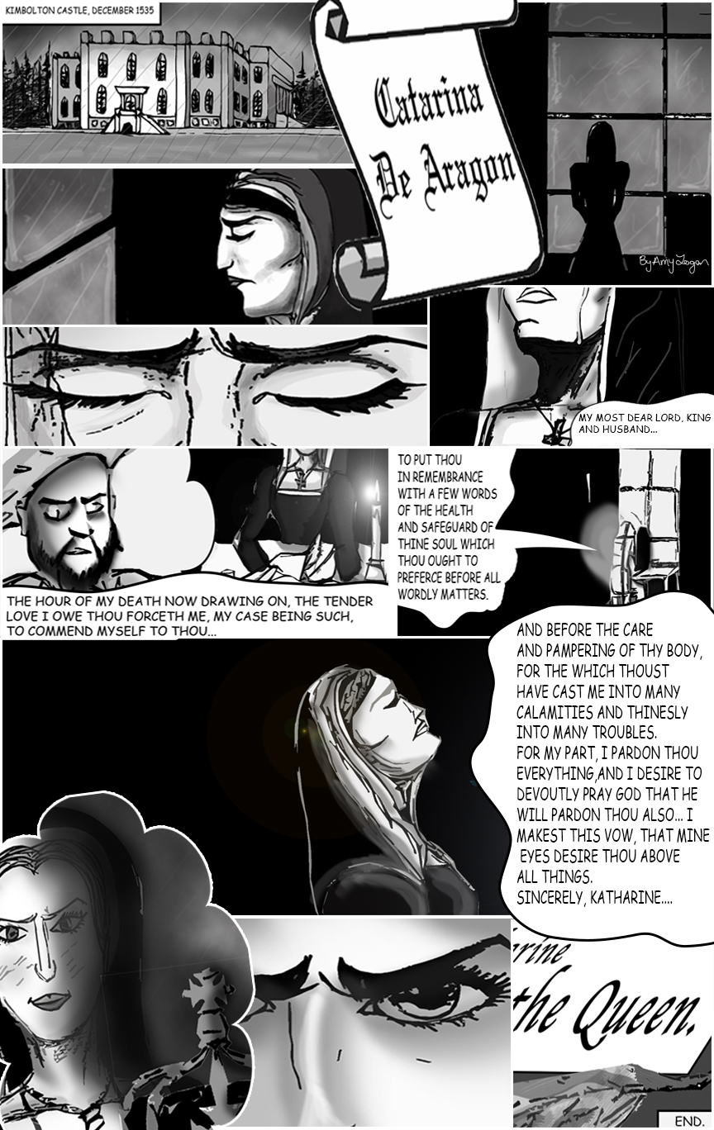

Slide 11
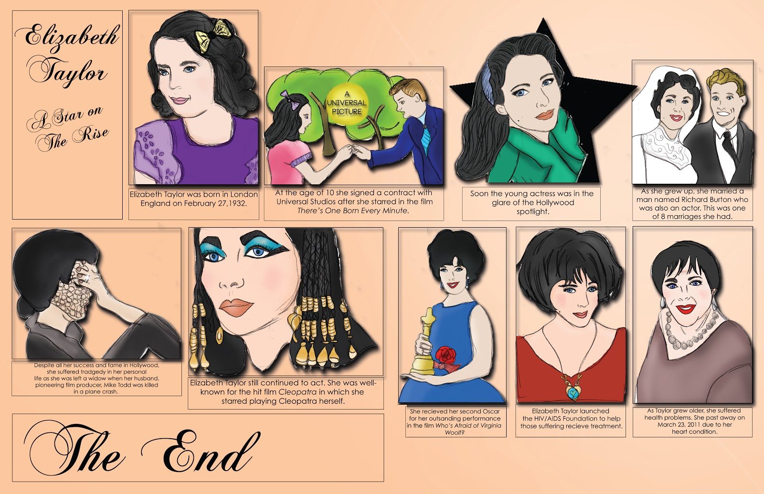

Slide 12
Storyboard Assignment Requirements
http://www.google.com/url?sa=t&rct=j&q=&esrc=s&source=web&cd=1&ved=0CDAQFjAA&url=http%3A%2F%2Fwww.awaytoteach.net%2Ffiles%2FIndependent%2520Novel%2520Storyboard%2520Assignment2h.doc&ei=Ccu-UMKCI8TXigLmm4HwBQ&usg=AFQjCNFBfNTuwvw15oqden602UVogFRpwA
You must include:
  A title picture with author name
  Seven other boxes representing chapters 13-15 of the book.
  Each box should include one sentence regarding the theme, tone, mood, or literary devices, and a MLA parenthetical page citation and a picture or symbol.
The picture/visual may be drawn with colored pencils or computer graphics.
On the back: A one paragraph (7-8 sentences) evaluation of the chapters 13-15.

Slide 13
Include this page inside your final project (unattached)!
Name ______________________________ Independent Book Project
Date ______________ Period______
Title __________________________________________
Cover _____/5
Interior _____/15
8 Plot scenes
Summaries
Quotes w/ pages
Visuals
Back Cover _____/5
Recommendation
Professionalism _____/5
Overall presentation
Formatting (Followed directions)
(Expected-Penalty for negligence) _____ TOTAL= _______/30

Slide 14
Four Corners Decision
http://www.brighthubeducation.com/high-school-english-lessons/38412-frankenstein-lesson-plan-decision-making/

Slide 15
Exquisite MonsterAssignment
Fold a piece of paper in three sections (hot dog style)
Draw a head that would be appropriate and advantageous for the monster’s companion. Make sure the neck continue beyond the line
Pass. Don’t look. Draw a body that would be appropriate and advantageous for the monster’s companion.
Pass. Don’t look. Draw feet/fin that would be appropriate and advantageous

Slide 16
Exquisite Monster Assignment
Meet with your group, and select the best monster to be his companion.
Write a paragraph as a group to explain why your companion is his best option.
Vote on the best choice.
EXTRA CREDIT : Create the monster you just sketched from materials.

