Slide 1
Sorry, you were out. Hope all is well. Please talk with a class mate to find out what you missed. If they are not able to help you, please come see me during study hall or after school tutoring on Wednesdays.

Slide 2
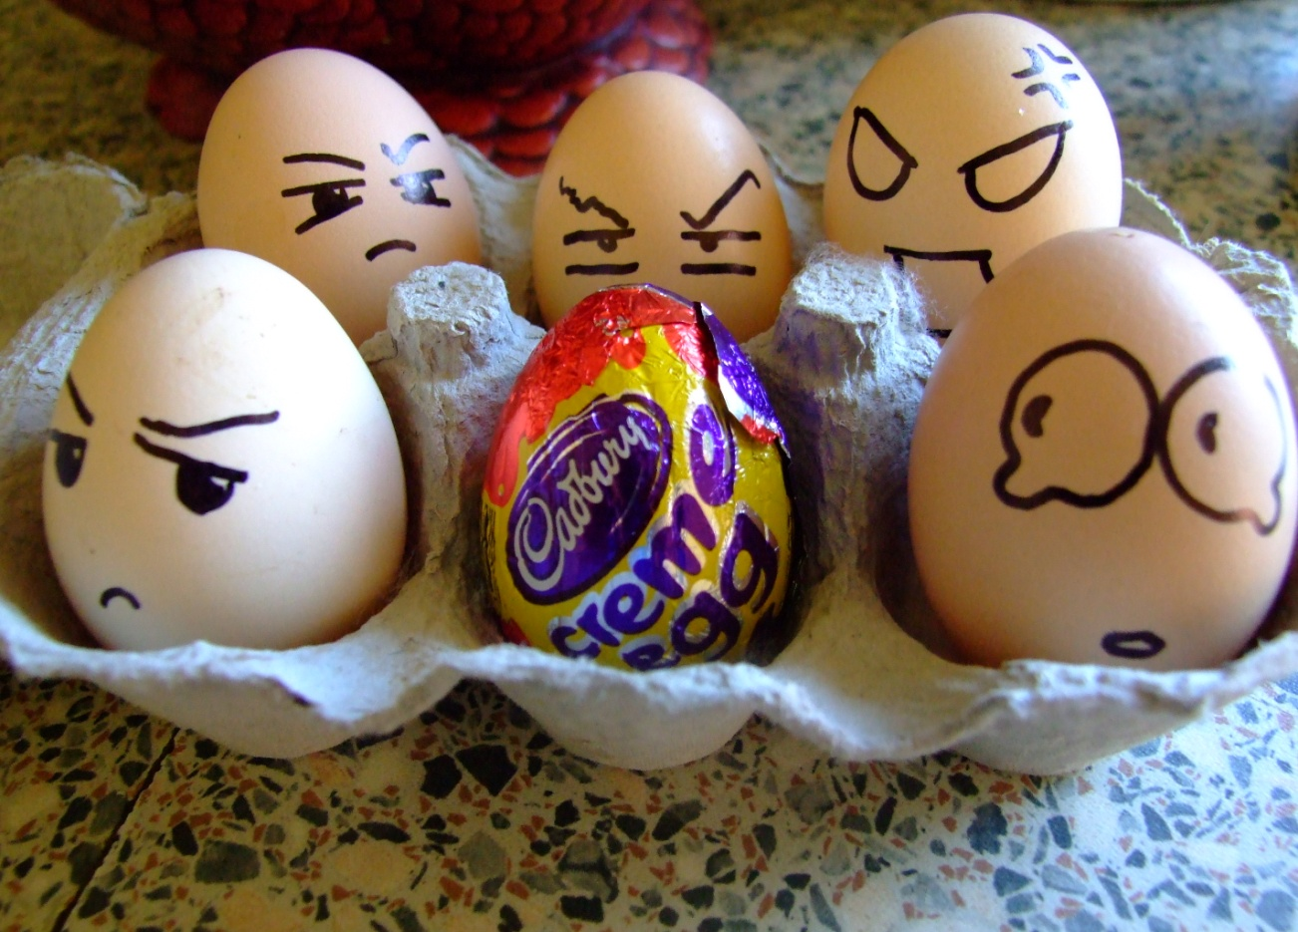
Quick
Write
Friday, 12/7 and Monday, 12/4
Review chapters 10-12
Price of Beauty Video clip
Beauty Artifacts Discussion
Graphic Novel Assignment
Read chapters 13-15
Four Corners Debate
Describe “Exquiste Monster”
What are reasons people get rejected by others? Society? Their peers? When is a time you felt rejected?
30 words

Slide 3
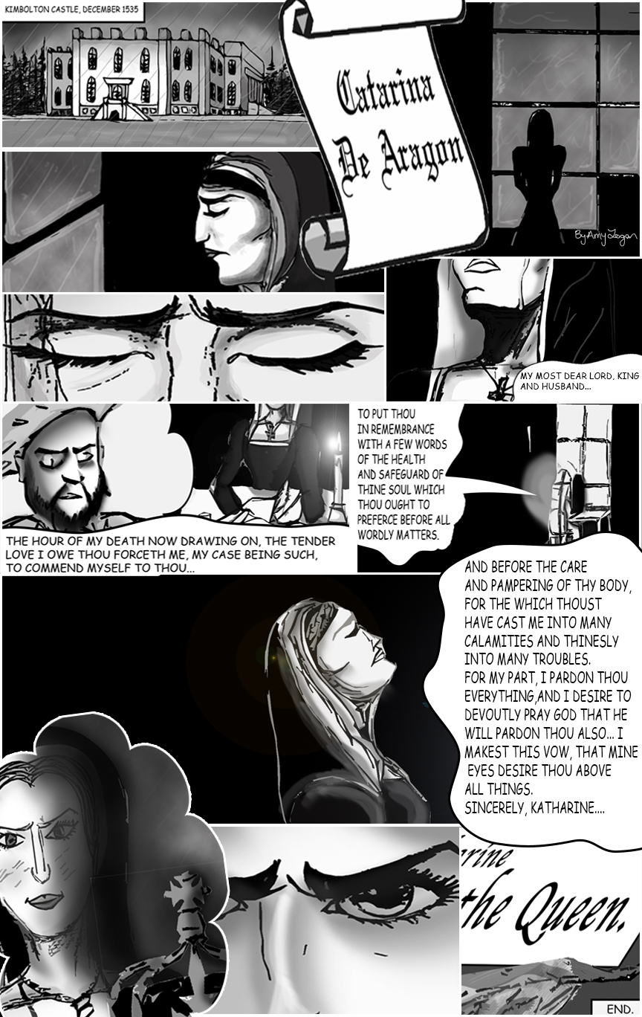

Slide 4
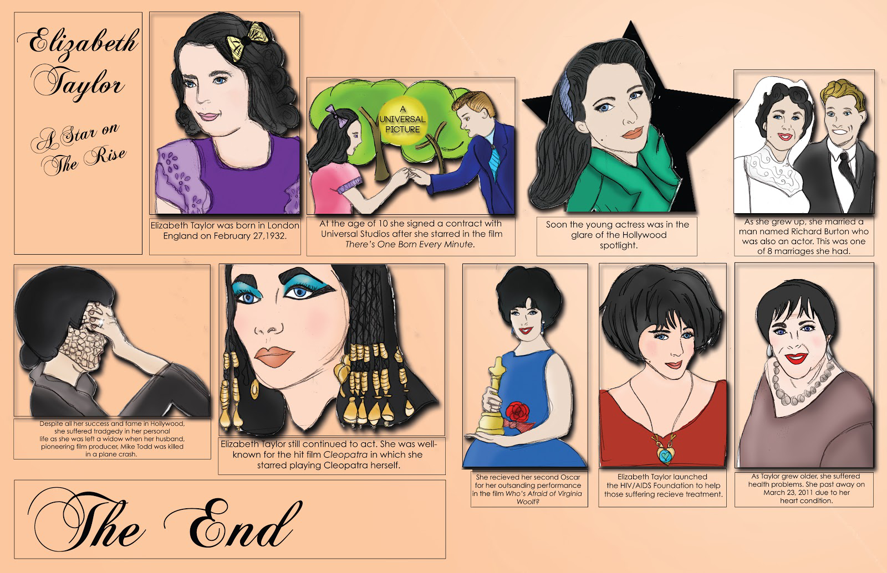

Slide 5
Storyboard Assignment Requirements
http://www.google.com/url?sa=t&rct=j&q=&esrc=s&source=web&cd=1&ved=0CDAQFjAA&url=http%3A%2F%2Fwww.awaytoteach.net%2Ffiles%2FIndependent%2520Novel%2520Storyboard%2520Assignment2h.doc&ei=Ccu-UMKCI8TXigLmm4HwBQ&usg=AFQjCNFBfNTuwvw15oqden602UVogFRpwA
You must include:
  A title picture with author name
  Seven other boxes representing chapters 13-15 of the book.
  Each box should include one sentence regarding the theme, tone, mood, or literary devices, and a MLA parenthetical page citation and a picture or symbol.
The picture/visual may be drawn with colored pencils or computer graphics.
On the back: A one paragraph (7-8 sentences) evaluation of the chapters 13-15.

Slide 6
Include this page inside your final project (unattached)!
Name ______________________________ Independent Book Project
Date ______________ Period______
Title __________________________________________
Cover _____/5
Interior _____/15
8 Plot scenes
Summaries
Quotes w/ pages
Visuals
Back Cover _____/5
Recommendation
Professionalism _____/5
Overall presentation
Formatting (Followed directions)
(Expected-Penalty for negligence) _____ TOTAL= _______/30

Slide 7
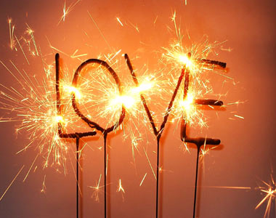
Quick
Write
Tue 12/11 and Wed. 12/12
Review chapters 13-15
Read Chapter 16
Four Corners Activity
“Design a Monster”
Read chapters 17 & 18
Why is love and
companionship an important part of the human experience? What has Mary Shelley suggested about love?
30 words

Slide 8
Quick
Write
Tue 12/11 and Wed. 12/12
Review chapters 13-15
Read Chapter 16
Four Corners Activity
“Design a Monster”
Read chapters 17 & 18
Why is love and
companionship an important part of the human experience? What has Mary Shelley suggested about love?
30 words

Slide 9
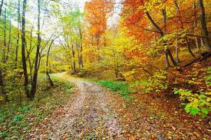
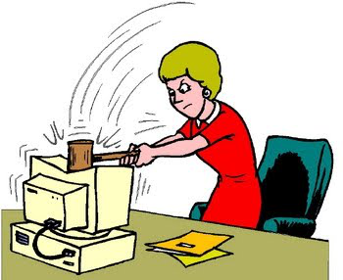

Wed Dec 5 and Thur Dec 6
GIIG – Vocab
Finish Mock Trial
Review Chap 7-9; perform skits
Read chapter 8-10; quote tracker
Monster Post Card
GIIG-
Contextual Vocab
1. deciduous
2. deleterious
3. diffident
B. shedding foliage
C. injurious
A. lacking self confidence

Slide 10
Thur. 11/29 and Fri. 11/30
GIIG
Vocab Quiz
Theme
Read chap 5-7
Theme Illustrations
Homework: Finish 5-7, quote tracking
GIIG-
Contextual Vocab
churlish
circumlocution
circumnavigate
He is a valiant as the lion, VULGAR as the bear
He had an earnest desire to tantalize a listener by INDIRECT LANGUAGE/UNNECESSARILY WORDY
No doubt the whale had thrice PROCEED AROUND the globe
Quiz on
Chap 17 and 18

Slide 11
Four Corners Decision
http://www.brighthubeducation.com/high-school-english-lessons/38412-frankenstein-lesson-plan-decision-making/

Slide 12
Corner 1
Make the mate

Slide 13
Corner 2
Refuse to make the monster.

Slide 14
Corner 3
Agree to make the monster and not actually do it.

Slide 15
Corner 4
Agree to make the monster and while pretending to make it, gather up a posse to hunt him

Slide 16
Wed Dec 5 and Thur Dec 6
GIIG – Vocab
Finish Mock Trial
Review Chap 7-9; perform skits
Read chapter 8-10; quote tracker
Monster Post Card
GIIG-
Contextual Vocab
1. deciduous
2. deleterious
3. diffident
B. shedding foliage
C. injurious
A. lacking self confidence

Slide 17
Exquisite MonsterAssignment
Fold a piece of paper in three sections (hot dog style)
Draw a head that would be appropriate and advantageous for the monster’s companion. Make sure the neck continue beyond the line
Pass. Don’t look. Draw a body that would be appropriate and advantageous for the monster’s companion.
Pass. Don’t look. Draw feet/fin that would be appropriate and advantageous

Slide 18
Exquisite Monster Assignment
Meet with your group, and select the best monster to be his companion.
Write a paragraph as a group to explain why your companion is his best option.
Staple the favorite one on top of all other ones
EXTRA CREDIT : Create the monster you just sketched from materials.

Slide 19

Quick
Write
Thur 12/ 13 and Fri 12/14
Review chapters 16-18
Vocab Quiz (A-C) words
Read chapters 19-21
Quote Group Discussions
Thesis Statement Activity
Submit official thesis statement
Please focus on reading for the next 15 minutes.
Quiz on chapters 17 and 18 coming up next.
30 words

Slide 20
Thur. 11/29 and Fri. 11/30
GIIG
Vocab Quiz
Theme
Read chap 5-7
Theme Illustrations
Homework: Finish 5-7, quote tracking
GIIG-
Contextual Vocab
churlish
circumlocution
circumnavigate
He is a valiant as the lion, VULGAR as the bear
He had an earnest desire to tantalize a listener by INDIRECT LANGUAGE/UNNECESSARILY WORDY
No doubt the whale had thrice PROCEED AROUND the globe
Quiz on
Chap 17 and 18

Slide 21
1. What argument does the monster give to make him a female companion?
2. What keeps Frankenstein from creating a second creature?
3. Extra Credit: Who is Frankenstein supposed to marry?
4. Extra Credit: Why does the creature direct revenge to Frankenstein's wedding?

Slide 22
15 Topics
1. Stem cell research: descriptions of artificial creation
2. protecting the environment: description of the environment
3. abortion: description of Frankenstein's creation of the monster and his desire to kill him
4. global warming: description of the environment
5. education: description of methods of learning
6. death penalty: description of the deaths and the desires to bring them
7. test tube babies: descriptions of artificial creation
8. women's rights: description of the female characters
9. dangerous knowledge: description of the use of knowledge
10. social networking: descrption of communication and invasion of privacy
11. support for arts: desciption of Frankenstein's creation of the monster
12. bigotry: the results of bigotry in Frankenstein
13. equality: the results of unequal opportunities
13.creationism/ intelligent design vs evolution: the results of Frankenstein's creation of the monster
14. family values: description of family interactions

Slide 23
Thesis Statement
Based on the _____________ in Frankenstein, Mary Shelley would seem to believe that (insert controversial topic here) is ________ because (list your main ideas from your quotes here)

