Slide 1

Sorry, you were out. Hope all is well. Please talk with a class mate to find out details
about what you missed. If they are not able to explain things well, see
me during study hall or at after school tutoring on Wednesdays

Slide 2
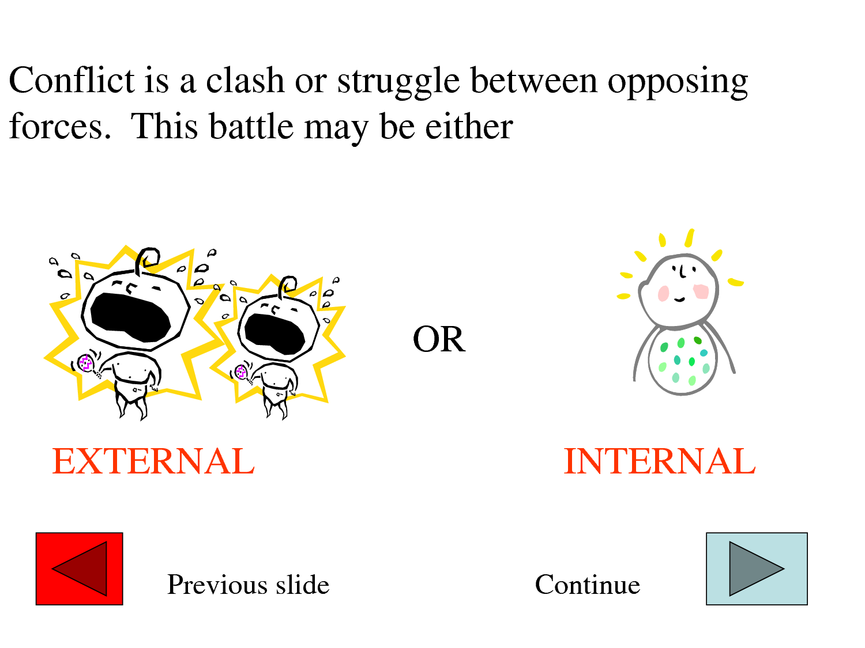
Quick
Write
Monday, 12/17 and Tues, 12/ 18
Review Chap 19-21
Duality/Doppleganger
Read chap 22-24
Describe the conflict in chapters 20-21. Is it external or internal conflict? How does Victor respond?
30 words

Slide 3
First link
http://www.google.com/#hl=en&tbo=d&sclient=psy-ab&q=conflict+handout&oq=conflict+handout&gs_l=hp.3..0j0i5i30l3.2373.6827.0.6925.16.13.0.3.3.0.273.1283.8j3j1.12.0.les%3B..0.0...1c.1.-MbFUnppNwI&pbx=1&bav=on.2,or.r_gc.r_pw.r_qf.&bvm=bv.1355325884,d.cGE&fp=df780ed0043388ab&bpcl=39967673&biw=1024&bih=634
http://www.google.com/#hl=en&tbo=d&sclient=psy-ab&q=conflict+assignment&oq=conflict+assignment&gs_l=hp.3..0j0i5i30l3.60629.63406.1.63641.17.14.0.0.0.2.203.1389.10j3j1.14.0.les%3B..0.0...1c.1.FkX1YwkM-SQ&pbx=1&bav=on.2,or.r_gc.r_pw.r_qf.&bvm=bv.1355325884,d.cGE&fp=df780ed0043388ab&bpcl=39967673&biw=1024&bih=634

Slide 4
http://www.youtube.com/watch?v=9CGIG6Zy_QA

Slide 5
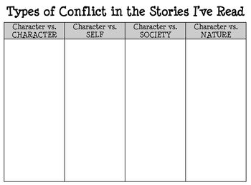
FRANKENSTEIN

Slide 6
Alternative Essay Assignment – For a B
What type of conflict does Dr Frankenstein (or the
monster) struggle with the most? (is it self, other,
nature or society?)
How does the conflict motivate Dr. Frankenstein
(or the monster?)

Slide 7
Study Hall
* Your novel needs to be done for your test next class.
* The novel test is on Wed and Thur
* Hopefully you have your quotes/thesis statement turned in. Otherwise, your
essay score is going to be sad.
* Grades have been updated; there were no name assignments.
* Check the computer to see your grade. One person at a time;
two people in the room at a time.
* Your test for Frankenstein is today.
YOU WILL BE TELLING ME THE SCORE YOU DESERVE FOR STUDY
HALL TODAY AT THE END OF THE CLASS. I WILL BE WATCHING
TO SEE IF I AGREE WITH YOU.
THANK YOU TO uhmmmm.... hmmm... nobody apparently. NO one
Seems to be on task at all. Hmmm... guess no one is getting an
A on their study hall grade this week. That's quite a bummer!

Slide 8
Test Review
Wed 12/19 and thur 12/20
Review Time
Spark Notes Video
Class Discussion
Test Time
Essay Outline
You have 10 minutes on the clock to review Frankenstein.
Create 3 Costa Questions for test review

Slide 9
Intro: (roughly five sentences)
Hook
Transition
Thesis Statement: (Answer “What would Mary Shelley say about your
Controversial topic based on the references to it in Frankenstein?
What are three reasons why? In a complete sentence)
1st Body Paragraph: (repeat three times)
Topic Sentence: Mary Shelley would believe that _________ is _________
because ________________
1st Concrete Detail: For instance, in the novel, “ ________________________
___________” (#).
2-4 Commentaries: This shows that ______________
2Nd Concrete Detail: The research indicates that ______________
2-4 Commentaries: This shows that Mary Shelley would be __________
Closing Sentencence: In concolusion, _____________________________

