Slide 1
Vocab.
Mon 10/8 and Tue 10/9
GIIG – Monthly “Making it Count”
Read pages 141- 153, Costa Qs
African Gallery Walk Activity
Discuss “Exile”
Brainstorm narrative poem
Contextual Clues:
Write what you think the underlined words mean.
1. Nwayieke lived four compounds away, and she was notorious for her late cooking.
2. She remembered that night, long ago, when she had seen Ogbu-agali-odu, one of those evil essences loose upon the world
3. He laughed a mirthless laughter.

Slide 2
Vocab
Contextual Clues:
Write what you think the underlined words mean.
1. Notorious - known widely and unfavorably
2. essences - unchanging nature
3. Mirthless – lacking joy; joyless

Slide 3

wed 10/10 and Thur 10/11
GIIG
read time, pages 154-167 . See homework
Narrative Poem Peer Edit
Dialogue Lesson (see PowerPoint)
Dialogue Creative Writing Assignment
GIIG! DOL
Two Rules for
Quotation Marks when used in creative writing:
Get ready to
copy the
2 rules!
"Ms. Swank, You’re so silly," said the student.
"Thank you!" replied Ms. Swank.
"I take great pride in that."

Slide 4
GIIG!
Two Rules for
Quotation Marks when used in creative writing:
Copy the 2 rules!
Remember to indent and capitalize the first word in the quotation.
"Ms. Swank, you're so weird," said the student.
"Thank you!" replied Ms Swank.
"I take great pride in that."

Slide 5
GIIG!
Two Rules for
Quotation Marks when used in creative writing:
Copy the 2 rules!
Remember to indent and capitalize the first word in the quotation.
Punctuation always go inside quotation marks.
"Ms. Swank, you're so silly," said the student.
"Thank you!" replied Ms. Swank.
"I take great pride in that."

Slide 6

How to use quotation marks correctly when you do creative writing.
2 Rules for quotations.

Slide 7
How to use quotation marks correctly….
Quotation Rules
Rule #1
Remember to indent and capitalize the first word in the quotation.
Rule #2
Punctuation always goes inside quotation marks.

Slide 8

“Quotation Marks”
1. Declarative Quotation:
A declarative quotation is a simple statement spoken by someone.
Example:
“Today is sunny,” she said.
On the reverse side, create a declarative quotation for the student next to you. Let them read it.
On their paper, respond with a declarative quotation as well.

Slide 9
Bring Dialogue to life!
Which type of quotation are you using? | Who is Saying What?

Slide 10
Bring Dialogue to life!
Which type of quotation are you using? | Who is Saying What?
Declarative Quotation:

Slide 11
Bring Dialogue to life!
Which type of quotation are you using? | Who is Saying What?
Declarative Quotation: | Example: “I think you made a mistake,” Jill commented.

Slide 12
Bring Dialogue to life!
Which type of quotation are you using? | Who is Saying What?
Declarative Quotation:
Declarative Quotation:

Slide 13

“Quotation Marks”
2. Exclamatory Quotation
2. An exclamatory quotation is when someone is raising their voice beyond normal.
Example
“I love soccer!” he yelled.
On the reverse side, create an exclamatory quotation for the student next to you. Let them read it.
On their paper, respond with a exclamatory quotation as well.

Slide 14
Bring Dialogue to life!
Which type of quotation are you using? | Who is Saying What?
Declarative Quotation:
Declarative Quotation:
Exclamatory Quotation

Slide 15

“Quotation Marks”
3. Interrogative Quotation
3. An interrogative quotation must be a question to be asked.
Example:
“ Where did you go? ” I asked.
On the reverse side, create an interrogative quotation for the student next to you. Let them read it.
On their paper, respond with a declarative or exclamatory quotation as well.

Slide 16

“Quotation Marks”
4. Split
Quotations
using
one sentence.
Split quotations is where the name of the person who is speaking is in the middle of a broken sentence.
Example:
“When she went to the store,” Martha said, “she bought milk.”
On the reverse side, create a split quotation using one sentence for the student next to you. Let them read it.
On their paper, respond with a split quotation as well.

Slide 17

“Quotation Marks”
5. Split
Quotation
using two sentences
5. Split quotations is when you split two complete sentences with the person’s name that is doing the talking.
Example:
“ Yesterday the class went to the zoo , ” Maria said. “ They saw monkeys. ”
On the reverse side, create a split quotation using two sentences for the student next to you. Let them read it.
On their paper, respond with a split quotation as well.

Slide 18

“Quotation Marks”
6. Embed character emotions, behaviors/actions into dialogue.
On the reverse side, choose
any type of quotation and enhance it.
6. Enhanced
dialogue
“I am so scared of fire,” the monster said, as he pushed himself away.

Slide 19
Quotation Quiz
Exclamatory Quotation
Split Quotations using one sentence
Interrogative Quotation
Declarative Quotation

Slide 20
Who Are You?
Where Are You?

Slide 21
Who Are You?
Where Are You?

Slide 22
How to Get Today’s A
Shoot for 50 !

Slide 23
How to Get Today’s A
Shoot for 50 !
30 points = ¾ page story
10 points = ¼ page story
40 points = full page story
20 points = ½ page story

Slide 24
How to Get Today’s A
Shoot for 50 !

Slide 25
How to Get Today’s A
Shoot for 50 !
40 points = full page story
30 points = ¾ page story
20 points = ½ page story
10 points = ¼ page story
You get an additional 2 points for every CRT term used correctly, making sure it is underlined as well.
Use all 6 types of dialoguing:
Declarative
Exclamatory
Interrogative
Split quotations using one sentence
Split quotations using two sentences
Enhanced dialogue

Slide 26
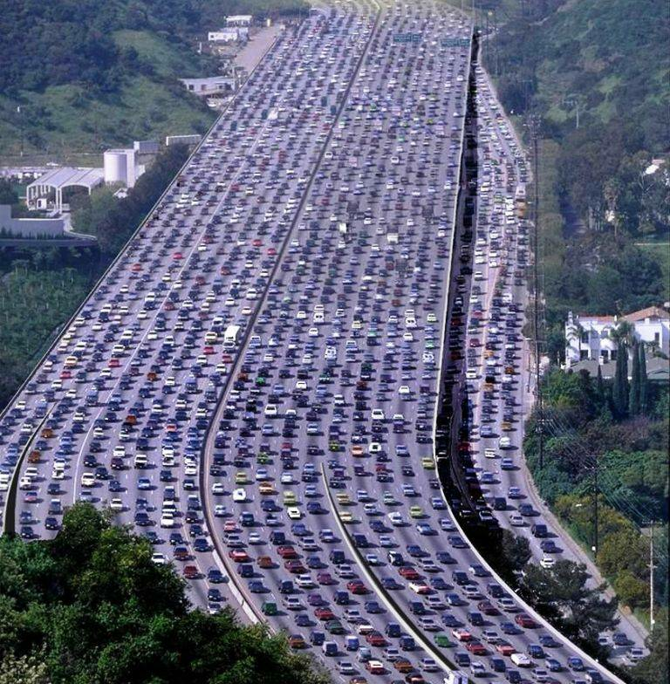

Slide 27

Shoot for a full page plus 2 points for dialogue used correctly from list. Remember to underline them!
Use all 6 types of dialoguing:
Declarative
Exclamatory
Interrogative
Split quotations using one sentence
Split quotations using two sentences
Enhanced dialogue

Slide 28
The people were driving in the second lane, blaring their music and laughing, as they were heading to the beach for the day. Then, all of a sudden…
“Ahhhhhh!” they all screamed. (exclamatory)
“Where did you learn to drive?” Jesus asked. (interrogative)
“I didn’t learn to drive,” Jesus said, “I am joy riding the car.” (split quotation with one sentence)
“ We’re all going to die!” Noel yelled, as he slapped the passenger. (split quotation using two sentences)

Slide 29
The people were driving in the second lane, blaring their music and laughing, as they were heading to beach for the day. Then, all of a sudden…
“Ahhhhhh!” they all screamed.
“Where did you learn to drive?” Jesus asked.
Use all 6 types of dialoguing:
Declarative
Exclamatory
Interrogative
Split quotations using one sentence
Split quotations using two sentences
Enhanced dialogue

Slide 30
The people were driving in the second lane, blaring their music and laughing, as they were heading to beach for the day. Then, all of a sudden…
“Ahhhhhh!” they all screamed.
“Where did you learn to drive?” Jesus asked.
Use all 6 types of dialoguing:
Declarative
Exclamatory
Interrogative
Split quotations using one sentence
Split quotations using two sentences
Enhanced dialogue

Slide 31
Shoot for a full page plus 2 points for any word used correctly from list. Remember to underline them!
blunt
brazen
pun
dismal
kindling
reverie
separation
evacuation
enclosure
transition
measuring

Slide 32
Shoot for a full page plus 2 points for any word used correctly from list. Remember to underline them!
blunt
brazen
pun
dismal
kindling
reverie
separation
evacuation
enclosure
transition
measuring

Slide 33
You have 4 minutes
to wrap up
your story!

Slide 34
Time to
Collect !

Slide 35

GIIG
Focus Lesson
Tuesday 10/11/2011
GIIG FANBOYS
Playing Detective with One Summer Night
Write each sentence and note which literary device is being acknowledged.
1 point
Hyperbole
Personification
Simile
Metaphor
Korina is the energizer bunny all day long. (1/2 point) metaphor (1/2 point)
She is like the energizer bunny. (1/2 point) simile (1/2 point)
Her necklace shimmied when it moved. (1/2 pt) personification (1/2 point)
Her stamina is a high powered rocket shooting to the moon. (1/2) hyperbole (1/2pt)

Slide 36
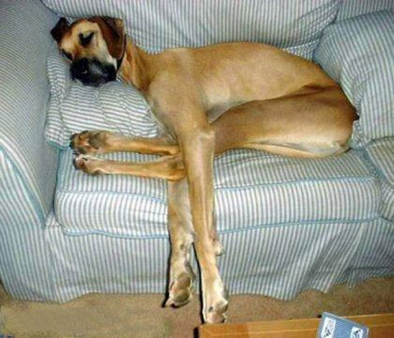
GIIG
DOL
Wednesday 10/12/2011
~ Sat Vocab Quiz
~ Introduce new words
What is an appositive?
1 point
Clue #1A: The old dog, a mangy beast, sleeps soundly on the couch
1 point .
Clue #1B: The old dog sleeps soundly on the couch 1 point
Clue #2A: The old dog, Beasley, sleeps soundly on the couch. 1 point
Clue #2B: The old dog sleeps soundly on the couch. 1 point

Slide 37
GIIG!
Thur. 10/13/2011
GIIG
Dialoguing a Conversation
Two Rules for
Quotation Marks when used in creative writing: (1 point)
Copy the 2 rules!
Remember to indent and capitalize the first word in the quotation. 2 point
Punctuation always go inside quotation marks. 2 point
"Ms. Swank, you're so silly," said the student 1 point.
"Thank you!" replied Ms. Swank.
"I take great pride in that.“ 1 point

Slide 38
Vocab
wed 10/10 and Thur 10/11
GIIG
read time, pages 154-167 . See homework
Narrative Poem Peer Edit
Dialogue Lesson (see PowerPoint)
Dialogue Creative Writing Assignment
Contextual Clues:
Write what you think the underlined words mean.
1. Notorious - known widely and unfavorably
2. essences - unchanging nature
3. Mirthless – lacking joy; joyless

Slide 39
Writing Prompt
Friday, 10/5 and Monday, 10/7
GIIG
Read time, pages 141- 153. Costa Questions
TFA, Vocab and Narrative Quiz next class
Writing a Narrative Poem
.
Many changes happened in Okonkso’s village and the surrounding areas. You, as a young member of the village, want to institute yet another change.
Your assignment is to think of a change you would make in the daily life/customs of the village.
Present your ideas to the egwugwu to persuade them to approve of your idea.
7 sentences = A
6 sentences = B
5 sentences = c
Include at least two concrete details with MLA page citations to support your reason that the change needs to happen

