Slide 1
Mon 9/10 and Tue 9/11 | Wed 9/12 and Thur 9/13 | Fri 9/14 and Mon 9/17
Student Planner GIIG – Contextual Vocab Punctuation Review KWL chart Intro to TFA 15 minutes read time | student planner GIIG – Nonfiction Assignment characterization 15 minutes read time | Student Planner GIIG - Conjunctions 15 minutes read time Become a Character scenes TFA and vocab quiz
Homework Read pages 1-14 Reading log | Read pages 15- 25 Study vocab | Read pages 26- 42 nonfiction assignment Reading Log Due

Slide 2
Tue 9/ 18 and Wed 9/19 | Thur 9/20 Fri 9/21
student planner GIIG – adjectives Chronology Time Line 15 minutes read time | Student Planner GIIG - contextual vocab Nonfiction Presentations Venn Diagrams 15 minutes read time
Read pages 43- 64 nonfiction assignment | Read pages 65- 86 Reading Log Due

Slide 3
GIIG: DOL
Mon 9/10 and Tue 9/11
GIIG – Contextual Vocab
Punctuation Review
KWL chart
Intro to TFA
review vocab
15 minutes read time
Contextual Clues
Write what you think
the underlined words mean
In his day he was lazy and improvident and was quite incapable of thinking about tomorrow.
It was deeper and more intimate than the fear of evil and capricious gods and of magic and the fear of the forest.
Okonkwo’s first son, Nwoye, was then twelve years old but was already causing his father great anxiety for his incipient laziness.

Slide 4
GIIG: DOL
Mon 9/10 and Tue 9/11
GIIG- complete subject
PORTFOLIO
NO NAME CALLING LOG
LINE GAME
READING LOG DUE FRI
Contextual Clues
Write what you think
the underlined words mean
In his day he was lazy and improvident and was quite incapable of thinking about tomorrow. Not having or showing foresight; thoughtless
It was deeper and more intimate than the fear of evil and capricious gods and of magic and the fear of the forest. Given to sudden changes of mood or behavior
Okonkwo’s first son, Nwoye, was then twelve years old but was already causing his father great anxiety for his incipient laziness. Initial stage

Slide 5
Vocab Review:
Analysis Compare; Comparison Connotation Denotation Discomfort Eagerness Imply, Implies, Implied Inform Interpret Melancholy Nostalgia

Slide 6
objective
optimistic
perspective
persuade
subjective
diction

Slide 7
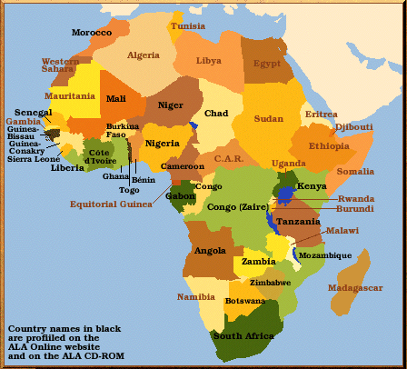

Slide 8
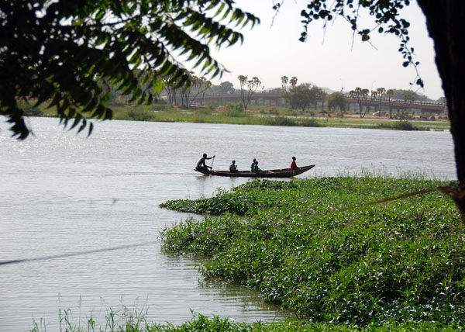

Slide 9
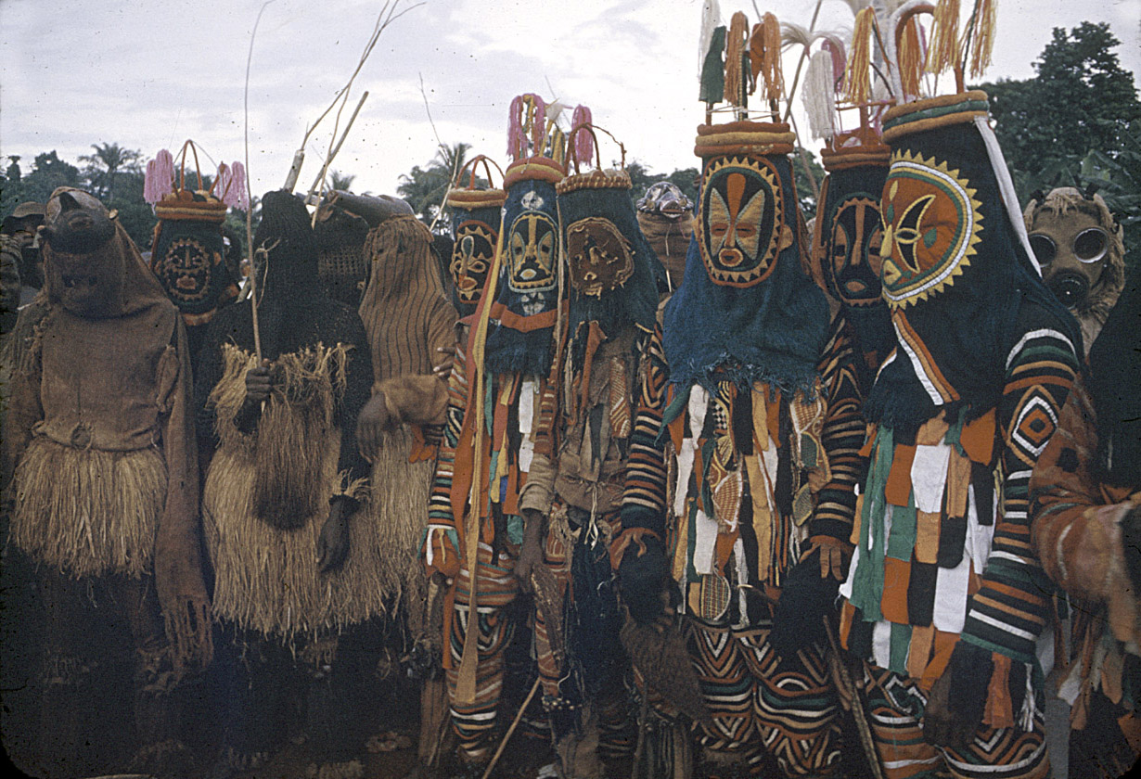
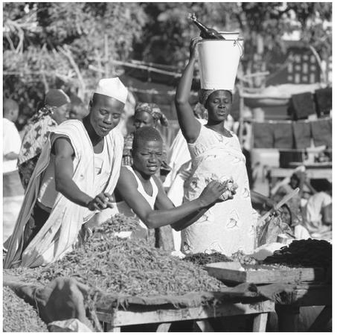
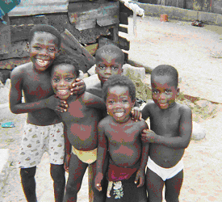

Slide 10
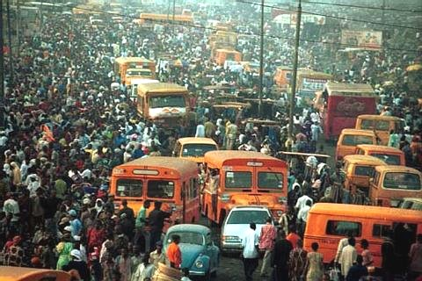
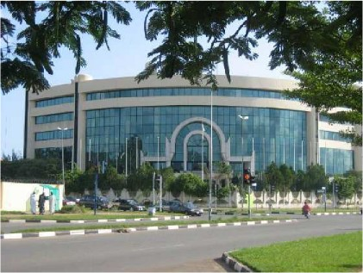
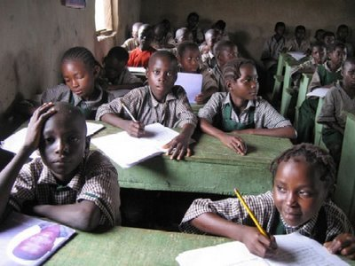

Slide 11
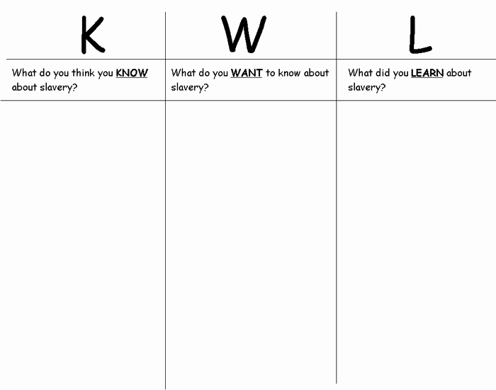
Before reading, think about what you already know about Chinua Achebe and/or Things Fall Apart. Write the information in the K column. Think about what you would like to find out from reading the book. Write your questions in the W column. After you have read the book, use the L column to write the answers to your questions from the W column, and anything else you remember from the book.

Slide 12
BWB Quiz
Sequence the four points that make BWB a rites of passage story.
Infer why John would believe the gods to be gods, based on the story.
Judge how John’s father feels about him.

Slide 13
Eats, Shoots and Leaves
Your name: ____________________ Period: __
1A is telling me…
1B is telling me …
2A illustration | 2B illustration
3 is telling me
4 is telling me
5. A comma is correct if …
6. Commas are used when …

Slide 14
7. Our school starts at 7 20 every morning. We end our day at 1 50.
8. Use a semicolon between two … A. Carl is tall his brother is short. b. The siren blew loudly I rushed to the window the police raced past as I looked out.
The following sentences are missing punctuation; where do you place what? 1. Andrew Mark and Eric all play on the varsity basketball team. 2. Monica was very disappointed in her performance she was, nevertheless, a gracious loser. 3. Although I have never been to Mexico I have always wanted to travel there. 4. Jason who is the youngest in the family was born August 12 1988. 5. Alison didn't feel well however, she came to school anyway. 6. It was a hot windy day but I still spent the afternoon working in the garden. 7. When she asked if he was hungry Joe replied "I'm starved."
Your name again: _______________ Your score: ______

Slide 15
Eats, Shoots and Leaves
The Power of Punctuation
!

Slide 16
1. Let’s look at the consequences of misplaced punctuation!
Are there consequences?
A. A woman, without her man, is nothing.
B. A woman: without her, man is nothing.
  What is the difference between the two?

Slide 17
2. Let’s try another example showing the power of punctuation.
    A. Charles the First walked and talked half an hour after his head was cut off.
  B. Charles the First walked and talked. Half an hour after, his head was cut off.

Slide 18

And for those of you that are in love…
…or in like
…or not…

Slide 19
Dear Jack,
I want a man who knows what love is all about. You are generous, kind, thoughtful. People who are not like you admit to being useless and inferior. You have ruined me for other men. I yearn for you. I have no feelings whatsoever when we’re apart. I can be forever happy – will you let me be yours? Jill

Slide 20
Dear Jack,
I want a man who knows what love is. All about you are generous, kind, thoughtful people, who are not like you. Admit to being useless and inferior. You have ruined me. For other men I yearn! For you I have no feelings whatsoever. When we’re apart I can be forever happy. Will you let me be?
Yours,
Jill

Slide 21
3. Dear Jack,
I want a man who knows what love is all about. You are generous, kind, thoughtful. People who are not like you admit to being useless and inferior. You have ruined me for other men. I yearn for you. I have no feelings whatsoever when we’re apart. I can be forever happy – will you let me be yours?
Jill
4. Dear Jack,
I want a man who knows what love is. All about you are generous, kind, thoughtful people, who are not like you. Admit to being useless and inferior. You have ruined me. For other men I yearn! For you I have no feelings whatsoever. When we’re apart I can be forever happy. Will you let me be?
Yours,
Jill

Slide 22
Wow!
Punctuation is important!
When do I use commas, colons, and semicolons?

Slide 23
5. A comma is correct if it can be replaced by the word and or or, and it is listing things in the same degree.
“I had a marvelous time watching students stick their tongues out and cross their eyes and balance on one foot and play dead.”
“I had a marvelous time watching students stick their tongues out, cross their eyes, balance on one foot and play dead.”

Slide 24
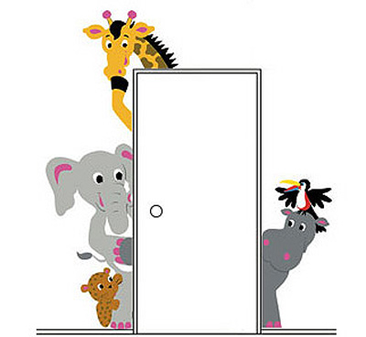

Same Degrees
Lions, tigers and bears.
Red, orange, green and pink.
Like
colors
animals

Slide 25
If the degrees are different, you don’t put a comma.
The green giraffe, the
pink elephant, the yellow zebra
all want to sit on the blue whale.

Slide 26
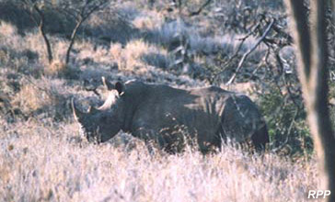
Who can tell me, which one is better and why?
It was a white endangered rhino.
It was an endangered, white rhino.
It was an endangered white rhino.
It was a white, endangered rhino.

Slide 27
Who can tell me, which one is better and why?
It was a white endangered rhino.
It was an endangered, white rhino.
It was an endangered white rhino.
It was a white, endangered rhino.

Slide 28
Who can tell me, which one is better and why?
I like chocolate, covered ants.
I like covered, chocolate ants.
I like chocolate covered, ants.
I like chocolate covered ants.

Slide 29
Who can tell me, which one is better and why?
I like chocolate, covered ants.
I like covered, chocolate ants.
I like chocolate covered, ants.
I like chocolate covered ants.

Slide 30
6. Commas for joining
Commas are used when two complete sentences are joined together, using such conjunctions as
for, and, nor, but, or, yet, so, therefore.
  The boys wanted to stay up until midnight,
  but they grew tired and fell asleep.
  I thought I had the biggest bag of Skittles,
  yet you proved me wrong.

Slide 31
7. To be a colon: To not be a colon:
That is the question.
For today’s purposes, colons are used when you are noting time.
Our school starts at 7 20 every morning.
We end our day at 1 50.

Slide 32
8. Use a semicolon between two independent clauses of a compound sentence when they are not joined by a coordinate conjunction.
Where would you place semicolons that are needed in the following sentences?
A. Carl is tall his brother is short.
Carl is tall ; his brother is short.
B. The siren blew loudly I rushed to the window the police raced past as I looked out.
The siren blew loudly ; I rushed to the window ; the police raced past as I looked out.

Slide 33
7. Our school starts at 7 20 every morning. We end our day at 1 50.
8. Use a semicolon between two … A. Carl is tall his brother is short. b. The siren blew loudly I rushed to the window the police raced pass as I looked out.
The following sentences are missing punctuation; where do you place what? 1. Andrew Mark and Eric all play on the varsity basketball team. 2. Monica was very disappointed in her performance she was, nevertheless, a gracious loser. 3. Although I have never been to Mexico I have always wanted to travel there. 4. Jason who is the youngest in the family was born August 12 1988. 5. Alison didn't feel well however, she came to school anyway. 6. It was a hot windy day but I still spent the afternoon working in the garden. 7. When she asked if he was hungry Joe replied "I'm starved."
Now let’s apply the rules
of punctuation in the
following 7 sentences.
Your name again: _______________ Your score: ______

Slide 34
A panda walks into a café. He orders a sandwich, eats it, then draws a gun and fires two shots in the air.
“Why?” asks the confused waiter, as the panda makes towards the exit. The panda produces a badly punctuated wildlife manual and tosses it over his shoulder.
“I’m a panda,” he says, at the door. “Look it up.”
The waiter turns to the relevant entry and, sure enough, finds an explanation.
“Panda. Large black-and-white bear-like mammal, native to China. Eats, shoots and leaves.”
So, punctuation really does matter, even if it is only occasionally a matter of life and death.

Slide 35
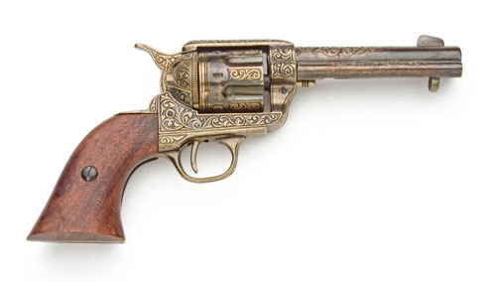
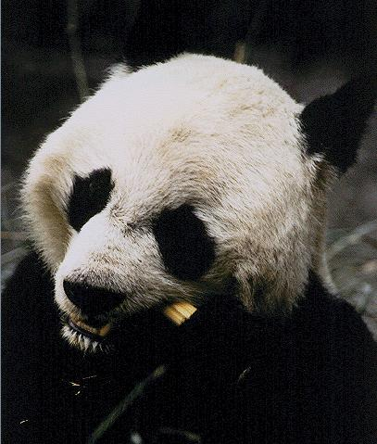
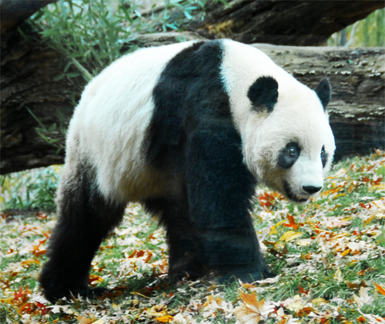
Eats, Shoots and Leaves

Slide 36
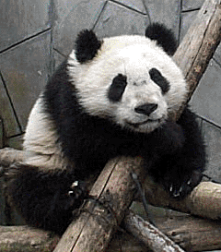

Slide 37
Let’s get good at punctuation…
Using your notes, ace the handout.

Slide 38
Your name again: ___________________ Period: __
1. Andrew Mark and Eric all play on the varsity basketball team.
2. Monica was very disappointed in her performance she was, nevertheless, a gracious loser.
3. Although I have never been to Mexico I have always wanted to travel there.
4. Jason who is the youngest in the family was born August 12 1988.
5. Alison didn't feel well however, she came to school anyway.
6. It was a hot windy day but I still spent the afternoon working in the garden.
7. When she asked if he was hungry Joe replied "I'm starved."

Slide 39
1. Andrew, Mark and Eric all play on the varsity basketball team.
2. Monica was very disappointed in her performance; she was, never the less, a gracious loser.
3. Although I have never been to Mexico, I have always wanted to travel there.

Slide 40
4. Jason, who is the youngest in the family, was born August 12, 1988.
5. Alison didn't feel well; however, she came to school anyway.
6. It was a hot windy day, but I still spent the afternoon working in the garden.
7. When she asked if he was hungry, Joe replied, "I'm starved."

Slide 41
Now for a group challenge…
Cluster in pairs…and complete the handout on the reverse side, using all the punctuation rules you’ve covered today. ☺
1. Andrew, Mark and Eric all play on the varsity basketball team.
2. Monica was very disappointed in her performance; she was, nevertheless, a gracious loser.
3. Although I have never been to Mexico, I have always wanted to travel there.
4. Jason, who is the youngest in the family, was born August 12, 1988.
5. Alison didn't feel well; however, she came to school anyway.
6. It was a hot windy day, but I still spent the afternoon working in the garden.
7. When she asked if he was hungry, Joe replied, "I'm starved."

Slide 42
A panda walks into a café. He orders a sandwich, eats it, then draws a gun and fires two shots in the air.
“Why?” asks the confused waiter, as the panda makes towards the exit. The panda produces a badly punctuated wildlife manual and tosses it over his shoulder.
“I’m a panda,” he says, at the door. “Look it up.”
The waiter turns to the relevant entry and, sure enough, finds an explanation.
“Panda. Large black-and-white bear-like mammal, native to China. Eats, shoots and leaves.”
So, punctuation really does matter, even if it is only occasionally a matter of life and death.

Slide 43
Portfolio Cover Sheet
Record your first GIIG score, then put your GIIG immediately after the score sheet.
Front Pocket - GIIGs
1. Writing
  Non-edits
  Writing Process
  Reflections
2. Reading Assignments
  Things Fall Apart
  Farenheit 451
  Poetry, etc.
3. Special Features
  Surveys
  Projects
4. Assessment Results
5. Helpful English Handouts
6. Miscellaneous
BWB Reading Strategies Cornell Notes
Costa Questions
Vocab Handouts

Slide 44


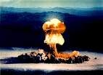
GIIG: DOL
Wed 9/12 and Tue 9/13
GIIG – subject
Nonfiction Assignment
characterization
15 minutes read time
A teacher named Ms. Swank eats taffy soup on Tuesday. 1 POINT
(1/2 POINT FOR THE ANSWER, ½ POINT FOR THE SENTENCE)
2. The man from EJSHS barks at his kids, so watch out. 1 POINT
3. The mad scientist blew up the kid’s assignments.
1 POINT
Write each
sentence and underline the complete subject.
(The ‘who’ part)
2 POINTS

Slide 45
GIIG: DOL
R 3.4 Determine characters’ traits by what the characters
Say about themselves in narration, dialogue, dramatic monologue
And soliloquy
A teacher named Ms. Swank eats taffy soup on Tuesday.
2. The man from EJSHS barks at his kids, so watch out.
3. The mad scientist blew up room 302.

Slide 46

"Action is character"

Slide 47
Nonfiction Assignment Topics: p 54
the colonization methods and policies of Great Britain; a study of one of
the tribes in Nigeria, or in another part of Africa; the development of apartheid in South Africa; a comparison
and contrast of Christianity and one of the African tribal religions; Nigeria’s fight for independence from
Great Britain; the conditions in present-day Nigeria.

Slide 48
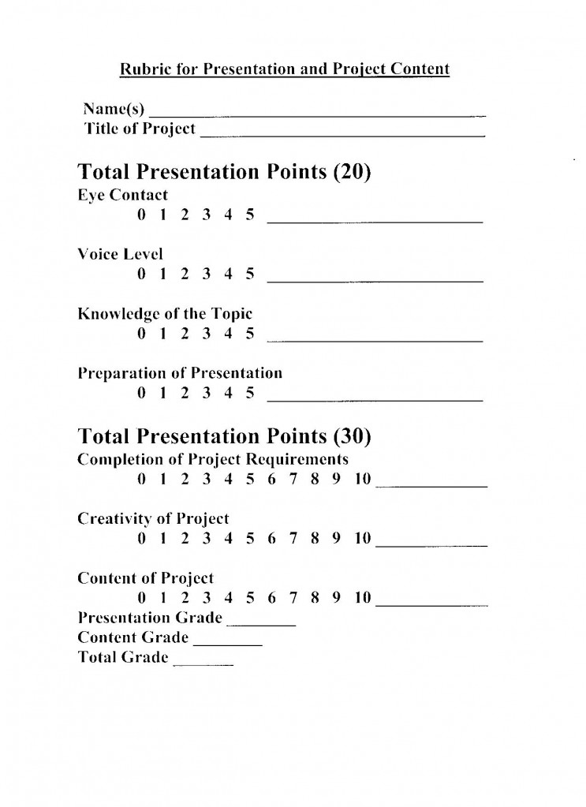

Slide 49
http://www.readwritethink.org/classroom-resources/lesson-plans/action-character-exploring-character-175.html?tab=3#tabs
ACTIONS ( 2 PHYSICAL, 2 CHARACTER’S SPEECH AND THOUGHTS, 2 OTHER CHARACTER’S SPEECH/THOUGHTS) | CHARACTER TRAIT THEY REVEAL
1. 2. 3. 4. 5. 6. | 1. 2. 3. 4. 5. 6.

Slide 50
ADJECTIVES http://grammar.ccc.commnet.edu/grammar/adjectives.htm
Positive | Comparative | Superlative
rich | richer | richest
lovely | lovelier | loveliest
beautiful | more beautiful | most beautiful

Slide 51
GIIG
~ F.L.
Fri 9/14 and Mon 9/17
GIIG - Conjunctions
15 minutes read time
Become a Character scenes
TFA quiz and vocab quiz
Create compound sentences by using evidence around the room. Underline each conjunction.
1 POINT
Conjunction clues:
for, and, nor, but, or,
yet, so, therefore
Example: You may copy! Shoot for 4 more original sentences. Each one must be a different conjunction.
1. Ms. Swank is watching the students; therefore, she must be awake.
2. The teacher was watching us, but she still didn’t notice the cell phone.
A = 6 total compound sentences 6 POINTS
B = 5 total compound sentences 5 POINTS
C = 4 total compound sentences 4 POINTS
fanboys + t

Slide 52
BECOME A CHARACTER
1. Choose a character from the book to "become."
2. Working notebook paper, list ten adjectives that describe yourself, the
character that you've become
3. Again, on notebook paper, list ten adjectives each for the remaining three
characters, describing them as the character that you've become would
describe them.
4. Look over your lists for accuracy: remember that you need strong
adjectives and that you need to choose your adjectives from the
perspective of the character you've chosen.
5. Make any revisions or additions to your lists.
6. Write each of your lists in a separate place on one side of your paper.
Don't write any names on the sheet. Other groups will be asked to guess
the characters described by each of your lists. And remember to write the
words l

Slide 53
GIIG
~ F.L.
Tue 9/18 and Wed 9/19
GIIG - Adjectives
15 minutes read time
Chronology Chapter 5
Label the following adjectives as positive, comparative or superlative.
1 POINT
Example: You may copy! Shoot for 4 more original sentences. .
1. Ms. Swank is watching the students; therefore, she must be awake.
2. The teacher was watching us, but she still didn’t notice the cell phone.
A = 6 total compound sentences 6 POINTS
B = 5 total compound sentences 5 POINTS
C = 4 total compound sentences 4 POINTS

Slide 54
GIIG: DOL
Thur 9/20 and Fri 9/21
GIIG – Contextual Vocab
15 minutes read time
Nonfiction Presentations
Contextual Clues
Write what you think
the underlined words mean
The new year must begin with tasty, fresh yams and not the shriveled and fibrous crop of the
Nwoye would feign annoyance and grumble aloud about women and their troubles.
And when he did this he saw that his father was pleased, and no longer rebuked him.
They were the harbingers sent to survey the land.

Slide 55
GIIG: DOL
Thur 9/20 and Fri 9/21
GIIG – Contextual Vocab
Punctuation Review
KWL chart
Intro to TFA
15 minutes read time
Contextual Clues
Write what you think
the underlined words mean
Nwoye would feign annoyance and grumble aloud about women and their troubles. Pretending to be affected
And when he did this he saw that his father was pleased, and no longer rebuked him.
Express sharp disapproval or criticism
They were the harbingers sent to survey the land. A person who goes ahead of everyone else

Slide 57
My name: _______________________ Period: __
Things Fall Apart Africa vs modern day?
5 +
5 +
5 +
TFA Africa
Modern Day

