Slide 1

GIIG! Quick Write
Tues, 11/27 and Wed, 11/28
Chapters 1-3
Class Timeline
Individual Scrapbook
Finish classwork as homework
How do you define personal responsibility?
What is an example of personal responsibility?
In other words, are you responsible for your own actions? Should you be responsible for the actions of the others?

Slide 2
GIIG-
Contextual Vocab
belie
bellicose
bowdlerize
Misrepresent
Warlike manners
Removing offensive material

Slide 3
GIIG-
Contextual Vocab
auspicious
antebellum
Chicanery
Favorable
Period before a war, especially the Civil War
Deception

Slide 4
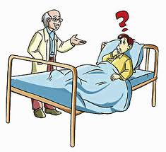
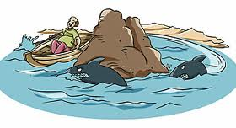
Thur. 11/29 and Fri. 11/30
GIIG
Vocab Quiz
Theme
Read chap 5-7
Theme Illustrations
Homework: Finish 5-7, quote tracking
GIIG-
Contextual Vocab
churlish
circumlocution
circumnavigate
He is a valiant as the lion, churlish as the bear
He had an earnest desire to tantalize a listener by circumlocution
No doubt the whale had thrice circumnavigated the globe

Slide 5
Thur. 11/29 and Fri. 11/30
GIIG
Vocab Quiz
Theme
Read chap 5-7
Theme Illustrations
Homework: Finish 5-7, quote tracking
GIIG-
Contextual Vocab
churlish
circumlocution
circumnavigate
He is a valiant as the lion, VULGAR as the bear
He had an earnest desire to tantalize a listener by INDIRECT LANGUAGE/UNNECESSARILY WORDY
No doubt the whale had thrice PROCEED AROUND the globe

Slide 6
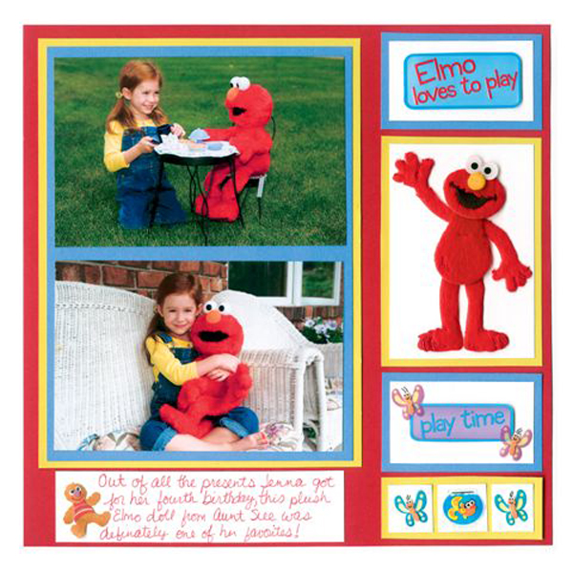
Chapter 1-3 Scrapbook Page
Due Monday, 12/3 (A day) or Tuesday, 12/ 4
* make it colorful with some type of borders (it should look like it took time)
* 1-3 photos/drawings of the events (1=C, 2=B, 3=A)
* 1-3 mementos from his journey that would be appropriate (1=C, 2=B, 3=A)
* a caption to explain the photos/drawings

