Slide 1
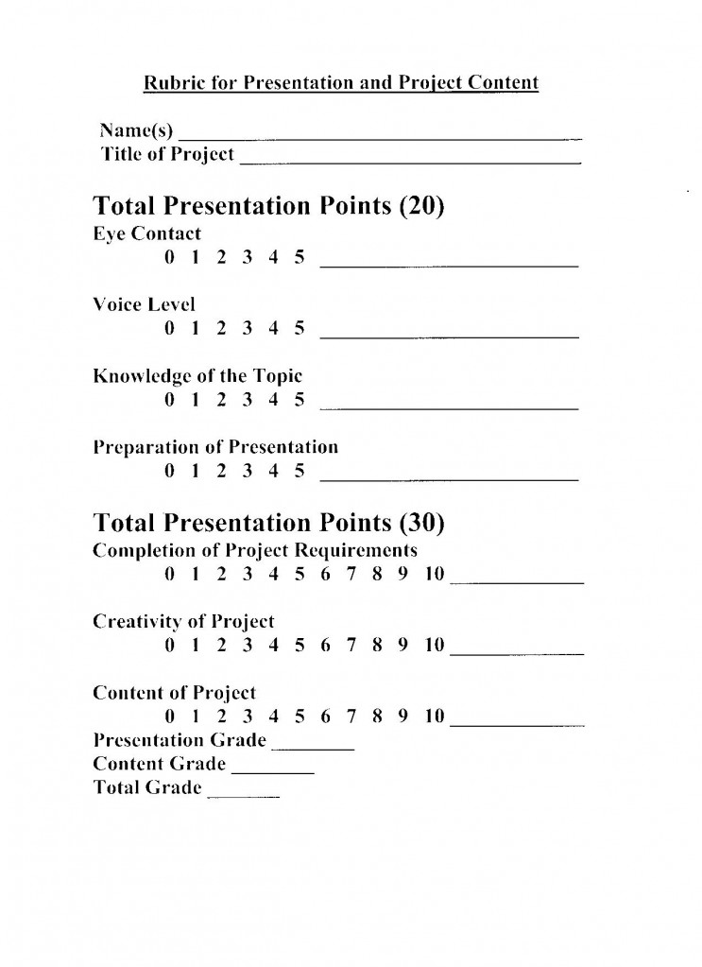

Slide 2
Portfolio Cover Sheet
Front Pocket - GIIGs
1. Writing
  Non-edits
  Writing Process
  Reflections
2. Reading Assignments
  Things Fall Apart
  Farenheit 451
  Poetry, etc.
3. Special Features
  Surveys
  Projects
4. Assessment Results
5. Helpful English Handouts
6. Miscellaneous

