Slide 1
 | Tue Sept 4 and Wed Sept 5 | Thur Sept 6 and Fri Sept 7
Class work: | Assign new vocab peer edit business letters By the Waters of Babylon discussion By the Waters of Babylon writing prompt | Collect new vocab collect business letters punctuation review By the Waters of Babylon Hot Seat
Homework: | new vocab finish final draft Honors – read Psalm 137; Why does Benet allude to Babylon from Psalm?

Slide 2
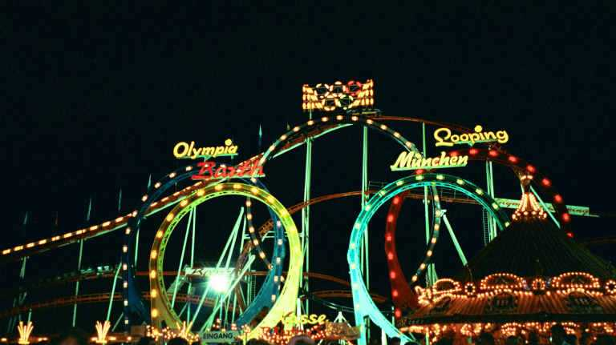
GIIG!
Focus Lesson
Tues Sept 4 and Wed Sept 5, 2012
peer edit business letters
By the Waters of Babylon discussion
By the Waters of Babylon writing prompt
Homework: new vocab.
  Finish Final Draft of Business Letter
  Honors: Read Psalm 137 and respond
List the five structural elements of plot.
2. Give example of each element.
3. Draw a simple rollercoaster and place numbers next to the track that represent each element.
A = Do all 3 tasks
B = Do first 2 tasks
C = Do first task only

Slide 3
http://www.dept.aoe.vt.edu/~cdhall/courses/aoe4065/BusinessLetterAssessmentRubric.pdf

Slide 4
English Vocab # 3
Learn how to spell, define and
embed into a creative paragraph (passage).
 | The techniques that writers use to develop characters through physical description, character’s speech/thoughts, other characters’ speech/thoughts, and narrator’s comments
 | A writer’s use of hints or clues to indicate events that will occur later.
 | An indirect reference to a historical or literary persona, place or thing.
 | Able to be believed; convincing.
 | A struggle between opposing forces and is the basis of plot in literature
Word Bank: conflict, allusion, credible, foreshadowing, characterization,

Slide 5
BWB Writing Prompt:
Answer the following prompt in two paragraph (with approximately 9 sentences each; remember this means you should have 1TS, 1CD, 2 CMs, 1CD, 2CMS and 1 CD)
How has your life prepared you for a situation you’re currently facing?
What moment proved you were (or were not) on the right track?

Slide 6
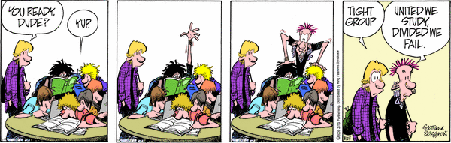
Welcome to Socratic Seminar

Slide 7
By the Waters of Babylon
Socratic Seminar #1
Get into assigned groups.
‘Shadow’ person chosen by Ms. Swank.
Hold discussion about text using any/all Costa Questions.
Note how many you used from your generated list.
Shadow monitors & documents seminar results. Shadow turns in all paperwork to teacher.

Slide 8
Socratic Seminar
1. Did every student come prepared? | Yes No
2. Did every student participate in discussion? | Yes No
3. Did any student ask any additional questions beyond their original list of questions? | Yes No
4. Did the group use any bonus questions? | Yes No
5. Was the group respectful? | Yes No
6. Did the group stay on the topic? | Yes No
7. Was there a lull in the discussion? | Yes No
8. Did the group hold discussion up to the stop time? | Yes No
9. On a scale of 1 – 10 (ten is high), how would you rate the discussion based on the entertainment value of watching it?

Slide 9
Socratic Seminar
1. Did every student come prepared? | Yes No
2. Did every student participate in discussion? | Yes No
3. Did any student ask any additional questions beyond their original list of questions? | Yes No
4. Did the group use any bonus questions? | Yes No
5. Was the group respectful? | Yes No
6. Did the group stay on the topic? | Yes No
7. Was there a lull in the discussion? | Yes No
8. Did the group hold discussion up to the stop time? | Yes No
9. On a scale of 1 – 10 (ten is high), how would you rate the discussion based on the entertainment value of watching it?

Slide 10
Helpers
Roger
Mary Luella Washington
Mr. Jacket
Mr Jacket’s Mom
Frankie T
Y’all should get very familiar with these characters by Monday! Don’t forget! Get in character, including dialects and clothes?

Slide 11
Novel Read Time!

Slide 12
Portfolios !

Slide 13

It's
Portfolio
Time !

Slide 14
Time to
organize & decorate!

Slide 15
Portfolio Cover Sheet
Record your first GIIG score, then put your GIIG immediately after the score sheet.
Put your creative writing story here!
‘Who Are You? Where Are You?’
1. GIIGs
2. Writing
  Non-edits
  Writing Process
  Reflections
3. Reading Assignments
  “My Brother Sam is Dead”
  “The Diary of Anne Frank”
  Poetry, etc.
4. Special Features
  Surveys
  Projects
5. Assessment Results
6. Miscellaneous
Language Arts Survey goes here!
Costa Clock Activity goes here.

Slide 16
3rd Period Actors
Roger - Andrew
Mary Luella Washington -
Mr. Jacket – Jesus
Mr Jacket’s Mom – Manda
Frankie T – Woody O

Slide 17
2nd Period Actors
Roger - Daniel
Mary Luella Washington – Victoria
Mr. Jacket – Torin
Mr Jacket’s Mom - Jenna
Frankie T – Robert

Slide 18
Today you all start with 0 points and are shooting for 50.
40
20
50
50
10
0
30

Slide 19
Today you all start with 0 points and are shooting for 50.
0
= starting class
10
= being respectful
20
= silently read (clarify)
30
= respectfully watch show
40
= ask question of panel
50
Volunteering or catching a mistake

Slide 20

GIIG
Focus Lesson
Thur Sept 6, 2012 and Fri Sept 7, 2012
GIIG – Literary Devices
collect business letters
punctuation review
By the Waters of Babylon Hot Seat
Write each sentence and note which literary device is being acknowledged.
Hyperbole
Personification
Simile
Metaphor
Ms. Swank is the energizer bunny all day long.
She is like the energizer bunny.
Her necklace shimmied when it moved.
Her stamina is a high powered rocket shooting to the moon.

Slide 21
john

Slide 22
Forest
person

Slide 23
John’s dad

Slide 24
The gods

Slide 25
Eats, Shoots and Leaves
Your name: ____________________ Period: __
1A is telling me…
1B is telling me …
2A illustration | 2B illustration
3 is telling me
4 is telling me
5. A comma is correct if …
6. Commas are used when …

Slide 26
7. Our school starts at 7 20 every morning. We end our day at 1 50.
8. Use a semicolon between two … A. Carl is tall his brother is short. b. The siren blew loudly I rushed to the window the police raced past as I looked out.
The following sentences are missing punctuation; where do you place what? 1. Andrew Mark and Eric all play on the varsity basketball team. 2. Monica was very disappointed in her performance she was, nevertheless, a gracious loser. 3. Although I have never been to Mexico I have always wanted to travel there. 4. Jason who is the youngest in the family was born August 12 1988. 5. Alison didn't feel well however, she came to school anyway. 6. It was a hot windy day but I still spent the afternoon working in the garden. 7. When she asked if he was hungry Joe replied "I'm starved."
Your name again: _______________ Your score: ______

Slide 27
Eats, Shoots and Leaves
The Power of Punctuation
!

Slide 28
1. Let’s look at the consequences of misplaced punctuation!
Are there consequences?
A. A woman, without her man, is nothing.
B. A woman: without her, man is nothing.
  What is the difference between the two?

Slide 29
2. Let’s try another example showing the power of punctuation.
    A. Charles the First walked and talked half an hour after his head was cut off.
  B. Charles the First walked and talked. Half an hour after, his head was cut off.

Slide 30

And for those of you that are in love…
…or in like
…or not…

Slide 31
Dear Jack,
I want a man who knows what love is all about. You are generous, kind, thoughtful. People who are not like you admit to being useless and inferior. You have ruined me for other men. I yearn for you. I have no feelings whatsoever when we’re apart. I can be forever happy – will you let me be yours? Jill

Slide 32
Dear Jack,
I want a man who knows what love is. All about you are generous, kind, thoughtful people, who are not like you. Admit to being useless and inferior. You have ruined me. For other men I yearn! For you I have no feelings whatsoever. When we’re apart I can be forever happy. Will you let me be?
Yours,
Jill

Slide 33
3. Dear Jack,
I want a man who knows what love is all about. You are generous, kind, thoughtful. People who are not like you admit to being useless and inferior. You have ruined me for other men. I yearn for you. I have no feelings whatsoever when we’re apart. I can be forever happy – will you let me be yours?
Jill
4. Dear Jack,
I want a man who knows what love is. All about you are generous, kind, thoughtful people, who are not like you. Admit to being useless and inferior. You have ruined me. For other men I yearn! For you I have no feelings whatsoever. When we’re apart I can be forever happy. Will you let me be?
Yours,
Jill

Slide 34
Wow!
Punctuation is important!
When do I use commas, colons, and semicolons?

Slide 35
5. A comma is correct if it can be replaced by the word and or or, and it is listing things in the same degree.
“I had a marvelous time watching students stick their tongues out and cross their eyes and balance on one foot and play dead.”
“I had a marvelous time watching students stick their tongues out, cross their eyes, balance on one foot and play dead.”

Slide 36
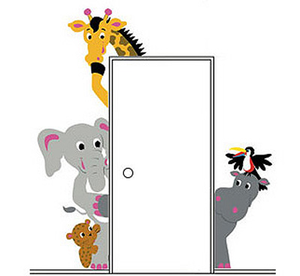

Same Degrees
Lions, tigers and bears.
Red, orange, green and pink.
Like
colors
animals

Slide 37
If the degrees are different, you don’t put a comma.
The green giraffe, the
pink elephant, the yellow zebra
all want to sit on the blue whale.

Slide 38
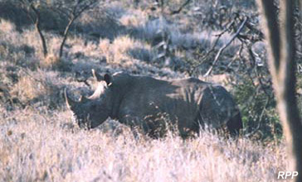
Who can tell me, which one is better and why?
It was a white endangered rhino.
It was an endangered, white rhino.
It was an endangered white rhino.
It was a white, endangered rhino.

Slide 39
Who can tell me, which one is better and why?
It was a white endangered rhino.
It was an endangered, white rhino.
It was an endangered white rhino.
It was a white, endangered rhino.

Slide 40
Who can tell me, which one is better and why?
I like chocolate, covered ants.
I like covered, chocolate ants.
I like chocolate covered, ants.
I like chocolate covered ants.

Slide 41
Who can tell me, which one is better and why?
I like chocolate, covered ants.
I like covered, chocolate ants.
I like chocolate covered, ants.
I like chocolate covered ants.

Slide 42
6. Commas for joining
Commas are used when two complete sentences are joined together, using such conjunctions as
for, and, nor, but, or, yet, so, therefore.
  The boys wanted to stay up until midnight,
  but they grew tired and fell asleep.
  I thought I had the biggest bag of Skittles,
  yet you proved me wrong.

Slide 43
7. To be a colon: To not be a colon:
That is the question.
For today’s purposes, colons are used when you are noting time.
Our school starts at 7 20 every morning.
We end our day at 1 50.

Slide 44
8. Use a semicolon between two independent clauses of a compound sentence when they are not joined by a coordinate conjunction.
Where would you place semicolons that are needed in the following sentences?
A. Carl is tall his brother is short.
Carl is tall ; his brother is short.
B. The siren blew loudly I rushed to the window the police raced past as I looked out.
The siren blew loudly ; I rushed to the window ; the police raced past as I looked out.

Slide 45
7. Our school starts at 7 20 every morning. We end our day at 1 50.
8. Use a semicolon between two … A. Carl is tall his brother is short. b. The siren blew loudly I rushed to the window the police raced pass as I looked out.
The following sentences are missing punctuation; where do you place what? 1. Andrew Mark and Eric all play on the varsity basketball team. 2. Monica was very disappointed in her performance she was, nevertheless, a gracious loser. 3. Although I have never been to Mexico I have always wanted to travel there. 4. Jason who is the youngest in the family was born August 12 1988. 5. Alison didn't feel well however, she came to school anyway. 6. It was a hot windy day but I still spent the afternoon working in the garden. 7. When she asked if he was hungry Joe replied "I'm starved."
Now let’s apply the rules
of punctuation in the
following 7 sentences.
Your name again: _______________ Your score: ______

Slide 46
A panda walks into a café. He orders a sandwich, eats it, then draws a gun and fires two shots in the air.
“Why?” asks the confused waiter, as the panda makes towards the exit. The panda produces a badly punctuated wildlife manual and tosses it over his shoulder.
“I’m a panda,” he says, at the door. “Look it up.”
The waiter turns to the relevant entry and, sure enough, finds an explanation.
“Panda. Large black-and-white bear-like mammal, native to China. Eats, shoots and leaves.”
So, punctuation really does matter, even if it is only occasionally a matter of life and death.

Slide 47
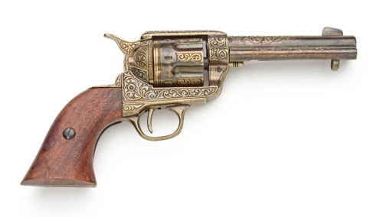
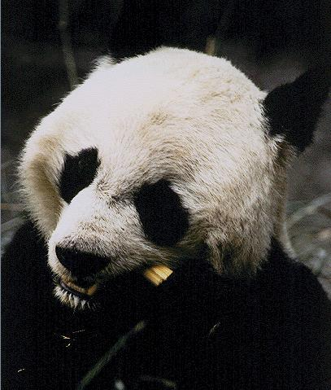
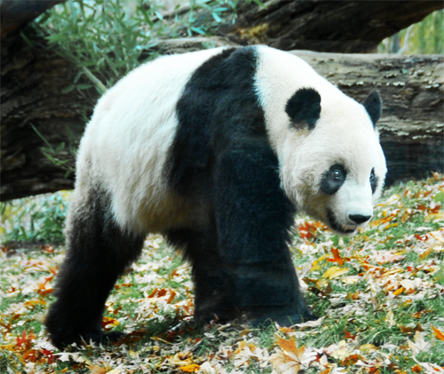
Eats, Shoots and Leaves

Slide 48
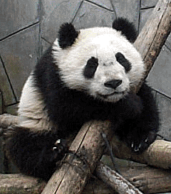

Slide 49
Let’s get good at punctuation…
Using your notes, ace the handout.

Slide 50
Your name again: ___________________ Period: __
1. Andrew Mark and Eric all play on the varsity basketball team.
2. Monica was very disappointed in her performance she was, nevertheless, a gracious loser.
3. Although I have never been to Mexico I have always wanted to travel there.
4. Jason who is the youngest in the family was born August 12 1988.
5. Alison didn't feel well however, she came to school anyway.
6. It was a hot windy day but I still spent the afternoon working in the garden.
7. When she asked if he was hungry Joe replied "I'm starved."

Slide 51
1. Andrew, Mark and Eric all play on the varsity basketball team.
2. Monica was very disappointed in her performance; she was, never the less, a gracious loser.
3. Although I have never been to Mexico, I have always wanted to travel there.

Slide 52
4. Jason, who is the youngest in the family, was born August 12, 1988.
5. Alison didn't feel well; however, she came to school anyway.
6. It was a hot windy day, but I still spent the afternoon working in the garden.
7. When she asked if he was hungry, Joe replied, "I'm starved."

Slide 53
Now for a group challenge…
Cluster in pairs…and complete the handout on the reverse side, using all the punctuation rules you’ve covered today. ☺
1. Andrew, Mark and Eric all play on the varsity basketball team.
2. Monica was very disappointed in her performance; she was, nevertheless, a gracious loser.
3. Although I have never been to Mexico, I have always wanted to travel there.
4. Jason, who is the youngest in the family, was born August 12, 1988.
5. Alison didn't feel well; however, she came to school anyway.
6. It was a hot windy day, but I still spent the afternoon working in the garden.
7. When she asked if he was hungry, Joe replied, "I'm starved."

Slide 54
A panda walks into a café. He orders a sandwich, eats it, then draws a gun and fires two shots in the air.
“Why?” asks the confused waiter, as the panda makes towards the exit. The panda produces a badly punctuated wildlife manual and tosses it over his shoulder.
“I’m a panda,” he says, at the door. “Look it up.”
The waiter turns to the relevant entry and, sure enough, finds an explanation.
“Panda. Large black-and-white bear-like mammal, native to China. Eats, shoots and leaves.”
So, punctuation really does matter, even if it is only occasionally a matter of life and death.

